Slide 1
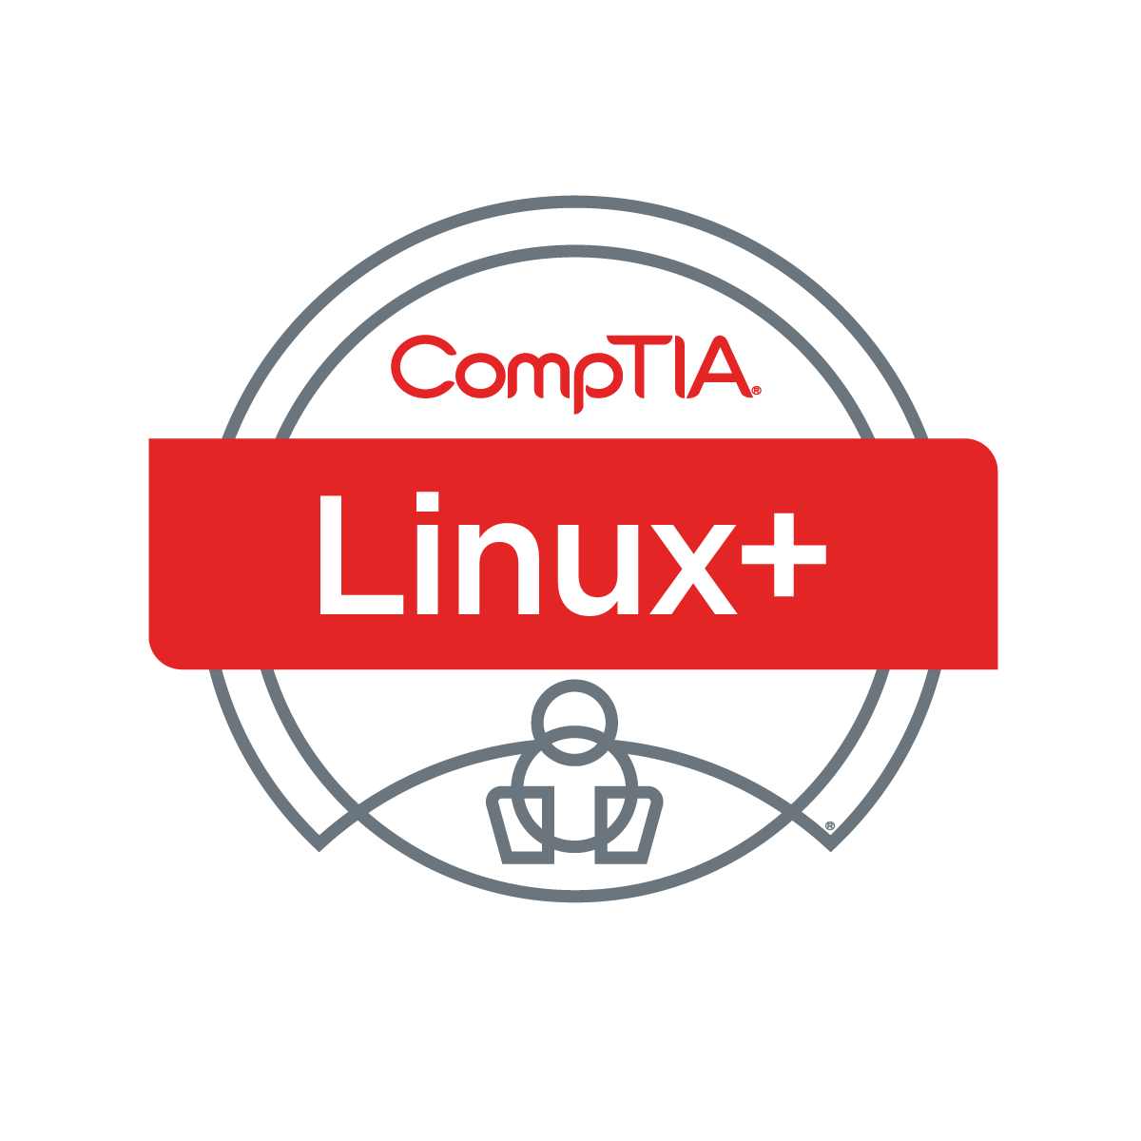
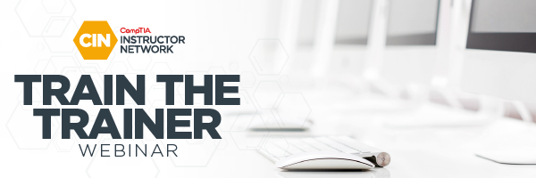
Linux+ XK0-005 TTT Session 1:
Introduction, Linux+ Information, Resources, Domain 1.1
July 11, 2022
@TeachCompTIA #LinuxPlusTTT
<number>
Notes:
<number>

Slide 2
Certificate of Attendance
Multimedia
Slides
Bios
ON24 Help
Q&A
Today’s Resources
Group Chat
Survey
<number>

Slide 3
Qualifications for Exam Voucher Distribution
Participate in all 12 sessions (live or on-demand) during the date range for the live series (January 18th – March 17th).
Be an active member of CIN through engagement in the community.
Be involved with a CompTIA training partner or an independent instructor teaching CompTIA certifications.
For questions or clarifications talk with your CompTIA Business Development Manager.

Slide 4
Instructor:
Lee McWhorter Chief Technology Officer
Covered 6 LLC | DGP International
lee@covered6.com
Host:
Stephen Schneiter
Instructor Network Program Manager
CompTIA
sschneiter@comptia.org

Slide 5
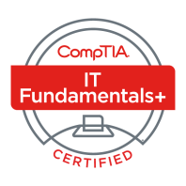
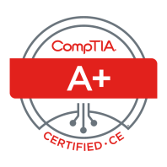
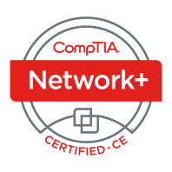
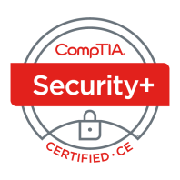
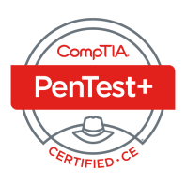
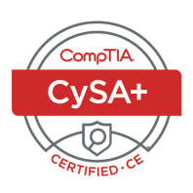
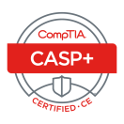
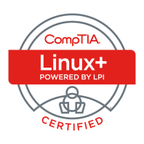
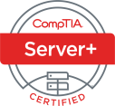
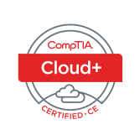
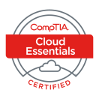
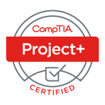
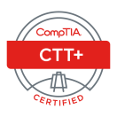
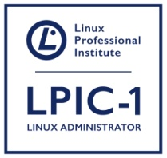
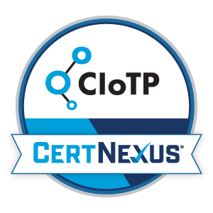
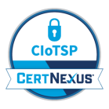
Lee McWhorter
CTO at Covered 6
CompTIA CIN Board member
lee@covered6.com
https://www.linkedin.com/in/lee-mcwhorter/
Twiiter: @tleemcjr
Previous TTT’s:
PenTest+ 001 2018
CASP+ 004 2021
PenTest+ 002 2022

Slide 6
Agenda
Session Objectives
Introduction
Linux+ Information
Linux+ Resources
Domain 1.1

Slide 7
A+ Core 1 220-1101 TTT Session Outline
Date | Topic
7/11/2022 | Introduction, Linux+ Information, Resources, Domain 1.1
7/12/2022 | Domains 1.2 (Files) and 1.3 (Storage)
7/18/2022 | Domains 1.4 (Services) and 1.5 (Networking)
7/19/2022 | Domains 1.6 (Build) and 1.7 (Configuration)
7/25/2022 | Domains 2.1 (Best Practices) and 2.2 (Identity Management)
7/26/2022 | Domains 2.3 (Firewalls), 2.4 (Remote), and 2.5 (Access Controls)
8/01/2022 | Domains 3.1 (Scripts) and 3.2 (Containers)
8/22/2022 | Domains 3.3 (Git), 3.4 (IaC), and 3.5 (Orchestration)
8/23/2022 | Domains 4.1 (Storage), 4.2 (Network), and 4.3 (Processing)
8/30/2022 | Domains 4.4 (Permissions), 4.5 (Common Problems) & Wrap Up
✓
<number>

Slide 8
The CompTIA Instructor Network (CIN) is a worldwide community for instructors who provide CompTIA certification training.
Communicate and collaborate with CompTIA staff and other instructors.
Access resources for students to understand the value of getting certified.
Receive complimentary training and tools from CompTIA to enrich your classroom.
Become proficient at teaching CompTIA standards.
Share best practices and resources with each other.
https://cin.comptia.org

Slide 9
Your Turn!
Tell us about yourself.

Slide 10
Poll 1
What type of training organization best describes your employer?
Academic Education Provider
Commercial Training Provider
Government
Corporate
Publisher
<number>

Slide 11
Poll 2
Do you have the CompTIA Linux+ certification?
Yes, I am certified with the current Linux+ certification
No, I have an older Linux+ certification
No, I have a Linux certification through another certification provider
I am not currently certified with any Linux certification

Slide 12
Poll 3
Do you currently offer a Linux+ course?
Yes, have been offering it for over 2 years
Yes, just started to offer it within the past 1-2 years
No, but planning to offer the new exam
No plans to offer right now
Notes:
<number>

Slide 13
POLL
When are you looking at implementing Linux+ XK0-005 training?
Have already implemented
Within 3 months of launch
Within 6 months of launch
After XK0-004 retirement
Undecided
<number>

Slide 14
Section break
Linux+ Information
<number>

Slide 15
What is CompTIA Linux+?
CompTIA Linux+ validates the skills administrators need to secure the enterprise, power the cloud and keep systems running. The new certification ensures that IT professionals, software developers, cybersecurity engineers and penetration testers have these necessary skills to support today’s tech systems.
The exam covers tasks associated with all major distributions of Linux, setting the foundation for advanced vendor/distro-specific knowledge.
CompTIA Linux+ validates mastery of the tools and technologies required to manage, secure, optimize, and troubleshoot, enterprise-level Linux systems.
The major areas of emphasis include:
Configuration and management of Linux systems
Operation of on-prem and cloud-based distributions
Scripting
Containerization and automation

Slide 16
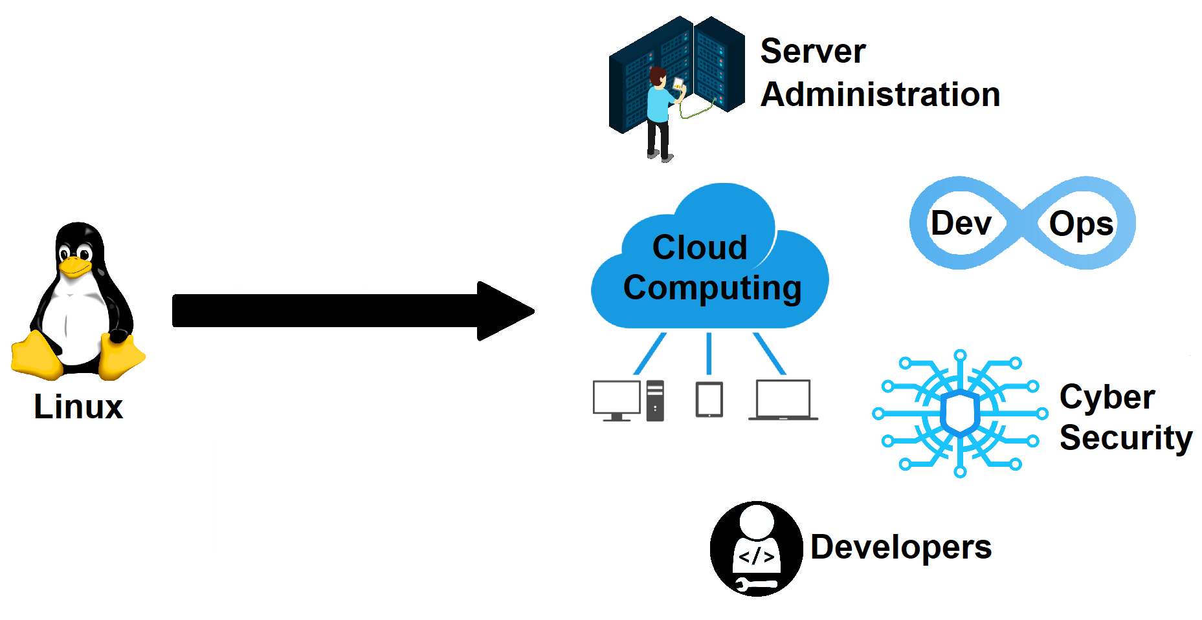
Linux is a core IT skill

Slide 17
Domain level highlights
System Management
The fundamentals of Linux exist at the command line. Certified CompTIA Linux+ professionals understand the principal building blocks of the system and how to manage storage, services, and configurations.
Building and installing software, quickly and securely, is one of the main features of the Linux OS. Key functions like sandboxing and package management are covered.
Security
Linux is used by major enterprise and governmental organizations because of its inherent security. CompTIA Linux+ validates important concepts including identity management, access controls, and firewall configuration.
Because a security first mindset is essential to the modern workplace, the certification covers security enhanced Linux (SELinux), public key infrastructure (PKI), and secure shell (SSH).

Slide 18
Domain level highlights
Scripting, Containers, and Automation
Scripts are a powerful instrument in the automation toolkit. The primary Linux tasks that form the basis of automation are covered by CompTIA Linux+.
Containers have become integral to streamlining deployments and creating automated processes. They are covered in-depth to ensure CompTIA Linux+ professionals are on the cutting edge of new Linux technologies.
Orchestration and automation not only allow for the secure deployment of repeated processes and cloud operations, they help contribute to the bottom line. The certification program covers container networks, bootstrapping, persistent memory, and Kubernetes.
Troubleshooting
Because no systems are perfect, Linux+ validates a candidate’s ability to fix storage, networking, and memory problems.
Linux+ focuses on important aspects of Linux, like using systemd to identify common problems and get the system working again.

Slide 19
Changes to Exam Domains
XKO-005
XKO-004

Slide 20
Key Differences I Found
What, at first glance, appears to be a major change of the domains is actually more of a reorganization and consolidation of the domains from five to four.
While still the largest domain, System Management type content has actually seen a small decrease in weight given it combines most of the old domains one and two, which together combined to be over 40% of the previous exam.
The Security domain has seen a slight increase in weight, but overall is roughly the same.
Scripting and Automation have gone up a bit in weight, but this is mainly due to the inclusion of Containers – think Kubernetes, Ansible, etc. Also don’t forget Git is in here too.
Troubleshooting has seen a fairly large (8%) increase, but some of this can be accounted for by some related concepts coming from the Management section to here.

Slide 21
Section break
Linux+ Resources
<number>

Slide 22
Linux+ Resources
Kali Linux Revealed book and course
Chapter 3 of the book is a great primer for Linux basics
http://www.mctechs.com/CompTIA/PenTest+TTT/Resources/Kali-Linux-Revealed-1st-edition.pdf
The newer course is supposedly still free…
https://kali.training/
<number>

Slide 23
Linux+ Resources
Previous Linux+ TTT
I can’t say enough about how great of a job Jason did on this one!
https://gateway.on24.com/wcc/eh/1119137/category/16389/linux-ttt-series/
https://cin.comptia.org/resources/categories/linux-xk0-004-ttt-series.8/
<number>

Slide 24
Linux+ Resources
Virtualbox
https://www.virtualbox.org/wiki/Downloads
VMWare (Note: Not free on MacOS, need to buy VM Fusion)
https://www.vmware.com/products/workstation-player/workstation-player-evaluation.html
<number>

Slide 25
Linux+ Resources
OSBoxes
https://www.osboxes.org/centos/
https://www.osboxes.org/fedora/
https://www.osboxes.org/kali-linux/
https://www.osboxes.org/ubuntu/
<number>

Slide 26
Linux+ Resources
https://ubuntu.com/download
https://getfedora.org/en/workstation/download/
https://www.redhat.com/en/technologies/linux-platforms/enterprise-linux
https://www.turnkeylinux.org/

Slide 27
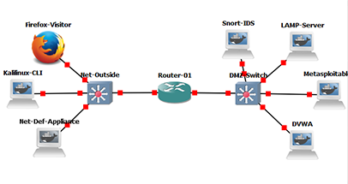
Linux+ Resources
https://gns3.com
<number>

Slide 28
Scripting Resources
https://www.techbrown.com/most-useful-bash-scripts-linux-system-administrator/
https://www.tomzone.fr/5-important-scripts-useful-for-a-linux-system-administrator/
https://github.com/errnair/sysadmin-shell-scripts
https://github.com/topics/linux-administration

Slide 29
Chat Question
What other Linux+ Resources can you recommend and share with the group?
Answer in the chat window and let’s share.
This photo is for placement only

Slide 30
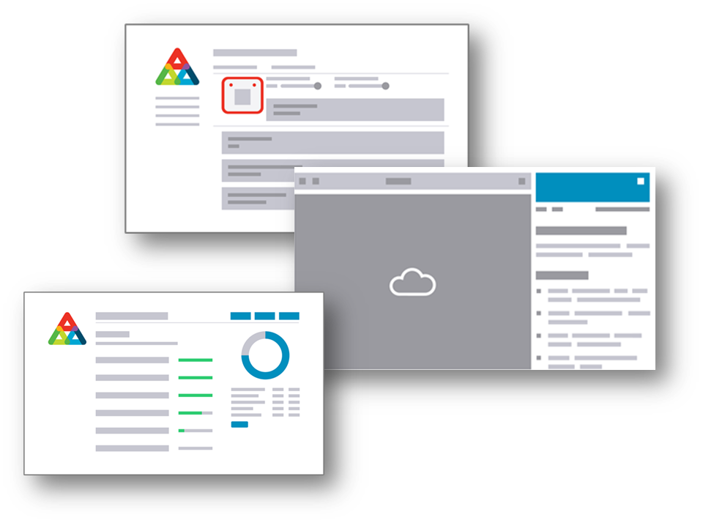
Available Resources for Instructor-led Training
Full Suite of Products Available at Launch for Instructor-led Training
Instructor and Student Guides
Print & eBook
CertMaster Learn
CertMaster Labs
CertMaster Practice
NEW Integration: CertMaster Learn + Labs
Exam Objectives
More resources available as 2022 launch approaches

Slide 31
Learning Products for Instructor-led Training
CertMaster Learn
CertMaster Labs
CertMaster Practice
Knowledge acquisition
Practical application
Confirm mastery

Slide 32
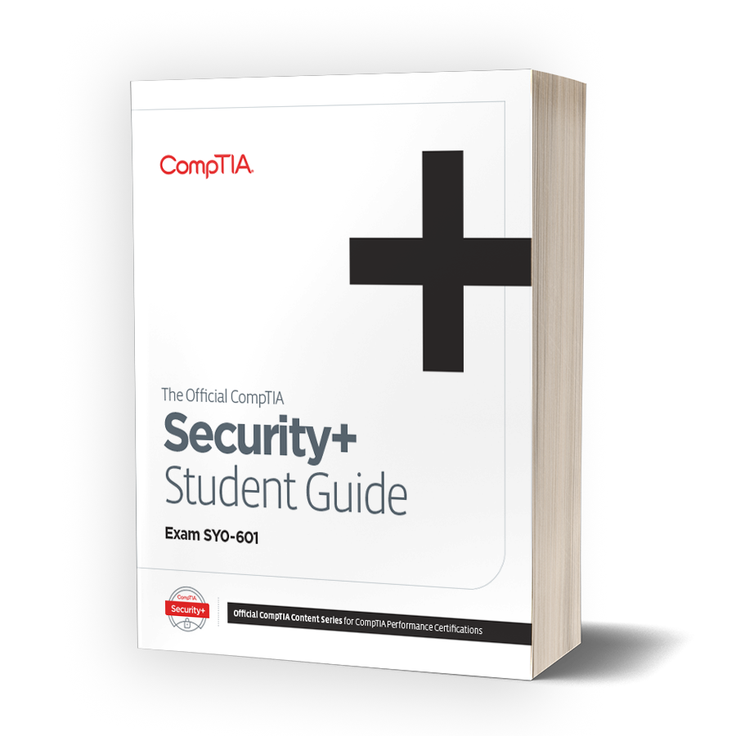
Core Learning Content
Student Guide
(available in digital or print format)
CertMaster Learn
OR
Suitable for any course format, including instructor-led environments and “guided” self-paced
Learning Plan provides easy to implement curriculum and keeps students on track
Embedded activities can be done in class or for homework, keeps students engaged
Reporting can help inform instruction, keep students accountable
Best suited for environments where instructor has an active role (lecture-based)
eBook is familiar teaching and learning tool; helpful as a reference
Activities check for knowledge
Platform easy to navigate and intuitive

Slide 33
Section break
Domain 1.1
<number>

Slide 34
Domain 1.1 - Summarize Linux fundamentals
Filesystem Hierarchy Standard (FHS)
- /boot – Static bootloader, kernel executable and configurtion files
- /proc – Virtual file system created at boot, useful process information
- /sys – Pseudo file system provided by the Linux kernel
- /var – Variable data, think logs, databases, and such
- /usr – Shareable, read-only files of all types
- /lib – Shared library files
<number>

Slide 35
Domain 1.1 - Summarize Linux fundamentals
Filesystem Hierarchy Standard (FHS) (cont)
- /dev – Device files for all hardware attached
- /etc – Local system configuration files
- /opt – Optional files such as vendor supplied applications
- /bin – User executable files
- /sbin – System binaries used for system administration
- /home – Contains each users home folder (except root)
<number>

Slide 36
Domain 1.1 - Summarize Linux fundamentals
Filesystem Hierarchy Standard (FHS) (cont)
- /media – Place to mount external removeable media devices like USB
- /mnt – Standard mount point for regular file systems
- /root – Root user’s home folder
- /tmp – Temporary directory
<number>

Slide 37
Domain 1.1 - Summarize Linux fundamentals
Basic boot process
- Basic input/output system (BIOS)
- Unified Extensible Firmware Interface (UEFI)
- Commands
• mkinitrd – initial image used by kernel to preload block devices to find /
• grub2-mkconfig - grub2-install - grub2-update
• dracut – functionality for automating the Linux boot process
<number>

Slide 38
Domain 1.1 - Summarize Linux fundamentals
Basic boot process (cont)
- initrd.img – basic file system loaded into RAM to boot main system
- vmlinuz – Name of the Linux Kernel executable, a compressed kernel
- Grand Unified Bootloader version 2 (GRUB2) – multiboot bootloader which replaced the original Grub.
<number>

Slide 39
Domain 1.1 - Summarize Linux fundamentals
Basic boot process (cont)
- Boot sources
• Preboot eXecution Environment (PXE)
• Booting from Universal Serial Bus (USB)
• Booting from ISO
<number>

Slide 40
Domain 1.1 - Summarize Linux fundamentals
• Kernel panic
• Device types in /dev
- Block devices
- Character devices
- Special character devices
• /dev/null - /dev/zero
• /dev/urandom
<number>

Slide 41
Domain 1.1 - Summarize Linux fundamentals
Basic package compilation from source
- ./configure
- make
- make install
Usually you would either download a ‘tarball’ of the source code or check it out with GIT first.
<number>

Slide 42
Domain 1.1 - Summarize Linux fundamentals
Storage concepts
- File storage – EXT3, EXT4, XFS, etc. Linux supports almost 100 types
- Block storage – another name for a Block device in the Linux Kernel
- Object storage – manages data and links it to associated metadata
- Partition type
• Master boot record (MBR)
• GUID [globally unique identifier] Partition Table (GPT)
<number>

Slide 43
Domain 1.1 - Summarize Linux fundamentals
Storage concepts (cont)
- Filesystem in Userspace (FUSE) – Lets non-privileged users their own file systems
- Redundant Array of Independent (or Inexpensive) Disks (RAID) levels
• Striping
• Mirroring
• Parity
<number>

Slide 44
Domain 1.1 - Summarize Linux fundamentals
Listing hardware information
- lspci – provides details on all PCI buses and devices
- lsusb – provides details on USB buses and connected devices
- dmidecode – provides system information as described in your system’s BIOS
<number>

Slide 45
Discussion time: Please type your questions in chat
Questions over content.
Share you experience.
What would you like to see different moving forward?
Let’s keep the conversation going in the CompTIA Instructor Forum: https://cin.comptia.org
<number>

