Slide 1


Linux+ XK0-005 TTT Session 3:
Domains 1.4 (Services) and 1.5 (Networking)
July 18, 2022
@TeachCompTIA #LinuxPlusTTT
<number>
Notes:
<number>

Slide 2

Certificate of Attendance
Multimedia
Slides
Bios
ON24 Help
Q&A
Today’s Resources
Group Chat
Survey
<number>

Slide 3

Qualifications for Exam Voucher Distribution
Participate in all 12 sessions (live or on-demand) during the date range for the live series (January 18th – March 17th).
Be an active member of CIN through engagement in the community.
Be involved with a CompTIA training partner or an independent instructor teaching CompTIA certifications.
For questions or clarifications talk with your CompTIA Business Development Manager.

Slide 4


Instructor:
Lee McWhorter
Chief Technology Officer
Covered 6 LLC | DGP International
lee@covered6.com
Host:
Stephen Schneiter
Instructor Network Program Manager
CompTIA
sschneiter@comptia.org

Slide 5

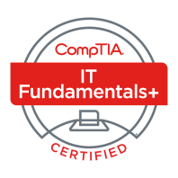
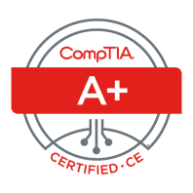
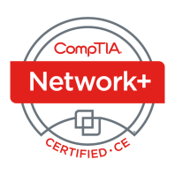


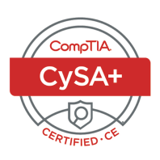

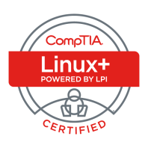
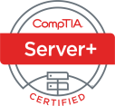
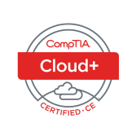
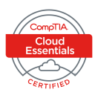
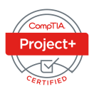
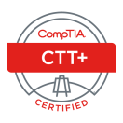




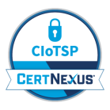
Lee McWhorter
CTO at Covered 6
CompTIA CIN Board member
lee@covered6.com
https://www.linkedin.com/in/lee-mcwhorter/
Twiiter: @tleemcjr
Previous TTT’s:
PenTest+ 001 2018
CASP+ 004 2021
PenTest+ 002 2022

Slide 6

Agenda
Session Objectives
Domain 1.4
Domain 1.5

Slide 7
A+ Core 1 220-1101 TTT Session Outline
Date | Topic
7/11/2022 | Introduction, Linux+ Information, Resources, Domain 1.1
7/12/2022 | Domains 1.2 (Files) and 1.3 (Storage)
7/18/2022 | Domains 1.4 (Services) and 1.5 (Networking)
7/19/2022 | Domains 1.6 (Build) and 1.7 (Configuration)
7/25/2022 | Domains 2.1 (Best Practices) and 2.2 (Identity Management)
7/26/2022 | Domains 2.3 (Firewalls), 2.4 (Remote), and 2.5 (Access Controls)
8/01/2022 | Domains 3.1 (Scripts) and 3.2 (Containers)
8/22/2022 | Domains 3.3 (Git), 3.4 (IaC), and 3.5 (Orchestration)
8/23/2022 | Domains 4.1 (Storage), 4.2 (Network), and 4.3 (Processing)
8/30/2022 | Domains 4.4 (Permissions), 4.5 (Common Problems) & Wrap Up
✓
✓
✓
<number>

Slide 8
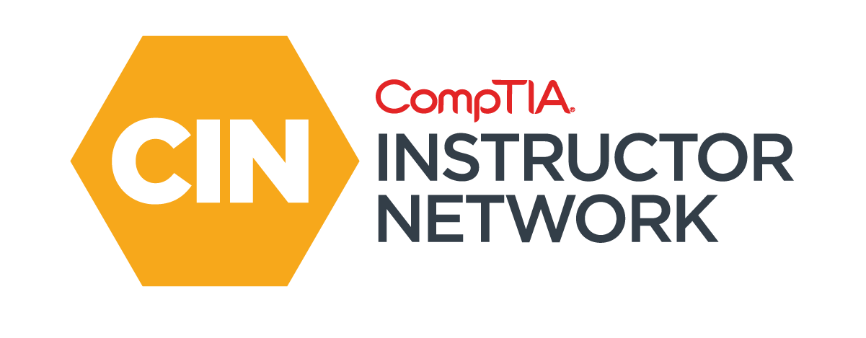
The CompTIA Instructor Network (CIN) is a worldwide community for instructors who provide CompTIA certification training.
Communicate and collaborate with CompTIA staff and other instructors.
Access resources for students to understand the value of getting certified.
Receive complimentary training and tools from CompTIA to enrich your classroom.
Become proficient at teaching CompTIA standards.
Share best practices and resources with each other.
https://cin.comptia.org

Slide 9
Section break
Domain 1.4
<number>

Slide 10
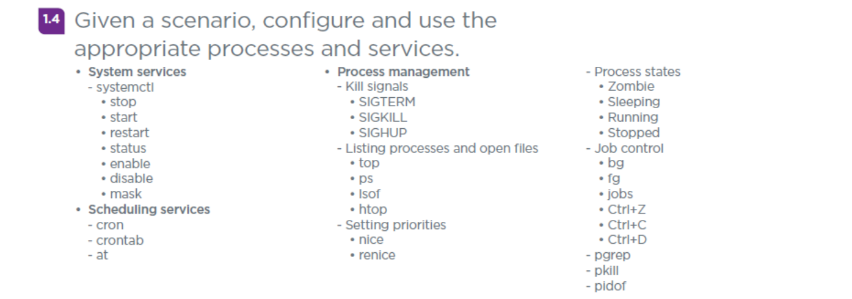
Domain 1.4 - Given a scenario, configure and use the
appropriate processes and services.
<number>

Slide 11
Domain 1.4 - Given a scenario, configure and use the
appropriate processes and services.
System services
- systemctl - utility which is used for examining and controlling the systemd system and service manager. Syntax = systemctl subcommand argument
• stop - systemctl stop {servicename}
• start - systemctl start {servicename}
• restart - systemctl restart {servicename}
• status - systemctl status {servicename} (Note: is-active / is-enabled)
• enable - systemctl enable {servicename} (Loads at start up)
• disable - systemctl disable {servicename} (Will NOT load at start up)
• mask - systemctl mask {servicename} (Prevents other calls)
(Note: Tab key twice after systemctl will show list of sub commands)
<number>

Slide 12
Domain 1.4 - Given a scenario, configure and use the
appropriate processes and services.
Scheduling services
- cron – Job scheduler like Task Scheduler on Windows
- crontab – Both the command (view or edit the table of commands to be run by cron) and file (file with cron jobs)
- at – Similar to cron, except its jobs only run once, use cron for recurring jobs.
<number>

Slide 13
Domain 1.4 - Given a scenario, configure and use the
appropriate processes and services.
Process management
- Kill signals
• SIGTERM – basically asked the program to terminate nicely
• SIGKILL – simply shuts the program down
• SIGHUP – commonly used to cause a process to restart and reread its configuration file(s).
<number>

Slide 14
Domain 1.4 - Given a scenario, configure and use the
appropriate processes and services.
Process management (cont)
Listing processes and open files
• top – task manager utility which displays CPU and memory information.
• ps – displays currently running programs for either the user or the entire system based on options.
• lsof - “list open files” shows open files and processes using them.
• htop – alternative to the top command.
<number>

Slide 15

Chat Question
What are some of the biggest reasons for using and the most common use cases for the process commands on the previous slide?
Answer in the chat window and let’s share.
This photo is for placement only

Slide 16
Domain 1.4 - Given a scenario, configure and use the
appropriate processes and services.
Process management (cont)
Setting priorities
• nice – utility that lets you run / start a program with more or less CPU / Priority than other programs.
• renice – utility used to change the priority of running programs.
<number>

Slide 17
Domain 1.4 - Given a scenario, configure and use the
appropriate processes and services.
Process management (cont)
Process states
• Zombie – process which has exited but not been cleaned up from process table by parent process.
• Sleeping – two types, interruptable and uninterruptable
• Running – active process (is also runnable which is process queued to run by not yet started)
• Stopped – better thought of as a suspended process, maybe due to being the background waiting on data.
<number>

Slide 18
Domain 1.4 - Given a scenario, configure and use the
appropriate processes and services.
Process management (cont)
Job control
• bg – background command, places foreground jobs in the background.
• fg – foreground command, places background jobs in the foreground.
• jobs – command used to list jobs running in the background and foreground.
• Ctrl+Z – keyboard shortcut effectively like bg.
• Ctrl+C – used to cancel or terminate a running program.
• Ctrl+D – shortcut to log out of an interface such as a BASH shell.
<number>

Slide 19
Domain 1.4 - Given a scenario, configure and use the
appropriate processes and services.
Process management (cont)
- pgrep – grep for processes showing IDs based on criteria.
- pkill – similar to the above, but for sending signals to running processes.
- pidof – find process IDs of named programs.
<number>

Slide 20
Section break
Domain 1.5
<number>

Slide 21
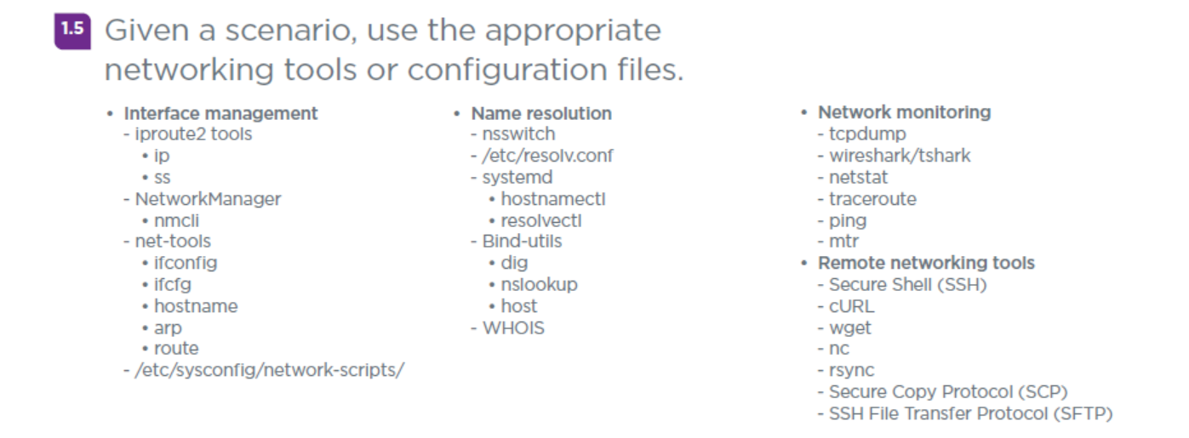
Domain 1.5 - Given a scenario, use the appropriate
networking tools or configuration files.
<number>

Slide 22
Domain 1.5 - Given a scenario, use the appropriate
networking tools or configuration files.
Interface management
- iproute2 tools
• ip – used to show or manipulate routing, devices, policy routing, and tunnels (replaced similar utilities from the net tools suite).
• ss – similar to netstat, dumps socket information.
- NetworkManager
• nmcli – command line tool to control NetworkManager and report network status.
<number>

Slide 23
Domain 1.5 - Given a scenario, use the appropriate
networking tools or configuration files.
Interface management (cont)
- net-tools
• ifconfig – replaced by ip addr
• ifcfg – files which control network devices
• hostname – can be used to determine and set hostname of system (Note: /etc/hostname file)
• arp – replaced by ip neigh
• route – replaced by ip route
- /etc/sysconfig/network-scripts/ - common one is:
/etc/sysconfig/network-scripts/ifcfg-eth0
<number>

Slide 24
Chat Question
Are you still using net tools utilities like ifconfig, have you switch to using the ip commands instead or are you using both?
Answer in the chat window and let’s share.
This photo is for placement only

Slide 25
Domain 1.5 - Given a scenario, use the appropriate
networking tools or configuration files.
Name resolution
- nsswitch - /etc/nsswitch.conf
- /etc/resolv.conf – similar to the above, file which provides resolver info.
- systemd
• hostnamectl – for setting system host name.
• resolvectl – utility to resolve domain names.
<number>

Slide 26
Domain 1.5 - Given a scenario, use the appropriate
networking tools or configuration files.
Name resolution (cont)
- Bind-utils
• dig – stands for Domain Internet Gopher and is used to gather DNS information.
• nslookup – stands for Name Server Lookup, used to get information from DNS server(s).
• host – another tool used for DNS look ups.
- WHOIS – utility used to query the Whois system/database and provide domain information on any domain (Note: Private registration can limit the information returned).
<number>

Slide 27
Domain 1.5 - Given a scenario, use the appropriate
networking tools or configuration files.
Network monitoring
- tcpdump – command line packet sniffer to capture and analyze network traffic.
- wireshark/tshark – Wireshark = GUI packet capture and analysis tool, Tshark is Wireshark’s command line interface.
- netstat – stands for network statistics, shows TCP, routing and related info.
- traceroute – is tracert on Windows, shows each hop for a TCP connection.
- ping – Utility that uses ICMP requests to test connectivity of a network resource.
- mtr – combines ping and traceroute into one tool.
<number>

Slide 28
Domain 1.5 - Given a scenario, use the appropriate
networking tools or configuration files.
Remote networking tools
- Secure Shell (SSH) – As name implies, provides a secure command line interface on a remote system.
- cURL – command line tool for transfer data between systems, can use most protocols.
- wget – similar to cURL, but only for HTTP/HTTPS and FTP protocols.
- nc – netcat the swiss army knife of network tools.
- rsync – utiilty for synchronizing file(s) / directories between two systems.
- Secure Copy Protocol (SCP) – secure protocol for transferring files.
- SSH File Transfer Protocol (SFTP) – FTP over SSH
<number>

Slide 29
Section break
GNS3 Linux Project Demo
<number>

Slide 30
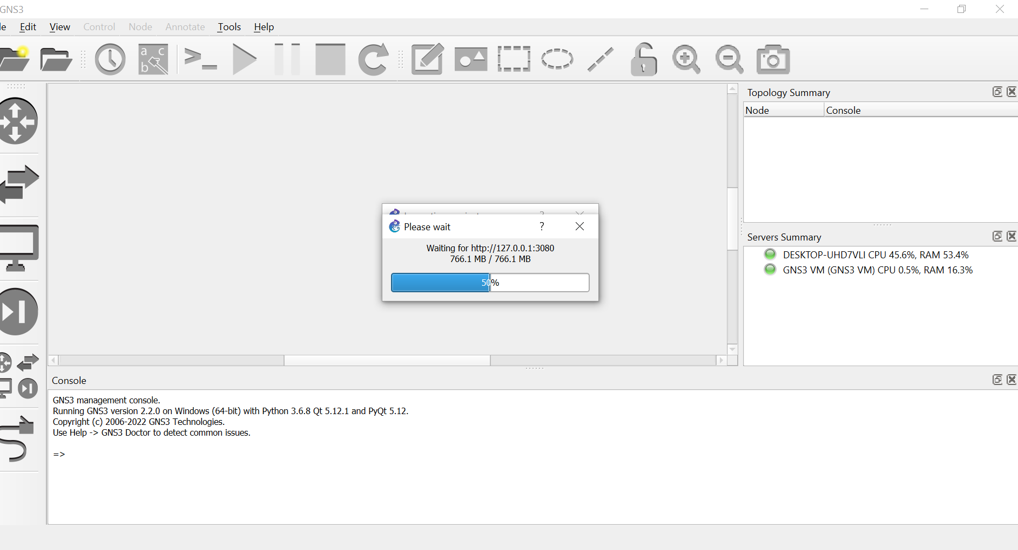
GNS3 Linux Project Demo
<number>

Slide 31
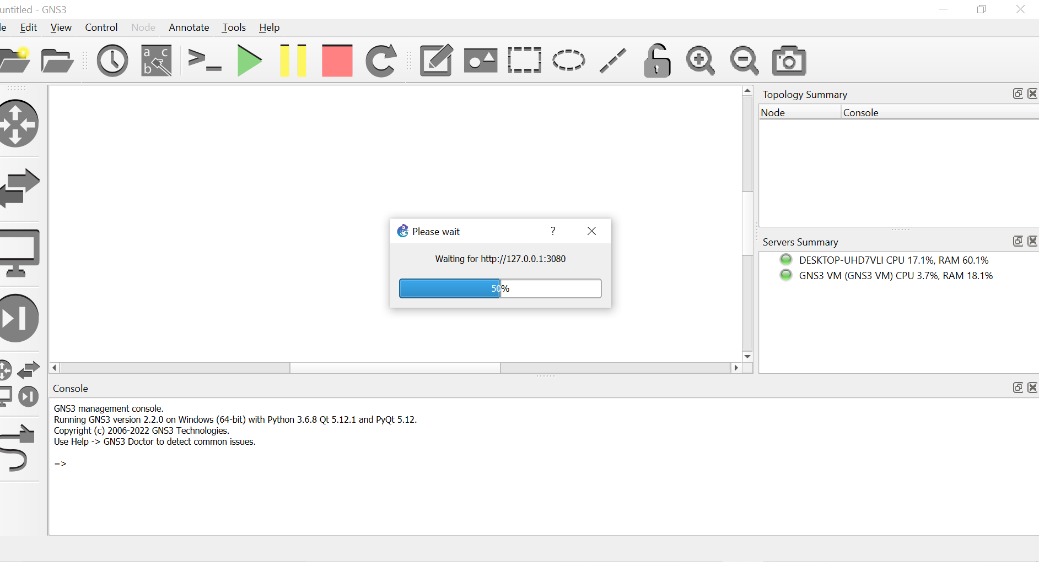
GNS3 Linux Project Demo
<number>

Slide 32
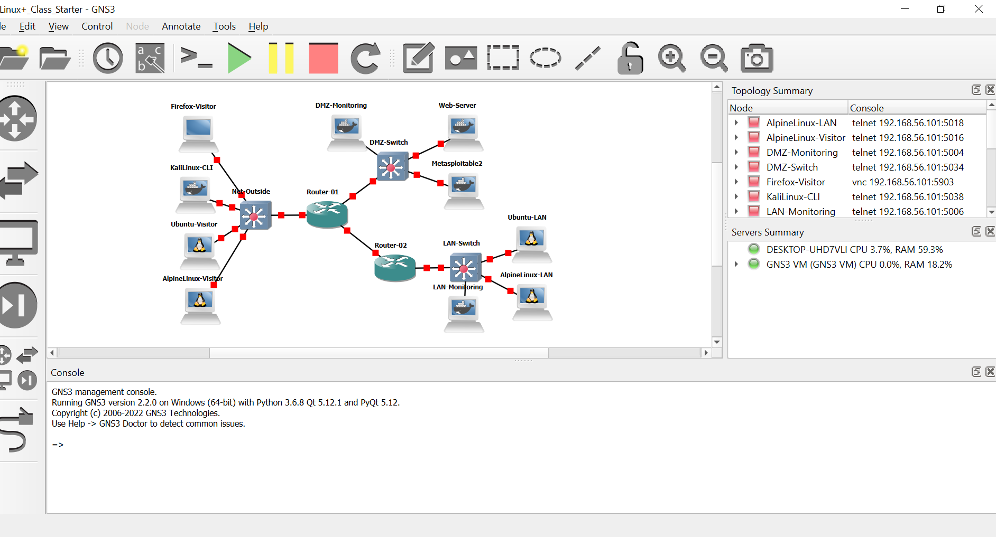
GNS3 Linux Project Demo
<number>

Slide 33
For Next Class
Set up some Linux VM’s
If interested, import the sample Linux GNS3 project into your GNS3.
Next class is Tuesday 7/19/22 and we will cover:
Domain 1.6
Domain 1.7
<number>

Slide 34

Discussion time: Please type your questions in chat
Questions over content.
Share you experience.
What would you like to see
different moving forward?
Let’s keep the conversation going in the CompTIA Instructor Forum: https://cin.comptia.org
<number>

