Slide 1
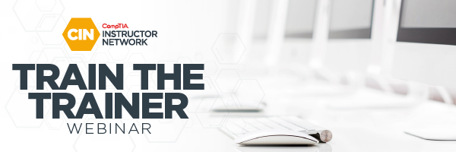
Linux+ XK0-005 TTT Session 4:
Domains 1.6 (Build) and 1.7 (Configuration)
July 19, 2022
@TeachCompTIA #LinuxPlusTTT
1
Notes:
<number>

Slide 2
Certificate of Attendance
Multimedia
Slides
Bios
ON24 Help
Q&A
Today’s Resources
Group Chat
Survey
1

Slide 3
Instructor:
Lee McWhorter Chief Technology Officer
Covered 6 LLC | DGP International
lee@covered6.com
Host:
Rick Butler
Subbing in for Stephen tonight!

Slide 4
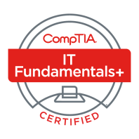
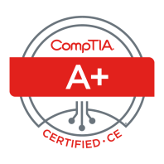
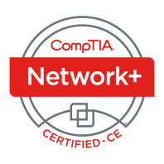
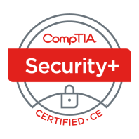
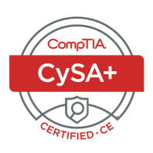
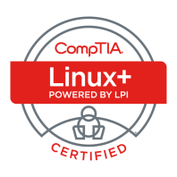
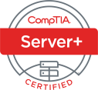
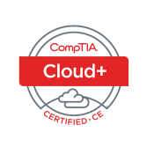
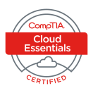
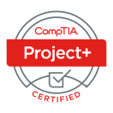
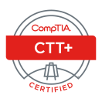
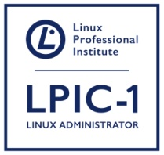
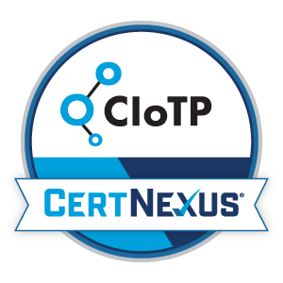
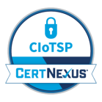
Lee McWhorter
CTO at Covered 6
CompTIA CIN Board member
lee@covered6.com
https://www.linkedin.com/in/lee-mcwhorter/
Twiiter: @tleemcjr
Previous TTT’s:
PenTest+ 001 2018
CASP+ 004 2021
PenTest+ 002 2022

Slide 5
Agenda
Session Objectives
Domain 1.6
Domain 1.7
Instructor Guide Demo

Slide 6
A+ Core 1 220-1101 TTT Session Outline
Date | Topic
7/11/2022 | Introduction, Linux+ Information, Resources, Domain 1.1
7/12/2022 | Domains 1.2 (Files) and 1.3 (Storage)
7/18/2022 | Domains 1.4 (Services) and 1.5 (Networking)
7/19/2022 | Domains 1.6 (Build) and 1.7 (Configuration)
7/25/2022 | Domains 2.1 (Best Practices) and 2.2 (Identity Management)
7/26/2022 | Domains 2.3 (Firewalls), 2.4 (Remote), and 2.5 (Access Controls)
8/01/2022 | Domains 3.1 (Scripts) and 3.2 (Containers)
8/22/2022 | Domains 3.3 (Git), 3.4 (IaC), and 3.5 (Orchestration)
8/23/2022 | Domains 4.1 (Storage), 4.2 (Network), and 4.3 (Processing)
8/30/2022 | Domains 4.4 (Permissions), 4.5 (Common Problems) & Wrap Up
✓
✓
✓
✓
1

Slide 7
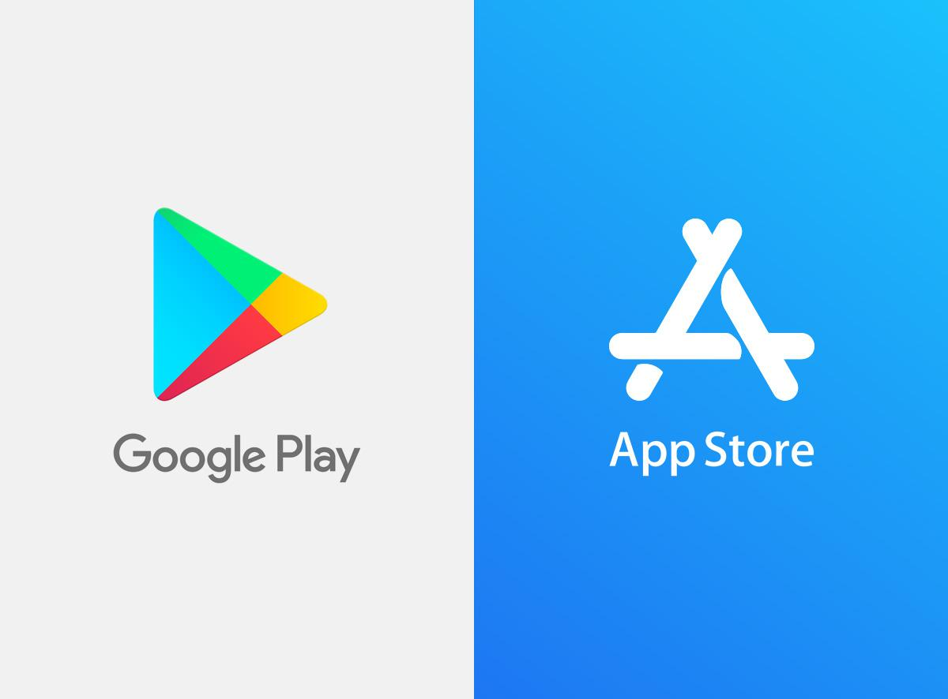
The CompTIA Instructor Network (CIN) is a worldwide community for instructors who provide CompTIA certification training.
Benefits of being a community member include:
Communicate and collaborate with CompTIA staff and other instructors.
Access resources for students to understand the value of getting certified.
Receive complimentary training and tools from CompTIA to enrich your classroom.
Become proficient at teaching CompTIA standards.
Share best practices and resources with each other.
https://cin.comptia.org
Notes:
<number>

Slide 8
Qualifications for Exam Voucher Distribution
Participate in all 12 sessions (live or on-demand) during the date range for the live series (January 18th – March 17th).
Be an active member of CIN through engagement in the community.
Be involved with a CompTIA training partner or an independent instructor teaching CompTIA certifications.
For questions or clarifications talk with your CompTIA Business Development Manager.
Please note as stated in the CompTIA Voucher Terms and Conditions, vouchers are not for resale!

Slide 9
Dates: Wednesday, August 3 - Thursday, August 4, 2022
Partner Summit 2022 is a chance to learn how you can open doors to success for so many, together in partnership with CompTIA.
Unlock your potential by joining these captivating sessions.
Connect with technology experts and engage in panel discussions.
Location: Sheraton Grand Chicago Riverwalk 301 E. North Water Street Chicago, IL 60611

Slide 10
Dates: Wednesday, August 3 - Thursday, August 4, 2022
CIN Capture the Flag is a friendly competition open to attendees at Partner Summit, that will allow you to try solving real-world challenges that map to CompTIA Security+, A+, and Network+ exam objectives.
Post Challenge Review Join us following the event close for challenge review, Q&A and refreshments!

Slide 11
Section break
Domain 1.6
10

Slide 12
Domain 1.6 - Given a scenario, build and install software.
10

Slide 13
Domain 1.6 - Given a scenario, build and install software.
Package management
- DNF – Dandified YUM
dnf install pkg dnf remove pkg dnf repolist all
- YUM – Yellow Dog Updater, Modified
yum install pkg yum erase pkg yum history list
- Zypp – (or libzypp; "Zen / YaST Packages Patches Patterns Products")
zipper install (or in) zipper update (or up) zipper repos
- RPM – Redhat Package Manager
All of these are RPM package managers and are used across a number of Linux distributions including Redhat, Fedora, CentOS, SUSE, OpenSUSE, etc.
10

Slide 14
Domain 1.6 - Given a scenario, build and install software.
Package management (cont)
- APT – Advanced Package Tool
apt update apt install pkg apt remove pkg
Note: APT and APT-GET are similar but not exactly the same, APT is a subset of features from APT-GET.
- dpkg – Debian Package Manager
These are DPKG package managers used on Debian and it’s variants including Ubuntu, Linux Mint, Kali, Elementary OS, etc.
10

Slide 15
Domain 1.6 - Given a scenario, build and install software.
Package management (cont)
- DNF
- YUM
- APT
- RPM
- dpkg
- Zypp
Good article I found on all these (and more) package managers:
https://www.pcwdld.com/best-linux-package-managers
10

Slide 16
Chat Question
What do you think would be some good packages for your students to install during labs for covering package managers?
Answer in the chat window and let’s share.
This photo is for placement only

Slide 17
Domain 1.6 - Given a scenario, build and install software.
Sandboxed applications
- snapd – Software package and deployment system, runs all Linux, packages called snaps and snapd is the tool / daemon for using them.
- Flatpak – formerly xdg-app, native to many Linux distros, can run on most.
- AppImage – supports distributing portable applications without requiring root/sudo.
10

Slide 18
Domain 1.6 - Given a scenario, build and install software.
System updates
- Kernel updates – Various ways to update the Kernel depending on tool/distro:
yum update kernel apt-get dist-upgrade GUI Updater tool
- Package updates – Once again various ways depending on tool/distro and whether you want to update a specific software or everything. Update everything examples below:
apt-get update apt-get upgrade
yum update
zypper refresh zypper update
10

Slide 19
Section break
Domain 1.7
10

Slide 20
Domain 1.7 - Given a scenario, manage software configurations.
10

Slide 21
Domain 1.7 - Given a scenario, manage software configurations.
Updating configuration files
- Procedures
• Restart service
• Reload service
If a software update would change the configuration file, then it is possible one of the following will be created to avoid overwriting your existing config.
- .rpmnew – New default configuration file, leaving original alone.
- .rpmsave – A save of your original config, the new default one is in place.
10

Slide 22
Domain 1.7 - Given a scenario, manage software configurations.
Updating configuration files (cont)
Repository configuration files
• /etc/apt.conf – Main APT configuration file
• /etc/yum.conf – Main YUM configuration file
• /etc/dnf/dnf.conf – DNF configuration file
• /etc/yum.repo.d – YUM repo file
• /etc/apt/sources.list.d – APT repo URLs and information
10

Slide 23
Domain 1.7 - Given a scenario, manage software configurations.
Configure kernel options
- Parameters
• sysctl – utility that reads / modifies the attributes of the system kernel
• /etc/sysctl.conf - used to override default kernel parameter values
- Modules
• lsmod – shows loaded kernel modules
• imsmod – what is this???
• rmmod – unloads a specific module from the kernel
• insmod – loads specific module into the kernel
• modprobe – can load or unload modules, udev uses auto for hardware
• modinfo – provides information on named kernel module
10

Slide 24
Domain 1.7 - Given a scenario, manage software configurations.
Configure common system services
- SSH – Secure Shell Configuration
Server = /etc/ssh/sshd_conf
Client = ~/.ssh/config and/or /etc/ssh/ssh_config
- Network Time Protocol (NTP) = /etc/ntp.conf
- Syslog = /etc/syslog.conf
- chrony = /etc/chrony.conf
10

Slide 25
Domain 1.7 - Given a scenario, manage software configurations.
Localization
- timedatectl – allows you to query and change the system clock and settings on a Linux system.
- localectl – used to query and change the system locale and keyboard layout settings.
10

Slide 26
Section break
Linux+ Instructor Guide
10

Slide 27
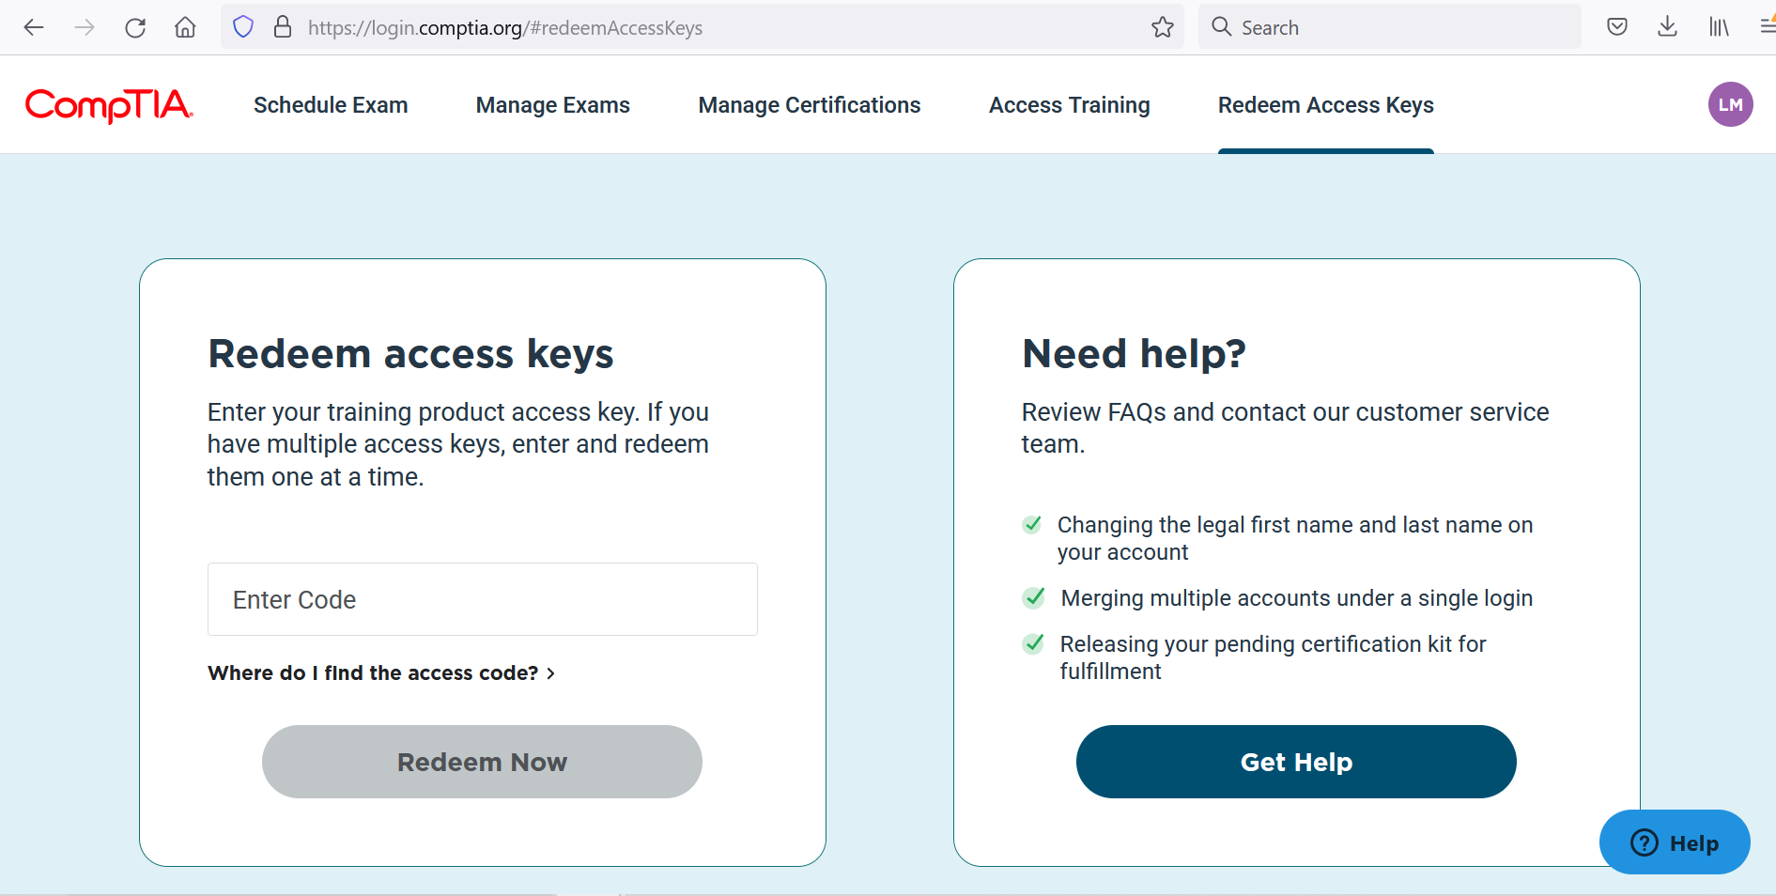
Linux+ Instructor Guide
<number>

Slide 28
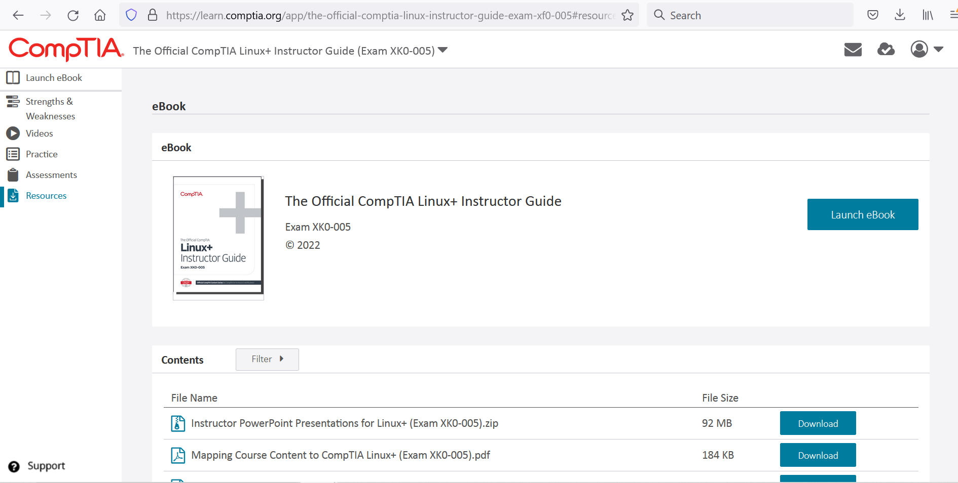
Linux+ Instructor Guide
<number>

Slide 29
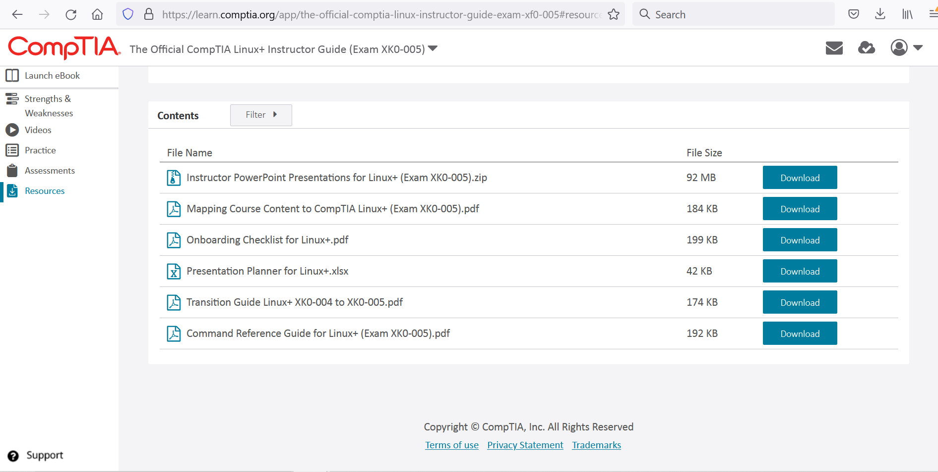
Linux+ Instructor Guide
<number>

Slide 30
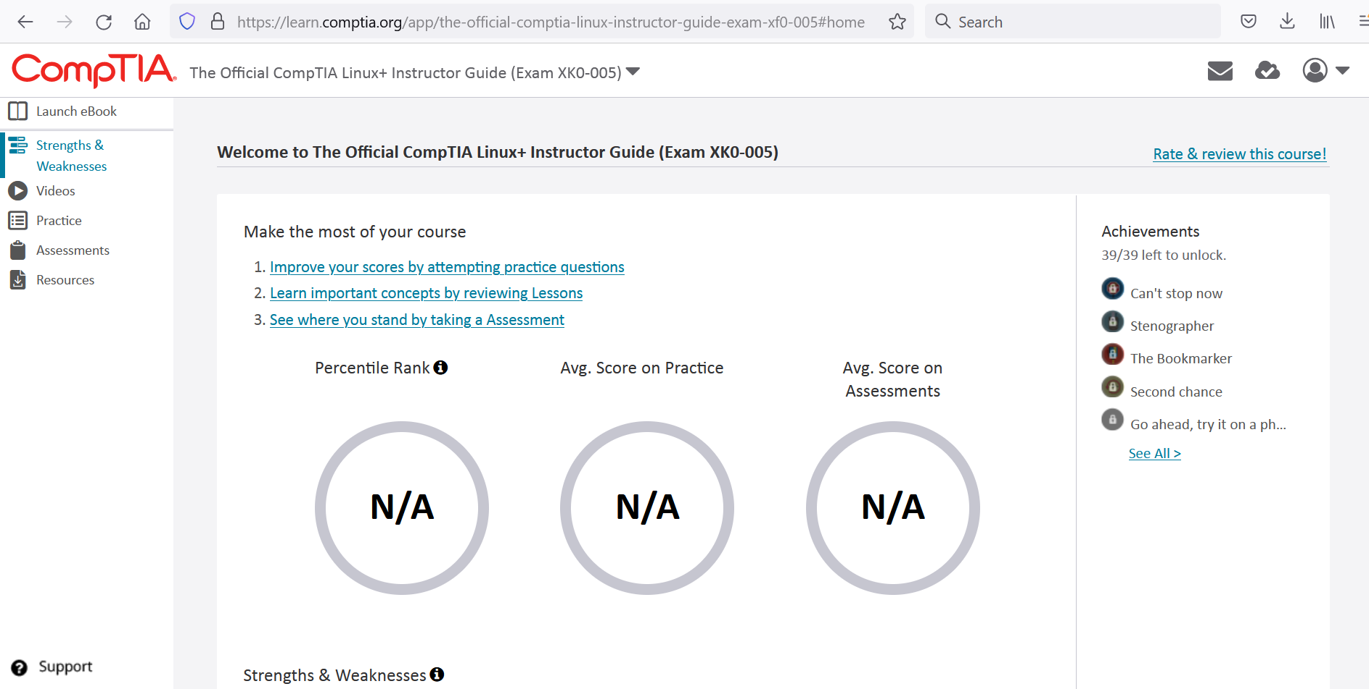
Linux+ Instructor Guide
<number>

Slide 31
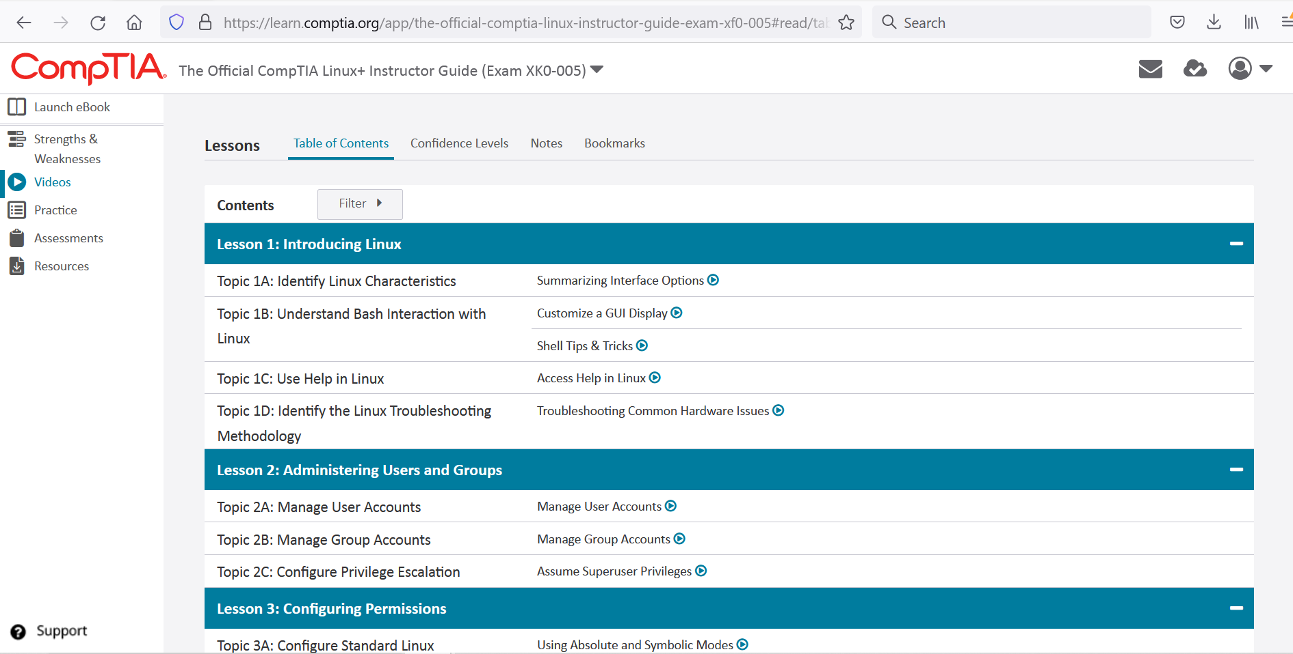
Linux+ Instructor Guide
<number>

Slide 32
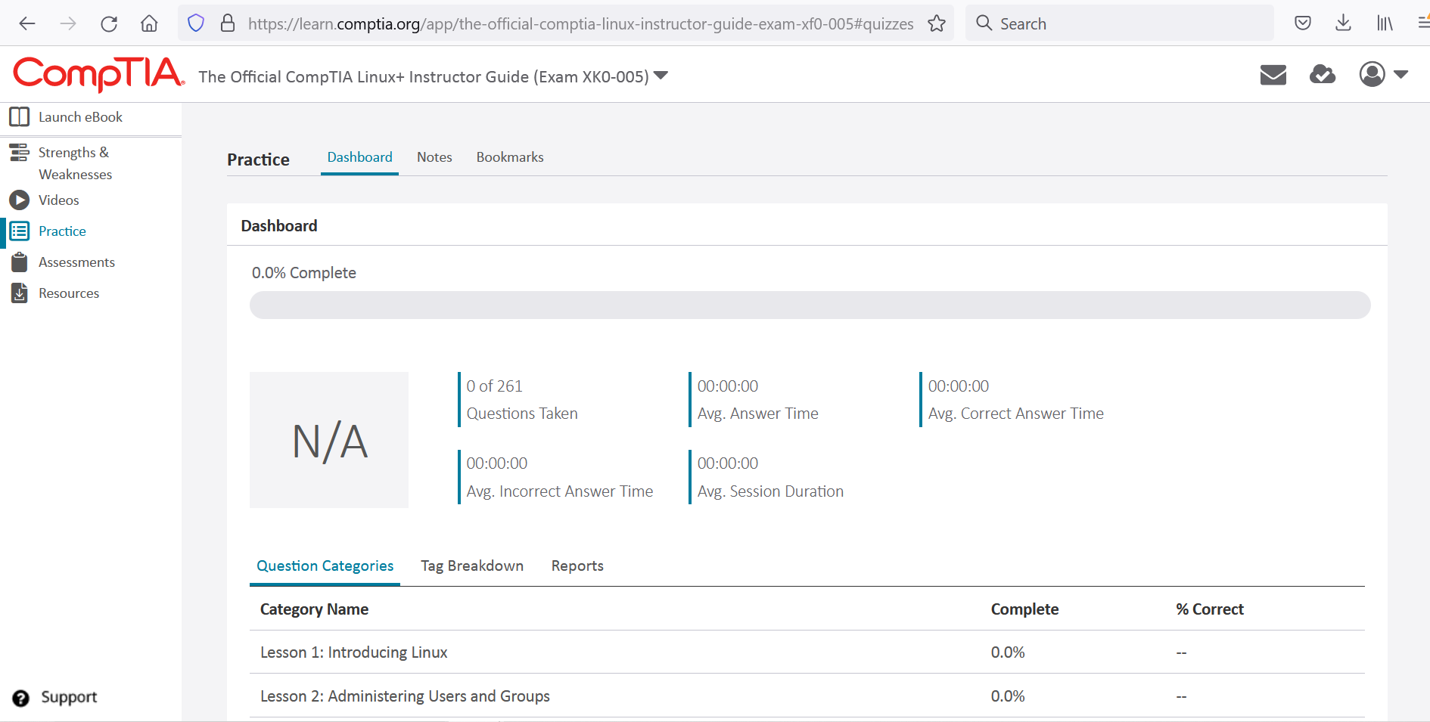
Linux+ Instructor Guide
<number>

Slide 33
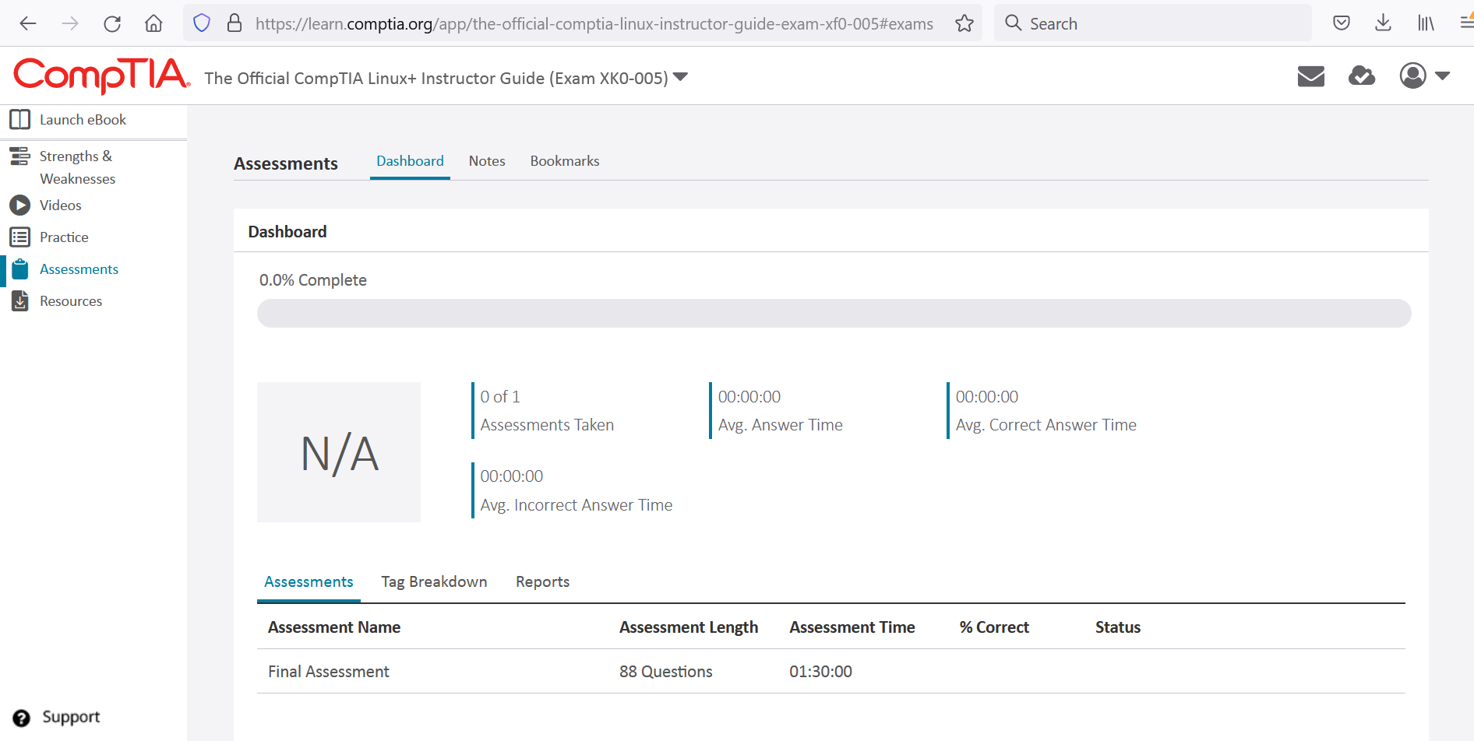
Linux+ Instructor Guide
<number>

Slide 34
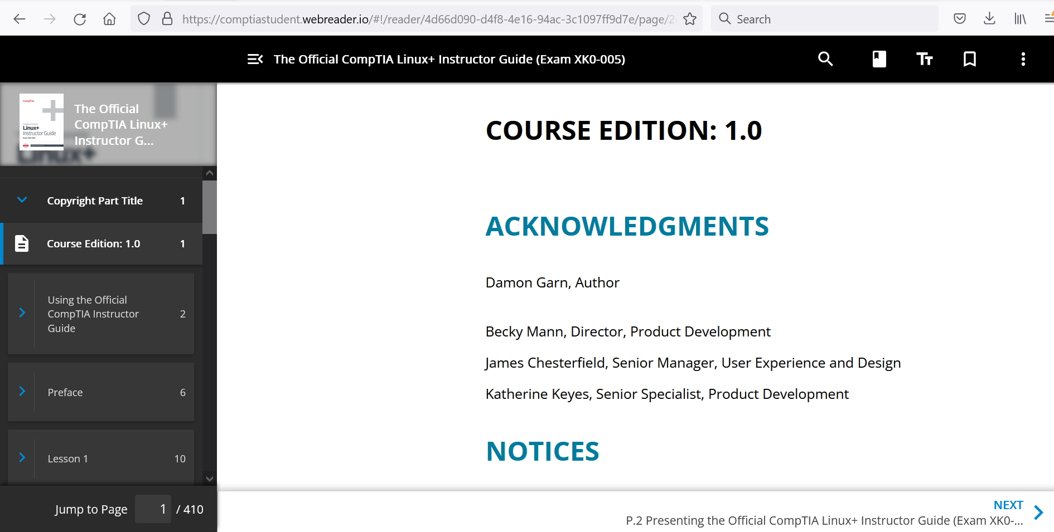
Linux+ Instructor Guide
<number>

Slide 35
For Next Week
Review Domain 1, practice with some of the utilities and services we have learned about in the first few session using either VMs and/or GNS3.
Next class is Monday 7/25/22 and we will cover:
Domain 2.1
Domain 2.2
<number>

Slide 36
Discussion time: Please type your questions in chat
Questions over content.
Share you experience.
What would you like to see different moving forward?
Let’s keep the conversation going in the CompTIA Instructor Forum: https://cin.comptia.org
<number>

