Slide 1
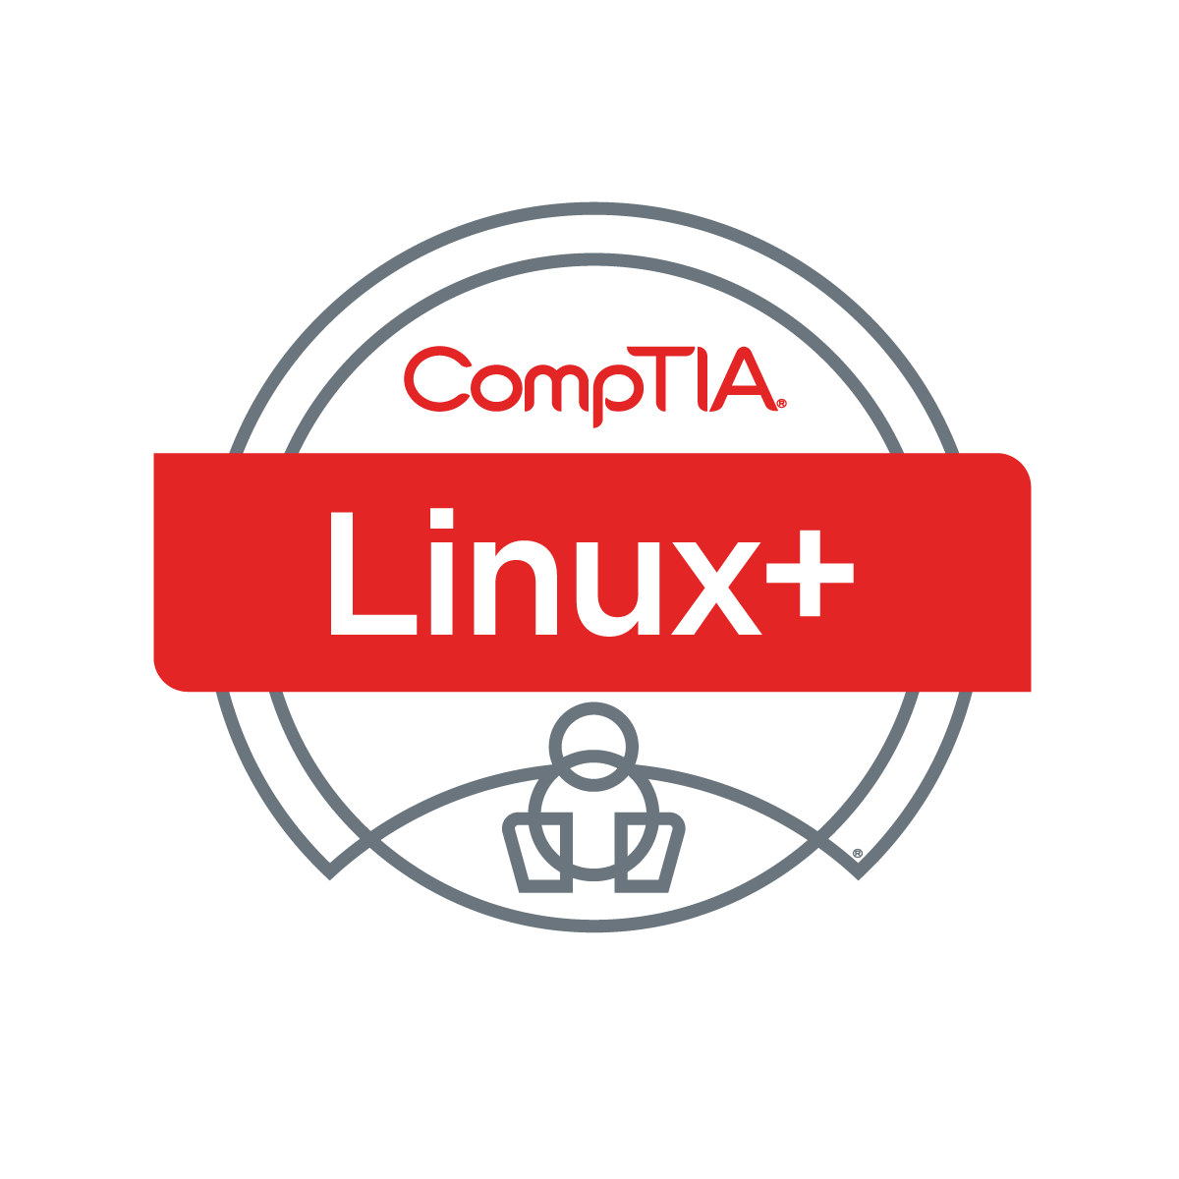

Linux+ XK0-005 TTT Session 5:
Domains 2.1 (Best Practices) and 2.2 (Identity Management)
July 25, 2022
@TeachCompTIA #LinuxPlusTTT
<number>
Notes:
<number>

Slide 2

Certificate of Attendance
Multimedia
Slides
Bios
ON24 Help
Q&A
Today’s Resources
Group Chat
Survey
<number>

Slide 3
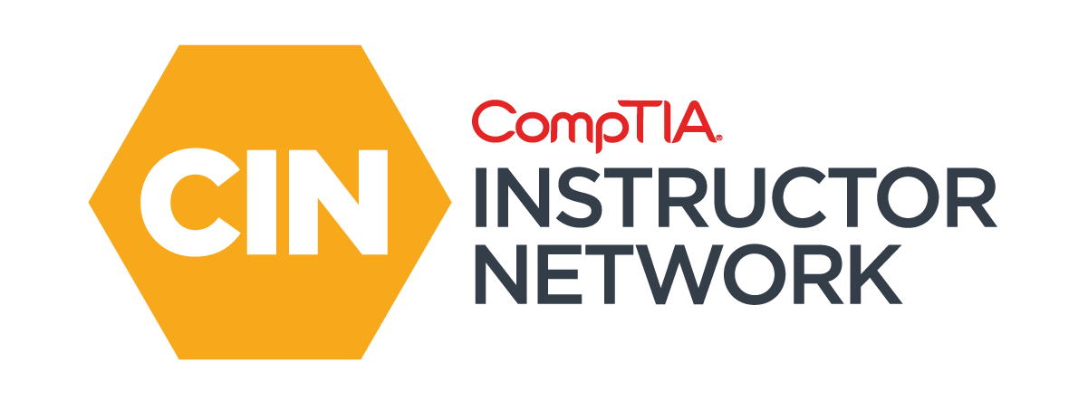

The CompTIA Instructor Network (CIN) is a worldwide community for instructors who provide CompTIA certification training.
Benefits of being a community member include:
  Communicate and collaborate with CompTIA staff and other instructors.
  Access resources for students to understand the value of getting certified.
  Receive complimentary training and tools from CompTIA to enrich your classroom.
  Become proficient at teaching CompTIA standards.
  Share best practices and resources with each other.
https://cin.comptia.org
Notes:
<number>

Slide 4

Qualifications for Exam Voucher Distribution
Participate in all 12 sessions (live or on-demand) during the date range for the live series (January 18th – March 17th).
Be an active member of CIN through engagement in the community.
Be involved with a CompTIA training partner or an independent instructor teaching CompTIA certifications.
For questions or clarifications talk with your CompTIA Business Development Manager.
Please note as stated in the CompTIA Voucher Terms and Conditions, vouchers are not for resale!

Slide 5



Dates: Wednesday, August 3 - Thursday, August 4, 2022
Partner Summit 2022 is a chance to learn how you can open doors to success for so many, together in partnership with CompTIA.

Slide 6

Dates: Wednesday, August 3 - Thursday, August 4, 2022
CIN Capture the Flag is a friendly competition open to attendees at Partner Summit, that will allow you to try solving real-world challenges that map to CompTIA Security+, A+, and Network+ exam objectives.
Post Challenge Review Join us following the event close for challenge review, Q&A and refreshments!

Slide 7


Instructor:
Lee McWhorter
Chief Technology Officer
Covered 6 LLC | DGP International
lee@covered6.com
Host:
Stephen Schneiter
Instructor Network Program Manager
CompTIA
sschneiter@comptia.org

Slide 8

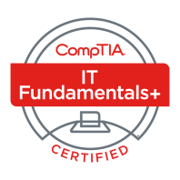
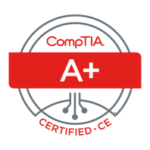
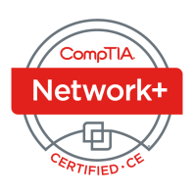
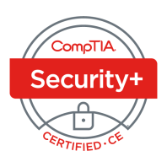
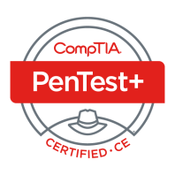
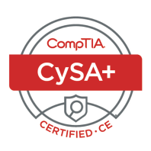
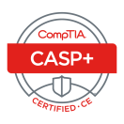
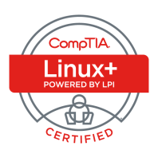
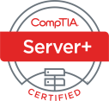
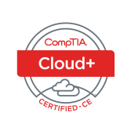
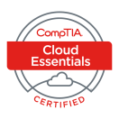
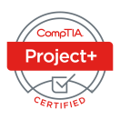
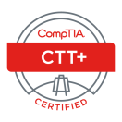



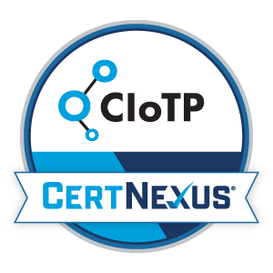
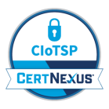
Lee McWhorter
CTO at Covered 6
CompTIA CIN Board member
lee@covered6.com
https://www.linkedin.com/in/lee-mcwhorter/
Twiiter: @tleemcjr
Previous TTT’s:
PenTest+ 001 2018
CASP+ 004 2021
PenTest+ 002 2022

Slide 9

Agenda
Session Objectives
Domain 2.1
Domain 2.2

Slide 10
A+ Core 1 220-1101 TTT Session Outline
Date | Topic
7/11/2022 | Introduction, Linux+ Information, Resources, Domain 1.1
7/12/2022 | Domains 1.2 (Files) and 1.3 (Storage)
7/18/2022 | Domains 1.4 (Services) and 1.5 (Networking)
7/19/2022 | Domains 1.6 (Build) and 1.7 (Configuration)
7/25/2022 | Domains 2.1 (Best Practices) and 2.2 (Identity Management)
7/26/2022 | Domains 2.3 (Firewalls), 2.4 (Remote), and 2.5 (Access Controls)
8/01/2022 | Domains 3.1 (Scripts) and 3.2 (Containers)
8/22/2022 | Domains 3.3 (Git), 3.4 (IaC), and 3.5 (Orchestration)
8/23/2022 | Domains 4.1 (Storage), 4.2 (Network), and 4.3 (Processing)
8/30/2022 | Domains 4.4 (Permissions), 4.5 (Common Problems) & Wrap Up
✓
✓
✓
✓
✓
<number>

Slide 11
Section break
Pop Quiz!
<number>

Slide 12
POLL
In what folder/directory are configuration files usually stored in on Linux system?
/lib
/boot
/etc
/usr
<number>

Slide 13
POLL - Answer
In what folder/directory are configuration files usually stored in on Linux system?
/lib
/boot
/etc
/usr
<number>

Slide 14
POLL
Which boot loader is covered in the current Linux+ exam objectives?
LILO
Grub2
Loadlin
Grub
<number>

Slide 15
POLL - Answer
Which boot loader is covered in the current Linux+ exam objectives?
LILO
Grub2
Loadlin
Grub
<number>

Slide 16
POLL
Which of the following are file systems supported by Linux?
EXT3
EXT4
XFS
All of the above
None of the above
<number>

Slide 17
POLL - Answer
Which of the following are file systems supported by Linux?
EXT3
EXT4
XFS
All of the above
None of the above
<number>

Slide 18
POLL
Which of the following Linux utilities is NOT used in file and directory operations?
lsmod
ls
mkdir
rm
<number>

Slide 19
POLL - Answer
Which of the following Linux utilities is NOT used in file and directory operations?
lsmod
ls
mkdir
rm
<number>

Slide 20
POLL
Which of the following Linux utilities’ primary function is to display free disk space?
du
lsdisk
df
fdisk
<number>

Slide 21
POLL - Answer
Which of the following Linux utilities’ primary function is to display free disk space?
du
lsdisk
df
fdisk
<number>

Slide 22
POLL
Which of the following Linux utilities displays running process for either a user or the whole system?
lsproc
ps
top
None of the above
<number>

Slide 23
POLL - Answer
Which of the following Linux utilities displays running process for either a user or the whole system?
lsproc
ps
top
None of the above
<number>

Slide 24
POLL
Which is the more current Linux utility for display IP address and related information?
ifconfig
netconfig
ipconfig
ip
<number>

Slide 25
POLL - Answer
Which is the more current Linux utility for display IP address and related information?
ifconfig
netconfig
ipconfig
ip
<number>

Slide 26
POLL
Which of the following is NOT a Linux package manager?
DNF
YUM
APT
RPM
All of the above are package managers
<number>

Slide 27
POLL - Answer
Which of the following is NOT a Linux package manager?
DNF
YUM
APT
RPM
All of the above are package managers
<number>

Slide 28
Section break
Domain 2.1
<number>

Slide 29
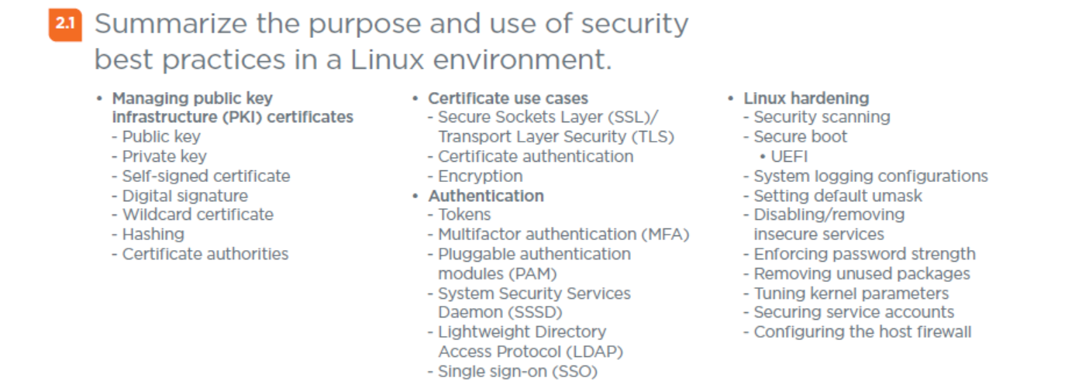
Domain 2.1 - Summarize the purpose and use of security best practices in a Linux environment.
<number>

Slide 30
Domain 2.1 - Summarize the purpose and use of security best practices in a Linux environment.
Managing public key infrastructure (PKI) certificates
- Public key – part of key pair, shared with other users / sites.
- Private key – part of key pair, kept secret and protected.
- Self-signed certificate – Is a certificate not signed by a certificate authority.
- Digital signature – a public / private key pair used in PKI.
- Wildcard certificate – single certificate with wildcard (*) in domain name.
- Hashing – used in PKI, make sure to use highest algorithm and key lengths.
- Certificate authorities – Range from major providers like Network Solutions and Let’s Encrypt to server based like Microsoft CA and Easy-RSA on Linux.
<number>

Slide 31
Domain 2.1 - Summarize the purpose and use of security best practices in a Linux environment.
Certificate use cases
- Secure Sockets Layer (SSL)/Transport Layer Security (TLS)
- Certificate authentication – Certificate authorities authenticate clients without having to have a copy of the public key on every server.
- Encryption – can be used to encrypt files.
<number>

Slide 32
Domain 2.1 - Summarize the purpose and use of security best practices in a Linux environment.
Authentication
- Tokens - provide secure storage for digital certificates and private keys.
- Multifactor authentication (MFA)
- Pluggable authentication modules (PAM) - mechanism to integrate multiple low-level authentication schemes into a high-level application programming.
- System Security Services Daemon (SSSD) - set of daemons to manage access to remote directory services and authentication.
- Lightweight Directory Access Protocol (LDAP)
- Single sign-on (SSO)
<number>

Slide 33
Domain 2.1 - Summarize the purpose and use of security best practices in a Linux environment.
Linux hardening
- Security scanning
- Secure boot
• UEFI
- System logging configurations
- Setting default umask
- Disabling/removing insecure services
<number>

Slide 34
Domain 2.1 - Summarize the purpose and use of security best practices in a Linux environment.
Linux hardening (cont)
- Enforcing password strength
- Removing unused packages
- Tuning kernel parameters
- Securing service accounts
- Configuring the host firewall
<number>

Slide 35

Chat Question
Do you have any other hardening techniques you cover in your classes?
Answer in the chat window and let’s share.
This photo is for placement only

Slide 36
Section break
Domain 2.2
<number>

Slide 37
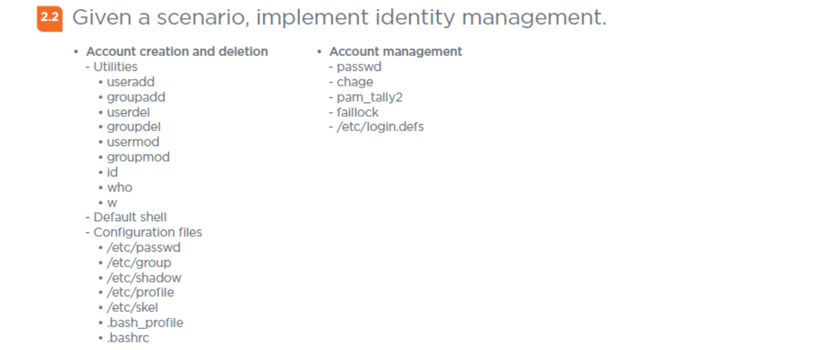
Domain 2.2 - Given a scenario, implement identity management.
<number>

Slide 38
Domain 2.2 - Given a scenario, implement identity management.
Account creation and deletion
- Utilities
• useradd – used to add a new user to the system.
• groupadd – used to add a new group to the system.
• userdel – used to delete a user from the system
• groupdel – used to delete a group from the system
• usermod – used to modify a user on the system.
• groupmod – used to modify a group on the system
• id – shows the user and group ID’s associated with a user.
• who – displays information about system and logged on users.
• w – displays information about logged on users and who they have su’d.
<number>

Slide 39
Domain 2.2 - Given a scenario, implement identity management.
Account creation and deletion (cont)
- Default shell
- Configuration files
• /etc/passwd – where usernames and IDs are stored.
• /etc/group – where group info and IDs of users in group are stored.
• /etc/shadow – where passwords of users are stored encrypted.
• /etc/profile – used to set system wide environmental variables on users shells.
• /etc/skel – used to create a default home directory, containing below.
• .bash_profile – executed when BASH is interactive login shell.
• .bashrc – executed for interactive non-login shell.
<number>

Slide 40
Domain 2.2 - Given a scenario, implement identity management.
Account management
- passwd – used to change a user’s password.
- chage – used to set number of days before a required password change.
- pam_tally2 – used to lock user accounts after certain number of failed ssh logins.
- faillock – a command and folder related to failed user logins and lockout.
- /etc/login.defs – provides default configuration information for several user account parameters.
<number>

Slide 41
For Next Class
Check out your Instructor Guide resources if you have not already done so or are not saving them for later study.
Next class is Tuesday 7/26/22 and we will cover:
Domain 2.3
Domain 2.4
Domain 2.5
<number>

Slide 42

Discussion time: Please type your questions in chat
Questions over content.
Share you experience.
What would you like to see
different moving forward?
Let’s keep the conversation going in the CompTIA Instructor Forum: https://cin.comptia.org
<number>

