Slide 1


Linux+ XK0-005 TTT Session 6:
Domains 2.3 (Firewalls), 2.4 (Remote), and 2.5 (Access Controls)
July 26, 2022
@TeachCompTIA #LinuxPlusTTT
<number>
Notes:
<number>

Slide 2

Certificate of Attendance
Multimedia
Slides
Bios
ON24 Help
Q&A
Today’s Resources
Group Chat
Survey
<number>

Slide 3


The CompTIA Instructor Network (CIN) is a worldwide community for instructors who provide CompTIA certification training.
Benefits of being a community member include:
  Communicate and collaborate with CompTIA staff and other instructors.
  Access resources for students to understand the value of getting certified.
  Receive complimentary training and tools from CompTIA to enrich your classroom.
  Become proficient at teaching CompTIA standards.
  Share best practices and resources with each other.
https://cin.comptia.org
Notes:
<number>

Slide 4

Qualifications for Exam Voucher Distribution
Participate in all 12 sessions (live or on-demand) during the date range for the live series (January 18th – March 17th).
Be an active member of CIN through engagement in the community.
Be involved with a CompTIA training partner or an independent instructor teaching CompTIA certifications.
For questions or clarifications talk with your CompTIA Business Development Manager.
Please note as stated in the CompTIA Voucher Terms and Conditions, vouchers are not for resale!

Slide 5



Dates: Wednesday, August 3 - Thursday, August 4, 2022
Partner Summit 2022 is a chance to learn how you can open doors to success for so many, together in partnership with CompTIA.

Slide 6

Dates: Wednesday, August 3 - Thursday, August 4, 2022
CIN Capture the Flag is a friendly competition open to attendees at Partner Summit, that will allow you to try solving real-world challenges that map to CompTIA Security+, A+, and Network+ exam objectives.
Post Challenge Review Join us following the event close for challenge review, Q&A and refreshments!

Slide 7


Instructor:
Lee McWhorter
Chief Technology Officer
Covered 6 LLC | DGP International
lee@covered6.com
Host:
Stephen Schneiter
Instructor Network Program Manager
CompTIA
sschneiter@comptia.org

Slide 8

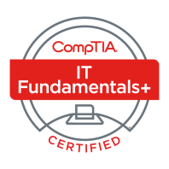




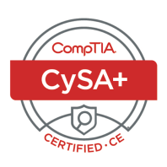

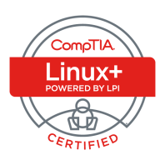
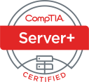

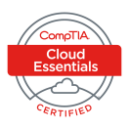
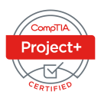






Lee McWhorter
CTO at Covered 6
CompTIA CIN Board member
lee@covered6.com
https://www.linkedin.com/in/lee-mcwhorter/
Twiiter: @tleemcjr
Previous TTT’s:
PenTest+ 001 2018
CASP+ 004 2021
PenTest+ 002 2022

Slide 9

Agenda
Session Objectives
Domain 2.3
Domain 2.4
Domain 2.5

Slide 10
A+ Core 1 220-1101 TTT Session Outline
Date | Topic
7/11/2022 | Introduction, Linux+ Information, Resources, Domain 1.1
7/12/2022 | Domains 1.2 (Files) and 1.3 (Storage)
7/18/2022 | Domains 1.4 (Services) and 1.5 (Networking)
7/19/2022 | Domains 1.6 (Build) and 1.7 (Configuration)
7/25/2022 | Domains 2.1 (Best Practices) and 2.2 (Identity Management)
7/26/2022 | Domains 2.3 (Firewalls), 2.4 (Remote), and 2.5 (Access Controls)
8/01/2022 | Domains 3.1 (Scripts) and 3.2 (Containers)
8/22/2022 | Domains 3.3 (Git), 3.4 (IaC), and 3.5 (Orchestration)
8/23/2022 | Domains 4.1 (Storage), 4.2 (Network), and 4.3 (Processing)
8/30/2022 | Domains 4.4 (Permissions), 4.5 (Common Problems) & Wrap Up
✓
✓
✓
✓
✓
✓
6

Slide 11
Section break
Domain 2.3
6

Slide 12
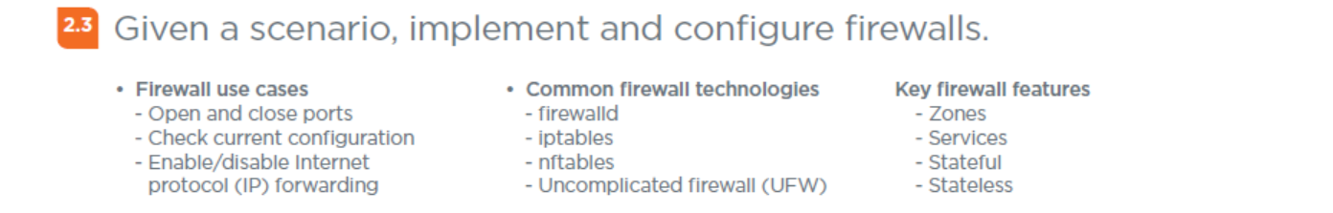
Domain 2.3 - Given a scenario, implement and configure firewalls.
6

Slide 13
Domain 2.3 - Given a scenario, implement and configure firewalls.
Firewall use cases
- Open and close ports – most common use case, to allow or disallow particular services based on port numbers.
- Check current configuration – examples:
firewall-config
iptables -S INPUT
iptables -S OUTPUT
nft list tables [<family>]
(Where <family> is : ip, arp, ip6, bridge, inet, netdev. )
ufw status
- Enable/disable Internet protocol (IP) forwarding
6

Slide 14
Domain 2.3 - Given a scenario, implement and configure firewalls.
Common firewall technologies
- firewalld – firewall management tool for Linux operating systems. Mainly used by Red Hat, Fedora, and SUSE.
- iptables – legacy user-space utility program that allows a system administrator to configure the IP packet filter rules of the Linux kernel firewall. Still support by some distros.
- nftables – subsystem of the Linux kernel providing filtering and classification of network packets/datagrams/frames. Replaced iptables in 2014 with kernel 3.13. While different syntax, supports iptables and conversion.
- Uncomplicated firewall (UFW) – program for managing a netfilter firewall, command line interface, uses iptables, runs on Ubuntu after 8.04.
6

Slide 15
POLL
How many of you have used the various firewalls covered?
I have used Firewalld only
I have used iptables only
I have used nftables only
I have used ufw only
I have used multiple of these firewalls
I have used none of these firewalls
6

Slide 16
Domain 2.3 - Given a scenario, implement and configure firewalls.
Key firewall features
- Zones – to include: trusted, home, work, internal, public, dmz, external, block, drop
- Services – firewall services on Linux are provided my many services includes ones from previous slide.
- Stateful – firewalls and rules that determine ‘state’ of a packet as part of filtering.
- Stateless – firewalls and rules which only use static information like source and destination.
6

Slide 17
Section break
Domain 2.4
6

Slide 18
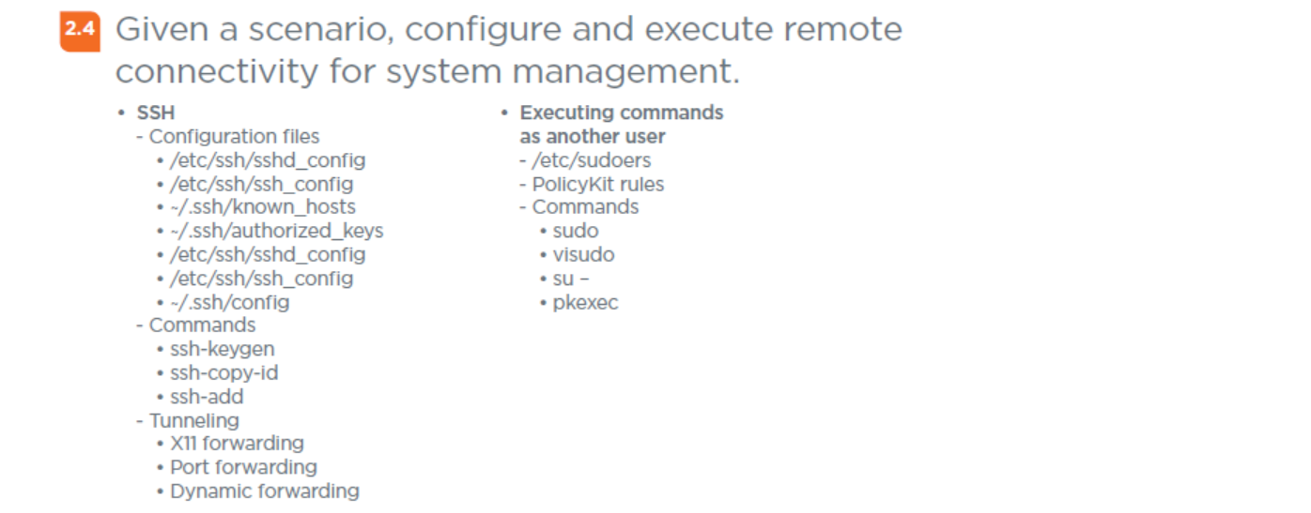
Domain 2.4 - Given a scenario, configure and execute remote connectivity for system management.
6

Slide 19
Domain 2.4 - Given a scenario, configure and execute remote connectivity for system management.
SSH
- Configuration files
• /etc/ssh/sshd_config – configures the SSH server daemon.
• /etc/ssh/ssh_config – configures the SSH client software.
• ~/.ssh/known_hosts – stores the public key of all servers connected to.
• ~/.ssh/authorized_keys – holds ssh public keys of users that should be allowed to log a server.
• /etc/ssh/sshd_config – dupe of above...
• /etc/ssh/ssh_config – dupe of above...
• ~/.ssh/config – allows a user to define settings for specific SSH hosts.
<number>

Slide 20

Chat Question
Do any of your have any tips for securing an SSH server?
Answer in the chat window and let’s share.
This photo is for placement only

Slide 21
Domain 2.4 - Given a scenario, configure and execute remote connectivity for system management.
SSH (cont)
- Commands
• ssh-keygen – utility for creating new authentication public/private key pairs for SSH.
• ssh-copy-id – utility that allows you to install an SSH key on a remote server's authorized keys.
• ssh-add - prompts the user for a private key password and adds it to the list maintained by ssh-agent.
ssh-agent – helper program that keeps track of user's identity keys and their passphrases.
<number>

Slide 22
Domain 2.4 - Given a scenario, configure and execute remote connectivity for system management.
SSH (cont)
- Commands
- Tunneling
• X11 forwarding - provides one way for an SSH connection to access graphical applications running on the SSH server. Alternatives are Remote desktop and VNC.
• Port forwarding – mechanism in SSH for tunneling application ports from the client machine to the server machine, or vice versa. Is often used to circumvent standard firewall security protocols.
• Dynamic forwarding – SSH feature which leverages the SOCKS protocol. In this configuration, SSH acts as a SOCKS proxy.
<number>

Slide 23
Domain 2.4 - Given a scenario, configure and execute remote connectivity for system management.
Executing commands as another user
- /etc/sudoers – a file that controls who can run what commands as what users. Most modern Linux distributions require a user be listed in the sudo, sudoers, or wheel group to use the sudo command.
- PolicyKit rules – used for controlling system-wide privileges. It provides an organized way for non-privileged processes to communicate with privileged ones. Unlike sudo, does not grant root to entire process.
<number>

Slide 24
Domain 2.4 - Given a scenario, configure and execute remote connectivity for system management.
Executing commands as another user
- Commands
• sudo – a utility that enables users to run programs with the security privileges of another user, by default the root/superuser.
• visudo – it an editing for /etc/sudoers files which checks syntax of the changes before overwriting the file. Using a normal edit you risk breaking su.
<number>

Slide 25
Domain 2.4 - Given a scenario, configure and execute remote connectivity for system management.
Executing commands as another user
- Commands (cont)
• su – - using su alone will give you root user, su username will switch to that username, but su – username will give you the login for the username like a normal login.
• pkexec - allows an authorized user to execute a program as another user. If no username is supplied, the program will be executed as the root/admin/superuser. Is associated with PolicyKit.
<number>

Slide 26
Section break
Domain 2.5
<number>

Slide 27
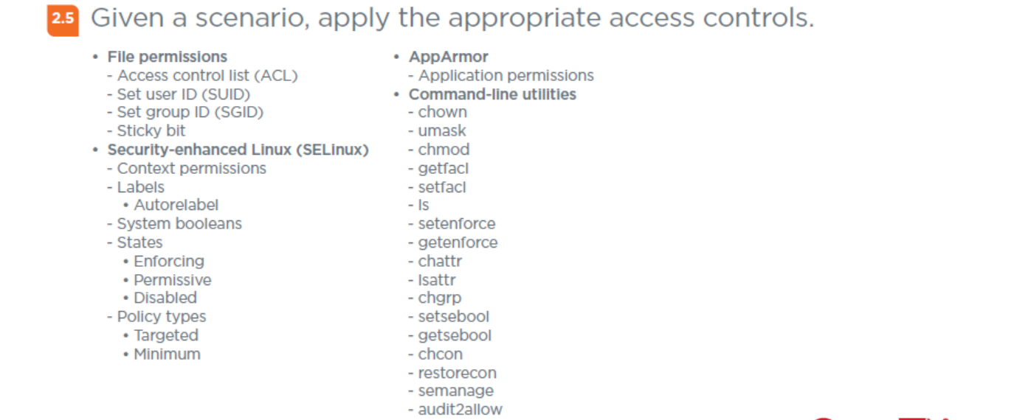
Domain 2.5 - Given a scenario, apply the appropriate access controls.
<number>

Slide 28
Domain 2.5 - Given a scenario, apply the appropriate access controls.
File permissions
- Access control list (ACL) – to use file ACLs the filesystem must be mounted with acl option. Use getfacl command to view permissions on any file or directory.
- Set user ID (SUID) – a permission bit flag for executable files. It allows an alternate user to run an executable with the same permissions as the owner of the file instead of the permissions of the alternate user.
<number>

Slide 29
Domain 2.5 - Given a scenario, apply the appropriate access controls.
File permissions (cont)
- Set group ID (SGID) – special permission which has a couple of functions. If set on a file, it allows the file to be executed as the group that owns the file (similar to SUID) If set on a directory, any files created in the directory will have their group ownership set to that of the directory owner.
- Sticky bit – a special permission bit which is set on a file or folder, thus permitting only the owner or root user of the file or folder to modify, rename, or delete that directory or file. No other user would be permitted to have these privileges on a file or folder which has a sticky bit set.
<number>

Slide 30
Domain 2.5 - Given a scenario, apply the appropriate access controls.
Security-enhanced Linux (SELinux) - defines access controls for the applications, processes, and files on a system. It uses security policies, which are a set of rules that tell SELinux what can or can't be accessed.
- Context permissions – SELinux stores a context label in the extended attributes of the file system. The context contains additional information about a system object such as the SELinux user, their role, their type, and security level. SELinux uses this context information to control access by processes, Linux users, and files.
<number>

Slide 31
Domain 2.5 - Given a scenario, apply the appropriate access controls.
Security-enhanced Linux (SELinux) (cont)
- Labels – used for the SELinux context of a file or other object. File labels are the most common aspect of a SELinux system that need to be managed. As SELinux policy decisions are based on the label of a resource, making sure that the file labels are correctly set is an important part of maintaining systems.
• Autorelabel - an optional entry that allows the file system to be relabeled. If set to 0 and there is a file called .autorelabel in the root directory, then on the next boot, the SELinux subsystem will detect this file, and then relabel all of the files on that system with the correct SELinux contexts.
- System booleans - booleans allow you to control specific attributes of SELinux policies.
<number>

Slide 32
Domain 2.5 - Given a scenario, apply the appropriate access controls.
Security-enhanced Linux (SELinux) (cont)
- States
• Enforcing – in this mode SELinux is enforcing its policy and rules.
• Permissive – in this mode SELinux does not enforce, but does log.
• Disabled – in this mode SELinux does not load any policy or log.
- Policy types
• Targeted – SELinux applies access controls to a limited number of processes that are believed to be most likely to be the targets of an attack on the system.
• Minimum - stripped down version of the targeted. It is mainly used for lower spec machines that do not have resources to handle targeted mode.
<number>

Slide 33
Domain 2.5 - Given a scenario, apply the appropriate access controls.
AppArmor – Unlike SELinux which uses labels, AppArmor controls access based on the paths of the program files.
- Application permissions – AppArmor uses application profiles to restrict permissions for certain applications.
Many believe AppArmor is easier to configure that SELinux, but it is also not as secure overall.
<number>

Slide 34
POLL
How many of you have used SELinux and/or AppArmor?
I have used SELinux only
I have used AppArmor only
I have used both SELinux and AppArmor
I have used neither SELinux or AppArmor
<number>

Slide 35
Domain 2.5 - Given a scenario, apply the appropriate access controls.
Command-line utilities
- chown - for change owner, is used on Linux and Unix systems to change the owner of files and directories.
- umask – command to create mask to control permissions of newly created files.
- chmod – for change mode, to change the access permissions and the special mode flags of file system objects.
- getfacl – displays the comment header, base ACL (access control list) entries, and extended ACL entries (if any) for each file that is specified.
<number>

Slide 36
Domain 2.5 - Given a scenario, apply the appropriate access controls.
Command-line utilities (cont)
- setfacl – a utility sets Access Control Lists (ACLs) of files and directories
- ls – for list, is a utility for listing files and directories. Can be used to see permissions with the -l option and hidden files with -a. Other options available as well and found via the man pages.
- setenforce - utility that is used to switch the mode SELinux is running in from enforcing to permissive and vice versa without requiring a reboot.
- getenforce – utility for quick display of the current SELinux mode. Used without any command line parameters, getenforce reports SELinux status with just one word.
<number>

Slide 37
Domain 2.5 - Given a scenario, apply the appropriate access controls.
Command-line utilities (cont)
- chattr – utility which allows a user to set certain attributes of a file.
- lsattr – utility that displays the attributes of a file.
- chgrp – for change group, changes group ownership of files and directories.
- setsebool – sets the current state of a particular SELinux boolean or a list of booleans to a given value.
- getsebool – displays whether a particular SELinux boolean or all SELinux booleans are on or off.
<number>

Slide 38
Domain 2.5 - Given a scenario, apply the appropriate access controls.
Command-line utilities (cont)
- chcon – for change context, is used to change the SELinux security context of a file.
- restorecon – for restore SELinux context, will reset the SELinux security context for files and directories to its default values.
- semanage – utility used to configure certain elements of SELinux policy without requiring modification to or recompilation from policy sources.
- audit2allow – utility that gathers information from logs of denied operations and then generates SELinux policy allow rules.
<number>

Slide 39
For Next Week
Remember, after our next class, we have a long break until 8/22/22!
Next class is Monday 8/1/22 and we will cover:
Domain 3.1
Domain 3.2
<number>

Slide 40

Discussion time: Please type your questions in chat
Questions over content.
Share you experience.
What would you like to see
different moving forward?
Let’s keep the conversation going in the CompTIA Instructor Forum: https://cin.comptia.org
<number>

