Slide 1
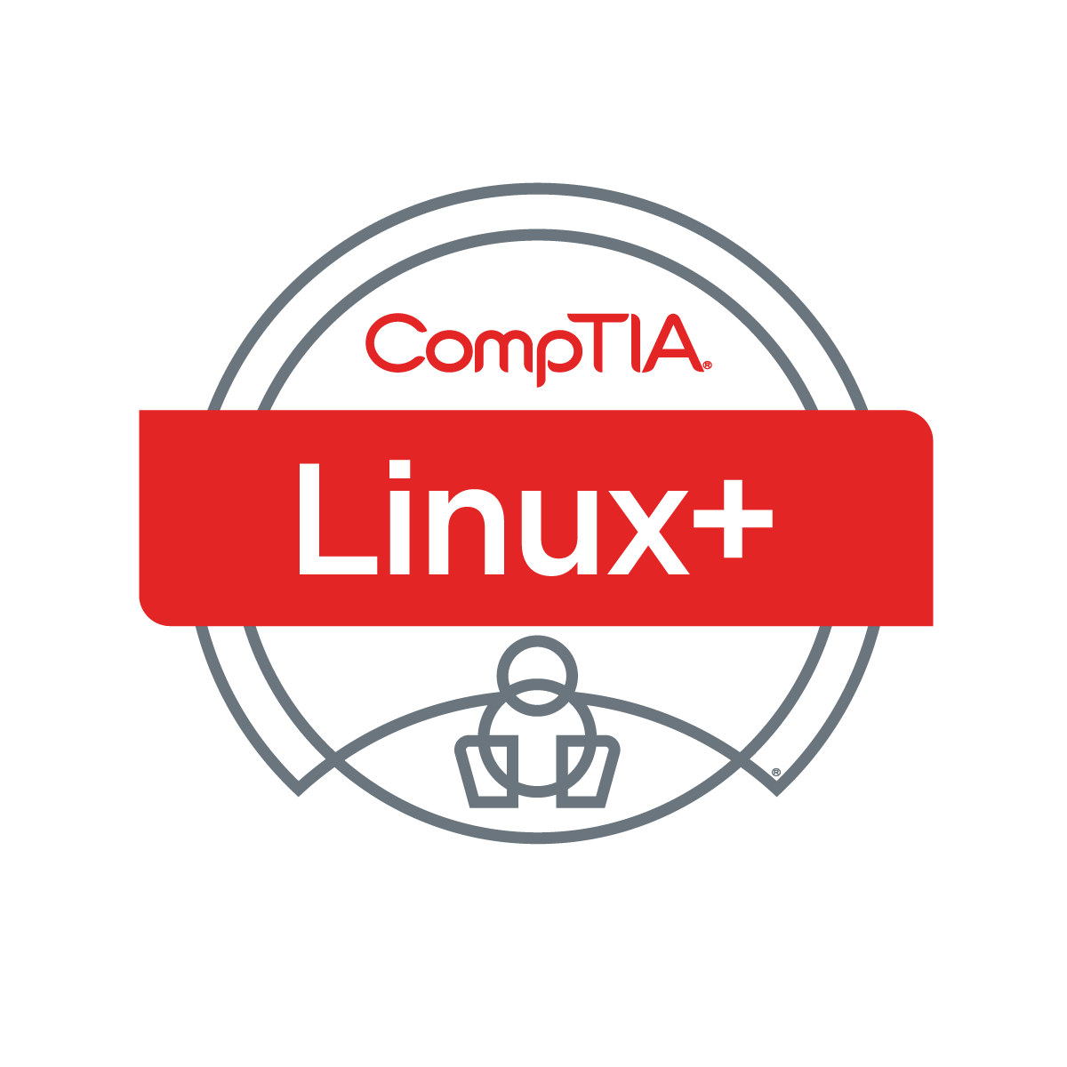

Linux+ XK0-005 TTT Session 7:
Domains 3.1 (Scripts) and 3.2 (Containers)
August 1, 2022
@TeachCompTIA #LinuxPlusTTT
1
Notes:
<number>

Slide 2

Certificate of Attendance
Multimedia
Slides
Bios
ON24 Help
Q&A
Today’s Resources
Group Chat
Survey
1

Slide 3


The CompTIA Instructor Network (CIN) is a worldwide community for instructors who provide CompTIA certification training.
Benefits of being a community member include:
  Communicate and collaborate with CompTIA staff and other instructors.
  Access resources for students to understand the value of getting certified.
  Receive complimentary training and tools from CompTIA to enrich your classroom.
  Become proficient at teaching CompTIA standards.
  Share best practices and resources with each other.
https://cin.comptia.org
Notes:
<number>

Slide 4

Qualifications for Exam Voucher Distribution
Participate in all 12 sessions (live or on-demand) during the date range for the live series (January 18th – March 17th).
Be an active member of CIN through engagement in the community.
Be involved with a CompTIA training partner or an independent instructor teaching CompTIA certifications.
For questions or clarifications talk with your CompTIA Business Development Manager.
Please note as stated in the CompTIA Voucher Terms and Conditions, vouchers are not for resale!

Slide 5



Dates: Wednesday, August 3 - Thursday, August 4, 2022
Partner Summit 2022 is a chance to learn how you can open doors to success for so many, together in partnership with CompTIA.

Slide 6

Dates: Wednesday, August 3 - Thursday, August 4, 2022
CIN Capture the Flag is a friendly competition open to attendees at Partner Summit, that will allow you to try solving real-world challenges that map to CompTIA Security+, A+, and Network+ exam objectives.
Post Challenge Review Join us following the event close for challenge review, Q&A and refreshments!

Slide 7


Instructor:
Lee McWhorter
Chief Technology Officer
Covered 6 LLC | DGP International
lee@covered6.com
Host:
Stephen Schneiter
Instructor Network Program Manager
CompTIA
sschneiter@comptia.org

Slide 8

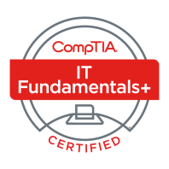




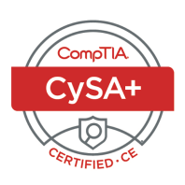

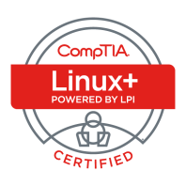
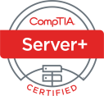
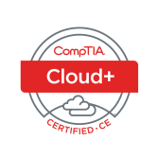
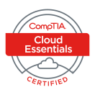
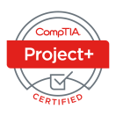






Lee McWhorter
CTO at Covered 6
CompTIA CIN Board member
lee@covered6.com
https://www.linkedin.com/in/lee-mcwhorter/
Twiiter: @tleemcjr
Previous TTT’s:
PenTest+ 001 2018
CASP+ 004 2021
PenTest+ 002 2022

Slide 9

Agenda
Session Objectives
Domain 3.1
Domain 3.2

Slide 10
A+ Core 1 220-1101 TTT Session Outline
Date | Topic
7/11/2022 | Introduction, Linux+ Information, Resources, Domain 1.1
7/12/2022 | Domains 1.2 (Files) and 1.3 (Storage)
7/18/2022 | Domains 1.4 (Services) and 1.5 (Networking)
7/19/2022 | Domains 1.6 (Build) and 1.7 (Configuration)
7/25/2022 | Domains 2.1 (Best Practices) and 2.2 (Identity Management)
7/26/2022 | Domains 2.3 (Firewalls), 2.4 (Remote), and 2.5 (Access Controls)
8/01/2022 | Domains 3.1 (Scripts) and 3.2 (Containers)
8/22/2022 | Domains 3.3 (Git), 3.4 (IaC), and 3.5 (Orchestration)
8/23/2022 | Domains 4.1 (Storage), 4.2 (Network), and 4.3 (Processing)
8/30/2022 | Domains 4.4 (Permissions), 4.5 (Common Problems) & Wrap Up
✓
✓
✓
✓
✓
✓
✓
<number>

Slide 11
Section break
Domain 3.1
<number>

Slide 12
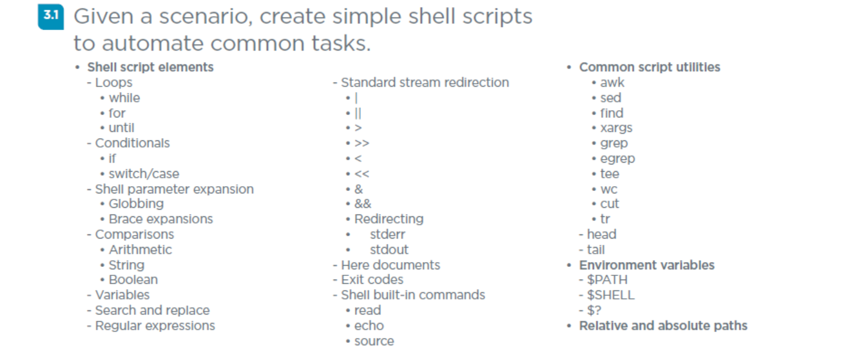
Domain 3.1 - Given a scenario, create simple shell scripts to automate common tasks.
<number>

Slide 13
Domain 3.1 - Given a scenario, create simple shell scripts to automate common tasks.
Shell script elements
- Loops
• while – execute a set of statements as long as a condition is true.
• for – used for iterating over a sequence.
• until – used to execute a block of code until the expression is evaluated to be false.
- Conditionals
• if – executes a statement if a specified condition is true.
• switch/case - used to perform different actions based on different conditions.
<number>

Slide 14
Domain 3.1 - Given a scenario, create simple shell scripts to automate common tasks.
Shell script elements (cont)
- Shell parameter expansion
• Globbing - using wildcard characters to request or evaluate sets of files
• Brace expansions – arbitrary strings may be generated.
bash$ echo a{d,c,b}e
ade ace abe
- Comparisons
• Arithmetic • String • Boolean
- Variables
- Search and replace
- Regular expressions
<number>

Slide 15
Domain 3.1 - Given a scenario, create simple shell scripts to automate common tasks.
- Standard stream redirection
• | (pipe) sends the standard output of one command to another command as standard input.
• || run one command only if another exited unsuccessfully.
• > redirects STDOUT output to a file, overwrite file if exists.
• >> redirects STDOUT and appends output to a file.
• < redirects STDIN.
• << redirects multiple lines of STDIN.
<number>

Slide 16
Domain 3.1 - Given a scenario, create simple shell scripts to automate common tasks.
- Standard stream redirection (cont)
• & runs a command in the background and then launches another.
• && run one command only if another exited successfully.
• Redirecting
• stderr
• stdout
<number>

Slide 17
Domain 3.1 - Given a scenario, create simple shell scripts to automate common tasks.
- Here documents – related to <<
Command << HeredocDelimiter
. . .
. . .
HeredocDelimiter
- Exit codes – 0 for success, 1 for general failure, 130 Crtl-C, etc.
- Shell built-in commands
• read - reads the contents of a line into a variable.
• echo - used to print the text or string to the shell or output file.
• source - reads and executes the file content in the current shell.
<number>

Slide 18
Domain 3.1 - Given a scenario, create simple shell scripts to automate common tasks.
Common script utilities
• awk - used for pattern scanning and processing.
• sed - parses and transforms text, using a simple, compact programming language.
• find - locates files based on some user-specified criteria.
• xargs - used to build and execute commands from standard input.
• grep - searching plain-text data sets for lines that match a regular expression.
• egrep - searches for a text pattern, using extended regular expression.
<number>

Slide 19
Domain 3.1 - Given a scenario, create simple shell scripts to automate common tasks.
Common script utilities (cont)
• tee - reads standard input and writes it to both standard output and one or more files.
• wc – read STDIN or files, counts newlines, words, bytes.
• cut - used to extract sections from each line of input, usually from a file.
• tr - (translate) replacing or removing specific characters in its input data set.
- head – prints data from the start of a file or piped data.
- tail – prints data from the end of a file or piped data.
<number>

Slide 20
Domain 3.1 - Given a scenario, create simple shell scripts to automate common tasks.
Environment variables
- $PATH - tells a Linux system where to look for certain programs.
- $SHELL – shows what Shell is running.
- $? - return value of the last executed command.
Relative and absolute paths
<number>

Slide 21

PRogramming
<number>

Slide 22
Programming
There are basically two ways to handle this sub domain:
  Assume or require previous basic programming experience and then teach to the specific objectives covered by Exam.
  Teach basic programming concepts, introduce all four of the possible languages, and cover the objectives from the Exam.
I have chosen the second option for a few of reasons:
  Around 25% of our class does not have previous programming experience.
  I simply believe this is the better approach.
  I have come up with what I hope is a unique way to present this material that I think you will find useful, educational and hopefully even fun.
<number>

Slide 23
Programming
What is programming?
  the act of instructing computers , via a sequence of instructions called a program or script, to perform tasks and solve problems.
How are programs written?
  Machine code was used for early programs, written in the instruction set of the particular machine, often directly in binary. Assembly languages were then developed that let the programmer specify instruction in a text format with abbreviations for operations and meaningful names for interacting with stored values. However, this was limited by the fact that any two machines with different instruction sets also had different versions of machine code or Assembly language.
<number>

Slide 24
VIDEO
Minecraft CPU and programming video
https://www.youtube.com/watch?v=yuMlhKI-pzE
<number>

Slide 25
Programming
How are programs written?
  Today most programs are writing in a Higher-level language that allow the programmer to write programs that are more abstract, and less bound to the underlying hardware. Early examples of higher-level languages include Fortran (derived from Formula Translation), COBOL (acronym for Common Business-Oriented Language), Lisp (derives from LISt Processor), and BASIC (Beginner's All-Purpose Symbolic Instruction Code).
  Most programs are simply text files (or a collection of related text files) and we have developed very powerful text or code editors to help us write programs. Today’s editors and integrated development environments (IDE) provide for error and syntax checking, and other features such as color coding to help make programming easier and to help prevent mistakes and bugs.
<number>

Slide 26
Programming
Scripting and Programming 101
  Don’t Panic! ☺
  Scripts are just short programs that automate the execution of tasks that could alternatively be executed one-by-one at the command line.
  All programming languages, including scripting languages, have a collection of commands or keywords and a set of rules on how to use them. This set of rules for writing a program or script in any given language is called the Syntax. Once you learn the keywords and Syntax, you can use an editor to write your code.
    Interpreted languages (each line of code is run or interpreted line by line)
    Compiled languages (code is compiled to convert it into executable binary code)
<number>

Slide 27
Programming
Scripting and Programming 101
  Programming languages also support variables within their Syntax. Variables in programming are simply named placeholders for some other value. The variable name is used in code to reference the stored value. For example, a website which requires a login might store the user name in a variable called $UserName.
  Be aware that most languages have rules for naming a variable, much like file naming rules for an operating system, where certain special characters are not allowed. It is good practice to use short, descriptive names and no spaces.
  An important concept related to variables is Scope, the visibility of variables a script or program can see or use. Most languages have both global and local scopes, so if a variable is not working as expected, it could be a scope issue.
<number>

Slide 28
Programming
Scripting and Programming 101
  For a script or program to be more than just a list of individual commands, the languages support flow control functions such as IF-statements and Loops.
  IF-statements allow a script or program to produce different results based on particular criteria. Most languages support more complex constructs using ElseIF and Else as well. Think: IF this, do that…
  While there are different types of Loops, these structures allow a script or program to repeat steps as needed based upon certain criteria. There are a number of common loop types, including While, Do, and For.
  To support conditional criteria, languages support Operators such as the standard math (+, -, *, /), logical (<, >, =, ==), and others. The plus sign has two meanings, addition on numbers or concatenation on strings.
<number>

Slide 29
Programming
Scripting and Programming 101
  Another important part of programming is the concept of Functions, or scripts within scripts.
  Functions allow a programmer to group together a number of commands and give that group a name. These are particularly useful if there are certain tasks which need to be performed several times. Instead of writing out the same code over and over again throughout the program, functions allow the code to be written once, then called via the function name every time it is needed.
  Functions also make it easier to re-use code and share this code and functionality across multiple scripts or programs.
<number>

Slide 30
Programming
Scripting and Programming 101
  Of the types of programming, Procedural & Object-Oriented are most common.
  Procedural programming is a programming paradigm, based upon the concept of the procedure call. Procedures (often also called routines, subroutines, or functions) are simply a collection of computational steps to be carried out. Any given procedure or function may be called at any point in a program's execution. Generally, procedural programs or scripts are organized in a fairly linear way, though flow control statements and functions can change the order of execution.
  Object-oriented programming (OOP) is a programming paradigm based on the concept of "objects", which may contain data, in the form of fields, properties or attributes; and code, in the form of procedures, often known as methods.
<number>

Slide 31
Programming
Components of Procedural Programs & Languages
Procedural
  Syntax
  Key or Reserved words
  Variables
  Functions
Components of Objected Oriented Programs & Languages
Object Oriented
  Syntax
  Key or Reserved words
  Fields, properties, or attributes
  Methods
<number>

Slide 32
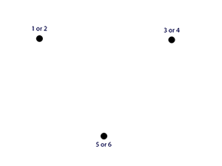
Programming
Fun example: Chaos Theory experiment in BASIC
  Put 3 dots in shape of a triangle on paper
  Label as shown
  Roll a six-side dice to determine start
  Then continue rolling the die:
Rule is: move halfway to next indicated
dot based on die roll and then
place a new dot on the paper.
  Rinse and repeat
<number>

Slide 33

Chat Question
What do you think will happen if we write and run a program to do the Chaos Theory experiment? Will it fill in the triangle or ?
Answer in the chat window and let’s share.
This photo is for placement only

Slide 34
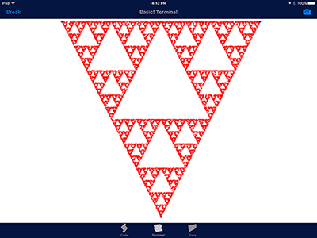
Programming
<number>

Slide 35
Programming
R = 3
X = 200
Y = 10
BGCOLOR 255,255,255
COLOR 0,0,255
CIRCLE 200,10,R
CIRCLE 840,10,R
CIRCLE 520,640,R
COLOR 255,0,0
R = 1
LOOP:
RN = RND
IF RN < 0.3333 THEN
DX = X - 200
DY = Y – 10
XMODE = 1
YMODE = 1
ELSE
IF RN < 0.6666 THEN
DX = 840 - X
DY = Y - 10
YMODE = 1
ELSE
IF X > 520 THEN
DX = X -520
DY = 640 - Y
XMODE = 1
ELSE
DX = 520 - X
DY = 640 - Y
END IF
END IF
END IF
IF XMODE = 1 THEN
X = X - (DX/2)
ELSE
X = X + (DX/2)
END IF
IF YMODE = 1 THEN
Y = Y - (DY/2)
ELSE
Y = Y + (DY/2)
END IF
POINT X,Y
XMODE = 0
YMODE = O
GOTO LOOP
<number>

Slide 36
Programming
BASH (Bourne-again shell) is a shell and command language written by Brian Fox for the GNU Project as a free software replacement for the Bourne shell. BASH is found on Unix (this includes Macs) and Linux computers and is usually the default shell on such systems. It also can be added to Windows in a number of ways.
BASH (and other) shell scripts are simply text files, often with the .sh file extension though this is not technically required.
One Note: For BASH (or other) shells scripts to run, they must be given the execute permission, usually with a command like: chmod 755 script.sh
<number>

Slide 37
Programming
PowerShell (originally known as Windows PowerShell) is a task automation and configuration management framework from Microsoft, consisting of a command-line shell and associated scripting language. PowerShell was made open-source and cross-platform in 2016 with the release of PowerShell Core. In PowerShell, tasks are generally performed by cmdlets (pronounced command-lets) and a series of cmdlets may be combined into scripts.
One Note: On Windows by default, PowerShell scripts are restricted. To run scripts, either change this restriction globally (not recommended) or make a custom PowerShell Shortcut using this command line:
powershell.exe -Execution Policy Unrestricted
<number>

Slide 38
Programming
Python is an interpreted high-level programming language for general-purpose programming which was created by Guido van Rossum in 1991. Python has a design philosophy that emphasizes code readability, using significant whitespace. It provides constructs that enable clear programming for both small and large scale projects.
Python features a dynamic type system and automatic memory management. It supports multiple programming paradigms including, but not limited to, object-oriented and procedural, and has a large and comprehensive standard library.
<number>

Slide 39
Programming
Ruby is a dynamic, interpreted, reflective, object-oriented, general-purpose programming language. It was designed and developed in the 1990s by Yukihiro "Matz" Matsumoto of Japan.
According to the Yukihiro, Ruby was influenced by Perl, Smalltalk, Eiffel, Ada, and Lisp. It supports multiple programming paradigms, including functional, object-oriented, and imperative.
Ruby has gained in prominence over the years, especially given the popularity of Ruby on Rails (or Rails), which is a server-side web application framework written in Ruby.
See: https://poignant.guide/
<number>

Slide 40
Programming
As we cover the basics in each language, compare and contrast them, and examine the Exam objectives, I will provide examples in all four languages of each concept. Most times these are identical examples, but not always.
Code snippets will be presented using the template to follow, which is divided into four areas, one for each language covered by the objectives.
I would advise most to pick one area/language and focus mainly on those.
Let’s start where every programming class starts – Hello World! ☺
<number>

Slide 41
Hello World
BASH
#!/bin/bash
#Hello World Bash Script
echo "Hello World!"
PowerShell
#Hello World PowerShell Script
echo "Hello World!"
Python
#Hello World Python Script
print (“Hello World!”)
Ruby
#!/usr/bin/ruby
#Hello World Ruby Script
puts "Hello World!"
<number>

Slide 42
Variables
BASH
#BASH variable declaration
SalesTaxRate = .0825
Note: Would use $SalesTaxRate to reference
PowerShell
#PowerShell variable declaration
$SalesTaxRate = .0825
Python
#Python variable declaration
SalesTaxRate = .0825
Ruby
#Ruby local variable declaration
_SalesTaxRate = .0825
Note: Ruby has many types of variables including Global ($), Local ( _ or lower case), Instance (@) and Class (@@)
<number>

Slide 43
Constants
BASH
#BASH constant declaration
readonly SalesTaxRate = .0825
PowerShell
#PowerShell constant declaration
Set-Variable SalesTaxRate -option Constant -value .0825
Python
There is no constant in Python core, though some people have created their own functions for this.
Ruby
#Ruby constant declaration
SalesTaxRate = .0825
Note: In Ruby a constant begins with a Capital letter.
<number>

Slide 44
Arrays I (Basic or Indexed Arrays)
BASH
#BASH array declaration
tempArray = (value1, value2, value3)
PowerShell
#PowerShell array declaration
$tempArray = @(value1, value2, value3);
Python - List
#Python list (array) declaration
tempArray = [value1, value2, value3]
Ruby
#Ruby array declaration
tempArray = [value1, value2, value3]
<number>

Slide 45
Arrays II (Accessing an Array item, note zero offset)
BASH
tempArray = (value1, value2, value3)
echo {$tempArray[0]}
Would output value1
PowerShell
$tempArray = @(val1, val2, val3);
echo $tempArray[1]
Would output val2
Python - List
tempArray = [value1, value2, value3]
print (tempArray[2])
Would output value3
Ruby
tempArray = [value1, value2, value3]
puts tempArray[0]
Would output value1
<number>

Slide 46
Arrays III (Named or Associative Arrays)
BASH
declare -A MyArray
MyArray[foo]=bar
echo ${MyArray[foo]}
Would output bar
PowerShell
$MyArray = @{}
$MyArray.foo = 'bar‘
echo $MyArray.foo
Would output bar
Python - Dictionary
MyArray = [{“foo”: “bar”}]
print (MyArray[“foo”])
Would output bar
Ruby
_MyArray = {“foo” => bar”}
puts _MyArray[“foo”]
Would output bar
<number>

Slide 47
IF Statements
BASH
if [$TotalSales -gt $BonusThreshold] then
# Code to calculate bonus here
fi
PowerShell
If ($TotalSales -gt $BonusThreshold) { # Code to calculate bonus here
}
Python
if TotalSales > BonusThreshold:
# Code to calculate bonus here
Ruby
if _TotalSales > _BonusThreshold
# Code to calculate bonus here
end
<number>

Slide 48
IF / ElseIf (or Elsif or Elif)/ Else Statements
BASH
if [<condition>] then
# Code here
elif [<condition>] then
# Code here
else
# Code here
fi
PowerShell
if (<condition>) {
# Code here
} elseif (<condition>) {
#Code here
} else {
#Code here
}
Python
if <condition>:
# Code here
elif <condition>:
# Code here
else:
# Code here
Ruby
if <condition>
# Code here
elsif <condition>
# Code here
else
# Code here
end
<number>

Slide 49
Loops
BASH – While Loop
while [$this -eq $that]
do
# commands
done
PowerShell – Do While Loop
Do {
# commands
} While ($this -eq $that)
Python – For Loop
tempArray = [value1, value2, value3]
for x in tempArray:
print (x)
Ruby – For Loop
tempArray = [value1, value2, value3]
for x in tempArray
puts x
end
<number>

Slide 50
Comparison Operators
BASH
For integers Bash uses: -eq (equal), -ne (not equal), -gt (greater than), -ge (greater or equal), -lt (less than), and -le (less or equal)
For strings Bash uses: = or == (equals), != (not equal), > (greater), and < (less)
PowerShell
PowerShell uses: eq (equals), ne (not equal), gt (greater than), ge (greater or equal), lt (less than), and le (less or equal)
Python
Python uses: == (equal), != or <> (not equal), > (greater than), >= (greater or equal), < (less than), and <= (less than or equal)
Ruby
Ruby uses: == (equal), === (equal in case statements), != (not equal), > (greater than), >= (greater or equal), < (less than), and <= (less than or equal)
<number>

Slide 51
String Operations
BASH
testString = “Test String”
echo ${#testString} # Returns 11
echo ${testString:0:4} # Returns Test
echo ${testString/Test/Testing} # Returns Testing String
PowerShell
$testString = “Test String”
echo $testString + “2” # Returns Test String2
$testString.Substring(0,4) # Returns Test
Python
testString = “Test String”
print testString.uppercase #Returns TEST STRING
print testString.replace(“Test”, “Testing”)
#Returns Testing String
Ruby
testString = “Test String”
print testString.length # Returns 11
print testString.upcase # Returns TEST STRING
<number>

Slide 52
I/O (Input/Output)
BASH
echo “Please enter your name”
read userName
echo “Hello $username!”
PowerShell
$userName = Read-Host -Prompt 'Please enter your name‘
Echo “Hello “ + $username
Python
userName = input(‘Please enter your name ')
print (“Hello “, userName)
Ruby
puts “Please enter your name”
userName = gets
puts “Hello “ + userName
<number>

Slide 53
I/O Continued
BASH
tempFile=$(<test.txt)
echo "$tempFile“
Bash can make use of system resources and utilities to access remote files.
PowerShell
$tempFile = Get-Content - Path C:\test.txt
Can use Where-Object cdmlet to search
PowerShell has numerous networking & TCP cmdlets like Get-NetIPAddress
Python
tempFile = open(‘test.txt', 'w')
The w in this example stands for write, there is also read (r) and read/write (r+)
tempFile = open(‘//Host/share/test.txt', 'w')
Ruby
File.open(‘test.txt’)
File.open(test.txt, 'w') { |file| file.write(“test text") }
Use open-uri Library to access via URLs.
<number>

Slide 54
Error handling
BASH
cd $some_directory
if [ "$?" = "0" ]; then
rm *
Else
echo "Cannot change directory!" 1>&2 exit
fi
PowerShell
Function Do-Something {
[CmdletBinding()]
param()
try {
if (-not (Test-Path –Path 'C:\test.txt')) {
Write-Host 'The file does not exist'
}
Write-Host 'The file does exist'
} catch {
}
}
Python
try:
print 1/0
except ZeroDivisionError:
print "You can't divide by zero!"
Ruby
def raise_and_rescue
begin
puts 'I am before the raise.‘
raise 'An error has occured.‘
puts 'I am after the raise.‘
rescue
puts 'I am rescued.‘
end
puts 'I am after the begin block.‘
end
raise_and_rescue
<number>

Slide 55
Section break
Domain 3.2
<number>

Slide 56
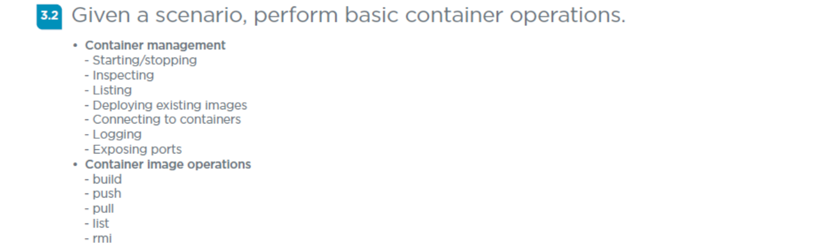
Domain 3.2 - Given a scenario, perform basic container operations.
<number>

Slide 57
Domain 3.2 - Given a scenario, perform basic container operations.
Container management
- Starting/stopping – docker run / docker stop
- Inspecting – docker inspect
- Listing – docker images
- Deploying existing images – Docker supports Azure and AWS
- Connecting to containers – docker exec
- Logging – docker logs
- Exposing ports – EXPOSE instruction in Dockerfile, -expose flag a runtime, or the -p or -P flags with docker run.
<number>

Slide 58
Domain 3.2 - Given a scenario, perform basic container operations.
Container image operations
- build – used to build a docker container from a Dockerfile.
- push – docker push places a container in a repo like hub.docker.com
- pull – docker pull retrieves a container from a repo.
- list – docker images list are containers on a system
- rmi – docker rmi will remove a container by name or ID.
<number>

Slide 59
For A Couple Weeks From Now!
…
NOTE: No class tomorrow! I’m heading to Chicago and Vegas!
Next class is Monday 8/22/22 and we will cover:
Domain 3.3
Domain 3.4
Domain 3.5
<number>

Slide 60

Discussion time: Please type your questions in chat
Questions over content.
Share you experience.
What would you like to see
different moving forward?
Let’s keep the conversation going in the CompTIA Instructor Forum: https://cin.comptia.org
<number>

