Slide 1
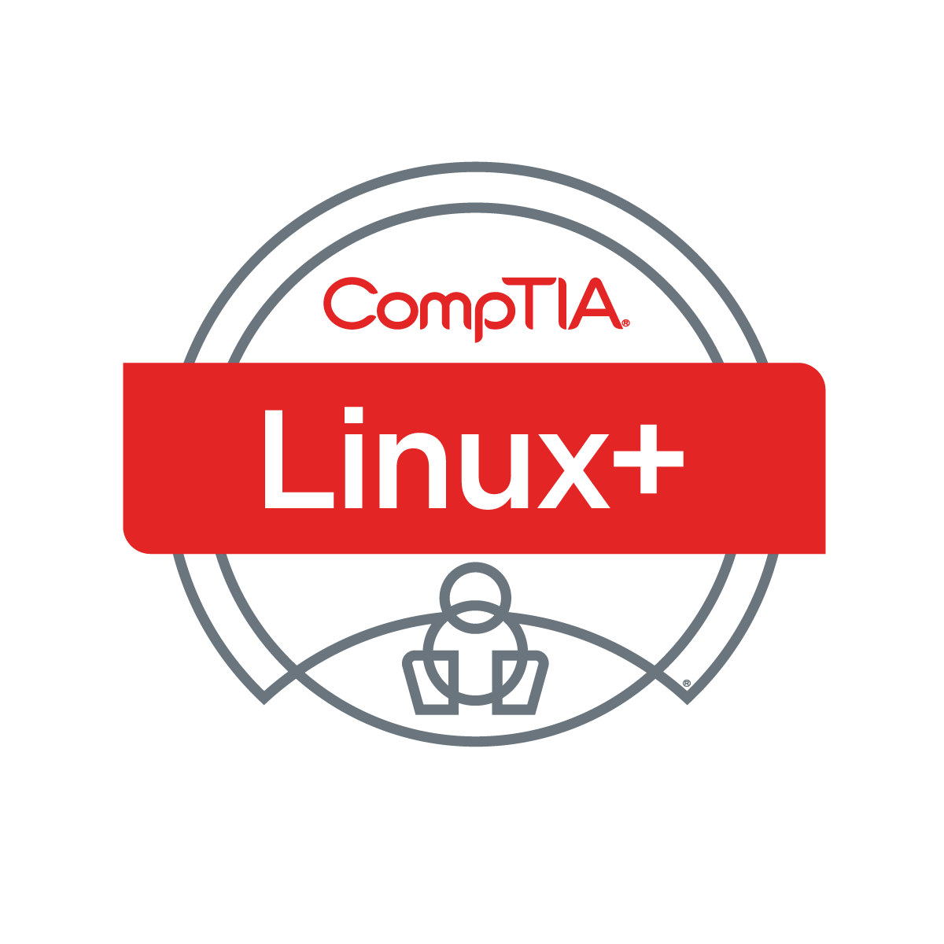

Linux+ XK0-005 TTT Session 8:
Domains 3.3 (Git), 3.4 (IaC), and 3.5 (Orchestration)
August 22, 2022
@TeachCompTIA #LinuxPlusTTT
1
Notes:
<number>

Slide 2

Certificate of Attendance
Multimedia
Slides
Bios
ON24 Help
Q&A
Today’s Resources
Group Chat
Survey
1

Slide 3
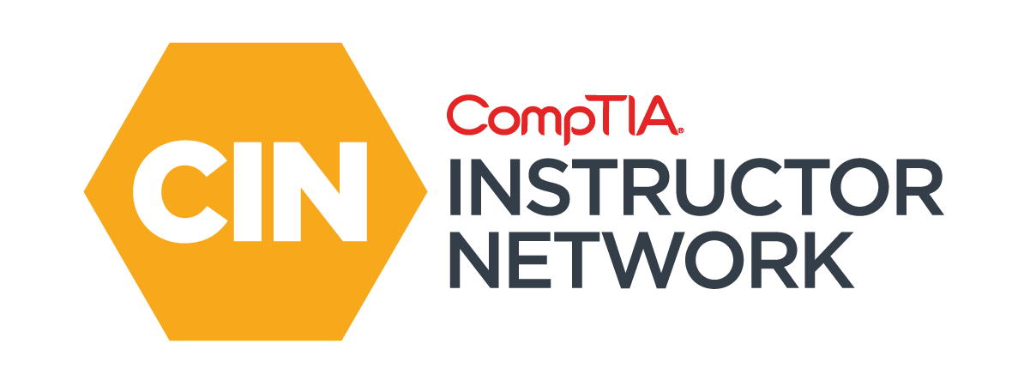
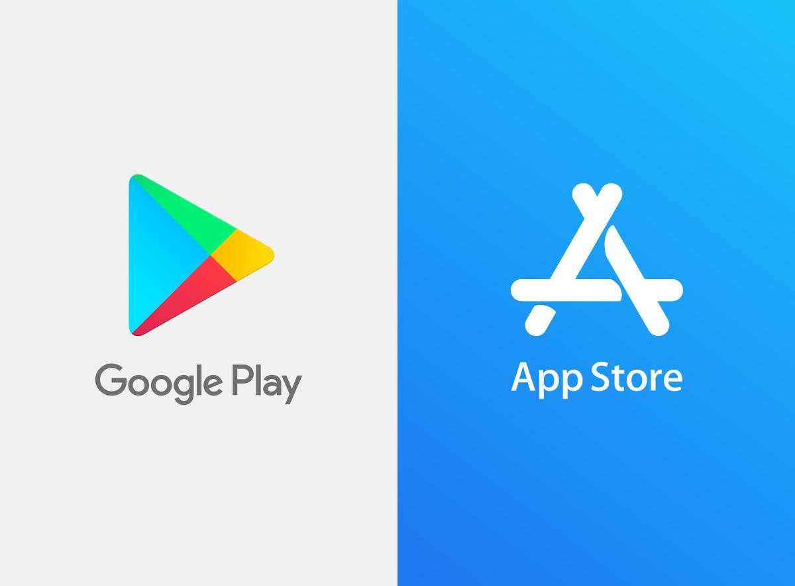
The CompTIA Instructor Network (CIN) is a worldwide community for instructors who provide CompTIA certification training.
Benefits of being a community member include:
  Communicate and collaborate with CompTIA staff and other instructors.
  Access resources for students to understand the value of getting certified.
  Receive complimentary training and tools from CompTIA to enrich your classroom.
  Become proficient at teaching CompTIA standards.
  Share best practices and resources with each other.
https://cin.comptia.org
Notes:
<number>

Slide 4

Qualifications for Exam Voucher Distribution
Participate in all 12 sessions (live or on-demand) during the date range for the live series (January 18th – March 17th).
Be an active member of CIN through engagement in the community.
Be involved with a CompTIA training partner or an independent instructor teaching CompTIA certifications.
For questions or clarifications talk with your CompTIA Business Development Manager.

Slide 5

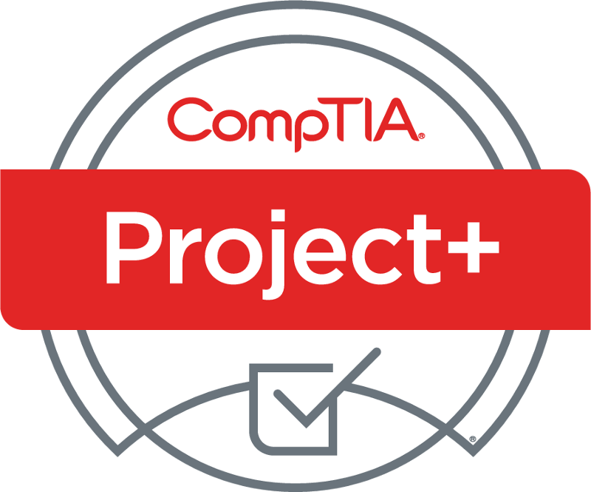

Project+ PK0-005 Sneak Peek
What: two-hour webinar investigating updated certification
When: Wednesday, September 7, 11:00 AM CST
Where: ON24
Who: Rick Butler, Intellitec College
Registr: https://bit.ly/CINSP-ProjectPlus2022 OR Scan QR Code

Slide 6


Instructor:
Lee McWhorter
Chief Technology Officer
Covered 6 LLC | DGP International
lee@covered6.com
Host:
Stephen Schneiter
Instructor Network Program Manager
CompTIA
sschneiter@comptia.org

Slide 7

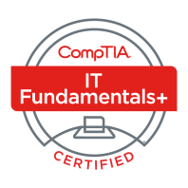
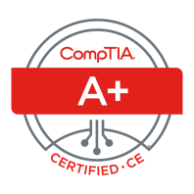
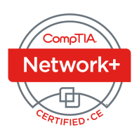

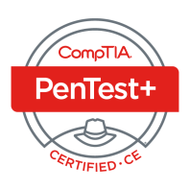
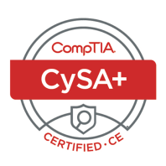
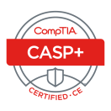
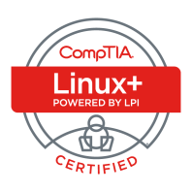
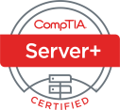
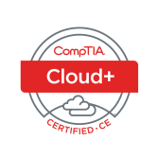
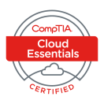
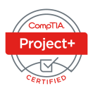
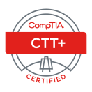



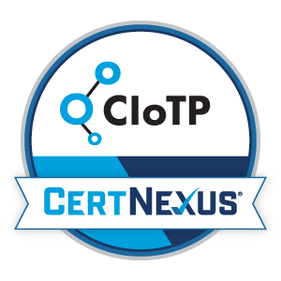
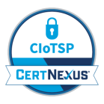
Lee McWhorter
CTO at Covered 6
CompTIA CIN Board member
lee@covered6.com
https://www.linkedin.com/in/lee-mcwhorter/
Twiiter: @tleemcjr
Previous TTT’s:
PenTest+ 001 2018
CASP+ 004 2021
PenTest+ 002 2022

Slide 8

Agenda
Session Objectives
Domain 3.3
Domain 3.4
Domain 3.5

Slide 9
A+ Core 1 220-1101 TTT Session Outline
Date | Topic
7/11/2022 | Introduction, Linux+ Information, Resources, Domain 1.1
7/12/2022 | Domains 1.2 (Files) and 1.3 (Storage)
7/18/2022 | Domains 1.4 (Services) and 1.5 (Networking)
7/19/2022 | Domains 1.6 (Build) and 1.7 (Configuration)
7/25/2022 | Domains 2.1 (Best Practices) and 2.2 (Identity Management)
7/26/2022 | Domains 2.3 (Firewalls), 2.4 (Remote), and 2.5 (Access Controls)
8/01/2022 | Domains 3.1 (Scripts) and 3.2 (Containers)
8/22/2022 | Domains 3.3 (Git), 3.4 (IaC), and 3.5 (Orchestration)
8/23/2022 | Domains 4.1 (Storage), 4.2 (Network), and 4.3 (Processing)
8/30/2022 | Domains 4.4 (Permissions), 4.5 (Common Problems) & Wrap Up
✓
✓
✓
✓
✓
✓
✓
✓
<number>

Slide 10
Section break
Pop Quiz!
<number>

Slide 11
POLL
In what folder/directory are configuration files usually stored in on Linux system?
/lib
/boot
/etc
/usr
<number>

Slide 12
POLL - Answer
In what folder/directory are configuration files usually stored in on Linux system?
/lib
/boot
/etc
/usr
<number>

Slide 13
POLL
Which boot loader is covered in the current Linux+ exam objectives?
LILO
Grub2
Loadlin
Grub
<number>

Slide 14
POLL - Answer
Which boot loader is covered in the current Linux+ exam objectives?
LILO
Grub2
Loadlin
Grub
<number>

Slide 15
POLL
Which of the following Linux utilities’ primary function is to display free disk space?
du
lsdisk
df
fdisk
<number>

Slide 16
POLL - Answer
Which of the following Linux utilities’ primary function is to display free disk space?
du
lsdisk
df
fdisk
<number>

Slide 17
POLL
Which of the following Linux utilities displays running process for either a user or the whole system?
lsproc
ps
top
None of the above
<number>

Slide 18
POLL - Answer
Which of the following Linux utilities displays running process for either a user or the whole system?
lsproc
ps
top
None of the above
<number>

Slide 19
POLL
Which is the more current Linux utility for display IP address and related information?
ifconfig
netconfig
ipconfig
ip
<number>

Slide 20
POLL - Answer
Which is the more current Linux utility for display IP address and related information?
ifconfig
netconfig
ipconfig
ip
<number>

Slide 21
POLL
Which of the following are Linux firewall technologies?
firewalld
iptables
nftables
UFW
All of the above
None of the above
<number>

Slide 22
POLL - Answer
Which of the following are Linux firewall technologies?
firewalld
iptables
nftables
UFW
All of the above
None of the above
<number>

Slide 23
POLL
Which of the following files is used to configure SSH clients globally on a Linux system?
/etc/ssh/sshd_config
/etc/ssh/ssh_config
/etc/sshd/ssh_config
~/.ssh/config
All of the above
None of the above
<number>

Slide 24
POLL - Answer
Which of the following files is used to configure SSH clients globally on a Linux system?
/etc/ssh/sshd_config
/etc/ssh/ssh_config
/etc/sshd/ssh_config
~/.ssh/config
All of the above
None of the above
<number>

Slide 25
POLL
In which folder does the sudoers file reside?
/home
/lib
/etc
/boot
/root
<number>

Slide 26
POLL - Answer
In which folder does the sudoers file reside?
/home
/lib
/etc
/boot
/root
<number>

Slide 27
POLL
Which of the following commands is used to change file permissions?
chown
chgrp
chcon
chmod
None of the above
<number>

Slide 28
POLL - Answer
Which of the following commands is used to change file permissions?
chown
chgrp
chcon
chmod
None of the above
<number>

Slide 29
POLL
What do the symbols >> do when used in redirection?
Redirect STDIN
Redirect STDOUT and overwrite a file
Redirect STDOUT and append to a file
Redirects mulitple lines to STDOUT
None of the above
<number>

Slide 30
POLL - Answer
What do the symbols >> do when used in redirection?
Redirect STDIN
Redirect STDOUT and overwrite a file
Redirect STDOUT and append to a file
Redirects mulitple lines to STDOUT
None of the above
<number>

Slide 31
POLL
What does the symbol # do when used in programming?
Indicates a single line comment
Indicates a loop operation
Indicates a comparison operator
Indicates a variable or constant
None of the above
<number>

Slide 32
POLL - Answer
What does the symbol # do when used in programming?
Indicates a single line comment
Indicates a loop operation
Indicates a comparison operator
Indicates a variable or constant
None of the above
<number>

Slide 33
Section break
Domain 3.3
<number>

Slide 34
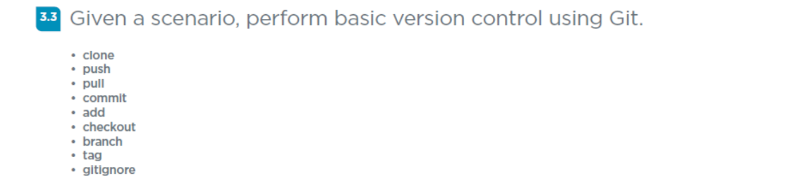
Domain 3.3 - Given a scenario, perform basic version control using Git.
<number>

Slide 35
Domain 3.3 - Given a scenario, perform basic version control using Git.
• clone – used to make a copy (or clone) of existing repo in new location
• push – used to send (or push) local commits to the remote repo
• pull – used to fetch (or pull) content from remote repo and update local
• commit – used to save changes to a local repo
• add – used before commit to add changes to staging area
• checkout – lets a user navigate between branches in a repo
• branch – lets a user create, list, rename and delete branches
• tag – lets a user add references to specific points in Git history
• gitignore – not a command, a .gitignore file is created, edited and committed
<number>

Slide 36
Section break
Domain 3.4
<number>

Slide 37
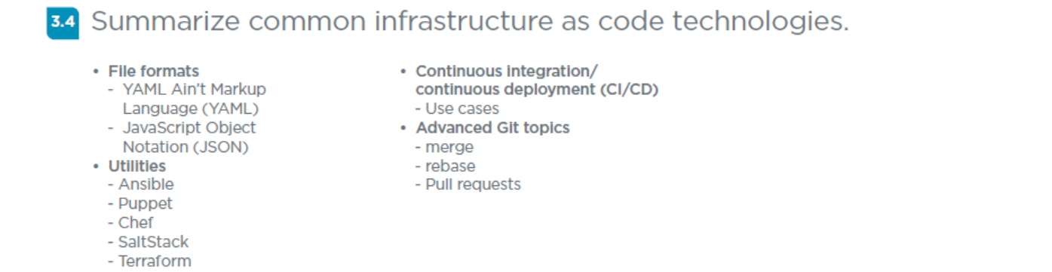
Domain 3.4 - Summarize common infrastructure as code technologies.
<number>

Slide 38
Domain 3.4 - Summarize common infrastructure as code technologies.
File formats
- YAML Ain’t Markup Language (YAML) - is a human-readable data-serialization language that is used for configuration files and with applications when data is being stored or transmitted.
- JavaScript Object Notation (JSON) - is an open standard file and data interchange format that uses human-readable text to store and transmit data objects consisting of attribute–value pairs.
<number>

Slide 39
Domain 3.4 - Summarize common infrastructure as code technologies.
Utilities
- Ansible - is an open-source suite of software tools (including software provisioning, configuration management, and application deployment functionality) that enables infrastructure as code.
- Puppet - is a software configuration management tool which uses its own language to describe system configuration.
- Chef - is a configuration management tool that uses pure-Ruby, domain-specific language for writing system configuration "recipes".
<number>

Slide 40
Domain 3.4 - Summarize common infrastructure as code technologies.
Utilities - continued
- SaltStack - Python-based, open-source software for event-driven IT automation, remote task execution, and configuration management.
- Terraform - another IaC tool which uses Hashicorp Configuration Language or JSON.
<number>

Slide 41
Domain 3.4 - Summarize common infrastructure as code technologies.
Continuous integration/continuous deployment (CI/CD)
- Use cases - to frequently deliver apps to customers by introducing automation into the stages of app development.
Advanced Git topics
- merge
- rebase
The official Git manual states that rebase “reapplies commits on top of another base branch,” whereas merge “joins two or more development histories together.” The key difference between merge and rebase is that while merge preserves history as it happened, rebase rewrites it.
- Pull requests – where contributor asks for a review and merge of code
<number>

Slide 42
Section break
Domain 3.5
<number>

Slide 43
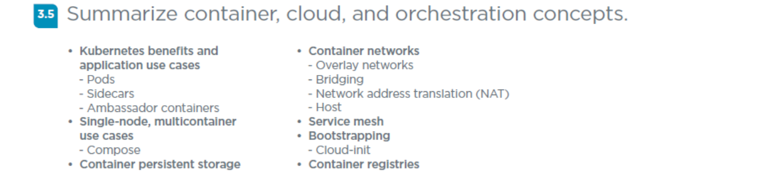
Domain 3.5 - Summarize container, cloud, and orchestration concepts.
<number>

Slide 44
Domain 3.5 - Summarize container, cloud, and orchestration concepts.
Kubernetes benefits and application use cases
- Pods - the smallest deployable units of computing that you can create and manage
- Sidecars - containers that are needed to run alongside the main container.
- Ambassador containers - a sidecar container that is in charge of proxying connections from the application container to other services.
<number>

Slide 45
Domain 3.5 - Summarize container, cloud, and orchestration concepts.
Kubernetes Single-node, multicontainer use cases
Single Cluster
Pros: Easy Admin, Cheap, Efficient use of resources
Cons: Too many users, Security
Multiple Clusters
Pros: Improves scalability, app isolation, effective management, better security
Cons: Difficult Admin, Cost, Less optimal use of resources
- Compose – Docker Compose
Kompose is a conversion tool for Docker Compose to container orchestrators such as Kubernetes
<number>

Slide 46
Domain 3.5 - Summarize container, cloud, and orchestration concepts.
Container persistent storage – Containers by default have limited to no persistent storage, if needed it has to be configured.
Container networks
- Overlay networks - an overlay network simply involves another layer of encapsulation for network traffic.
- Bridging
- Network address translation (NAT)
- Host
<number>

Slide 47
Domain 3.5 - Summarize container, cloud, and orchestration concepts.
Service mesh - enables services to detect each other and communicate.
Bootstrapping - getting the initial cluster up and running, there are mulitple ways to do this in Kubernetes.
- Cloud-init - a utility for instance initialization.
Container registries - a repository, or collection of repositories, used to store container images for Kubernetes.
<number>

Slide 48
For Next Class
Remember, we have class tomorrow and then the last class will be a week from this Tuesday.
Next class is Tuesday 8/23/22 and we will cover:
Domain 4.1
Domain 4.2
Domain 4.3
<number>

Slide 49

Discussion time: Please type your questions in chat
Questions over content.
Share you experience.
What would you like to see
different moving forward?
Let’s keep the conversation going in the CompTIA Instructor Forum: https://cin.comptia.org
<number>

