Slide 1


Linux+ XK0-005 TTT Session 10:
Domains 4.4 (Permissions), 4.5 (Common Problems) & Wrap Up
August 30, 2022
@TeachCompTIA #LinuxPlusTTT
1
Notes:
<number>

Slide 2

Certificate of Attendance
Multimedia
Slides
Bios
ON24 Help
Q&A
Today’s Resources
Group Chat
Survey
1

Slide 3
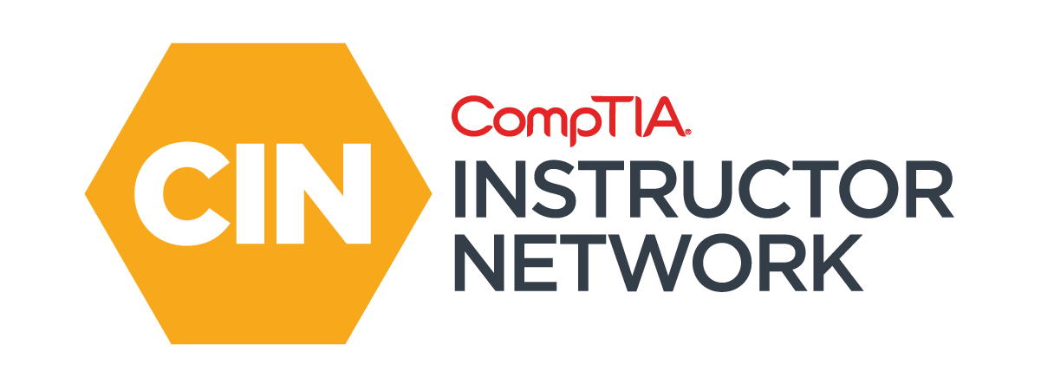

The CompTIA Instructor Network (CIN) is a worldwide community for instructors who provide CompTIA certification training.
Benefits of being a community member include:
  Communicate and collaborate with CompTIA staff and other instructors.
  Access resources for students to understand the value of getting certified.
  Receive complimentary training and tools from CompTIA to enrich your classroom.
  Become proficient at teaching CompTIA standards.
  Share best practices and resources with each other.
https://cin.comptia.org
Notes:
<number>

Slide 4

Qualifications for Exam Voucher Distribution
Participate in all 12 sessions (live or on-demand) during the date range for the live series (January 18th – March 17th).
Be an active member of CIN through engagement in the community.
Be involved with a CompTIA training partner or an independent instructor teaching CompTIA certifications.
For questions or clarifications talk with your CompTIA Business Development Manager.

Slide 5

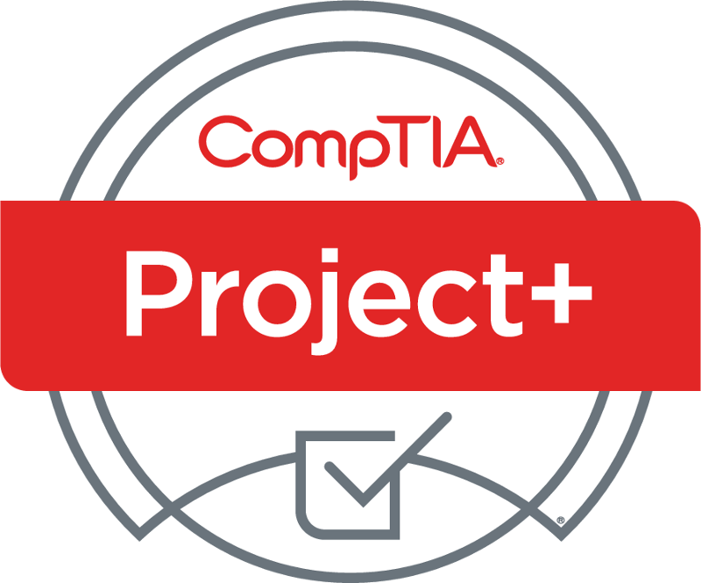

Project+ PK0-005 Sneak Peek
What: two-hour webinar investigating updated certification
When: Wednesday, September 7, 11:00 AM CST
Where: ON24
Who: Rick Butler, Intellitec College
Registr: https://bit.ly/CINSP-ProjectPlus2022 OR Scan QR Code

Slide 6


Instructor:
Lee McWhorter
Chief Technology Officer
Covered 6 LLC | DGP International
lee@covered6.com
Host:
Stephen Schneiter
Instructor Network Program Manager
CompTIA
sschneiter@comptia.org

Slide 7

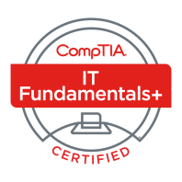
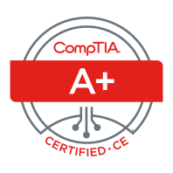
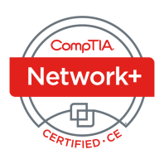
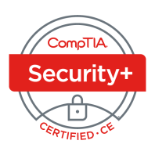
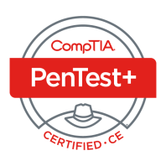
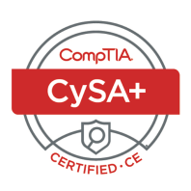

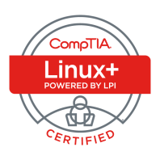
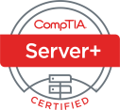
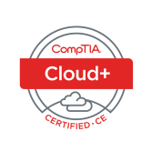
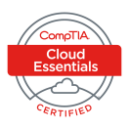
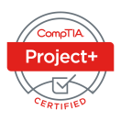
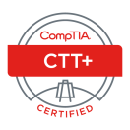



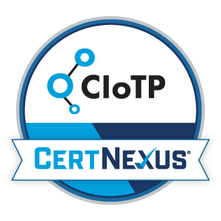
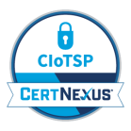
Lee McWhorter
CTO at Covered 6
CompTIA CIN Board member
lee@covered6.com
https://www.linkedin.com/in/lee-mcwhorter/
Twiiter: @tleemcjr
Previous TTT’s:
PenTest+ 001 2018
CASP+ 004 2021
PenTest+ 002 2022

Slide 8

Agenda
Session Objectives
Domain 4.4
Domain 4.5
Wrap Up

Slide 9
A+ Core 1 220-1101 TTT Session Outline
Date | Topic
7/11/2022 | Introduction, Linux+ Information, Resources, Domain 1.1
7/12/2022 | Domains 1.2 (Files) and 1.3 (Storage)
7/18/2022 | Domains 1.4 (Services) and 1.5 (Networking)
7/19/2022 | Domains 1.6 (Build) and 1.7 (Configuration)
7/25/2022 | Domains 2.1 (Best Practices) and 2.2 (Identity Management)
7/26/2022 | Domains 2.3 (Firewalls), 2.4 (Remote), and 2.5 (Access Controls)
8/01/2022 | Domains 3.1 (Scripts) and 3.2 (Containers)
8/22/2022 | Domains 3.3 (Git), 3.4 (IaC), and 3.5 (Orchestration)
8/23/2022 | Domains 4.1 (Storage), 4.2 (Network), and 4.3 (Processing)
8/30/2022 | Domains 4.4 (Permissions), 4.5 (Common Problems) & Wrap Up
✓
✓
✓
✓
✓
✓
✓
✓
✓
✓
<number>

Slide 10
Section break
Pop Quiz!
<number>

Slide 11
POLL
In what folder/directory are configuration files usually stored in on Linux system?
/lib
/boot
/etc
/usr
<number>

Slide 12
POLL - Answer
In what folder/directory are configuration files usually stored in on Linux system?
/lib
/boot
/etc
/usr
<number>

Slide 13
POLL
Which of the following commands is used to change file permissions?
chown
chgrp
chcon
chmod
None of the above
<number>

Slide 14
POLL - Answer
Which of the following commands is used to change file permissions?
chown
chgrp
chcon
chmod
None of the above
<number>

Slide 15
POLL
Which of the following GIT commands is used to save changes to a local repo?
commit
push
pull
add
None of the above
<number>

Slide 16
POLL - Answer
Which of the following GIT commands is used to save changes to a local repo?
commit
push
pull
add
None of the above
<number>

Slide 17
POLL
What does JSON stand for?
JAVA Standard Object Notation
Javascript Object Notation
JAVA Serial Objective Notation
Javascript Objective Notation
None of the above
<number>

Slide 18
POLL - Answer
What does JSON stand for?
JAVA Standard Object Notation
Javascript Object Notation
JAVA Serial Objective Notation
Javascript Objective Notation
None of the above
<number>

Slide 19
POLL
Which of the following networking types does Kubernetes support?
Overlay networks
Bridging
NAT
Host
All of the above
None of the above
<number>

Slide 20
POLL - Answer
Which of the following networking types does Kubernetes support?
Overlay networks
Bridging
NAT
Host
All of the above
None of the above
<number>

Slide 21
POLL
What do inodes do for the Linux file system?
Keep track of every file
Keep track of every directory/folder
Keep track of every file and directory/folder
Keeps track of symbolic links
None of the above
<number>

Slide 22
POLL - Answer
What do inodes do for the Linux file system?
Keep track of every file
Keep track of every directory/folder
Keep track of every file and directory/folder
Keeps track of symbolic links
None of the above
<number>

Slide 23
POLL
What three things does any device needs to function on a TCP/IP network?
IP address, gateway, DNS name
IP address, MAC address, gateway
IP address, MAC address, DNS name
IP address, gateway, netmask
None of the above
<number>

Slide 24
POLL - Answer
What three things does any device needs to function on a TCP/IP network?
IP address, gateway, DNS name
IP address, MAC address, gateway
IP address, MAC address, DNS name
IP address, gateway, netmask
None of the above
<number>

Slide 25
POLL
Which of the following report load averages?
w
top
lscpu
Both A and B
Both B and C
All of the above
<number>

Slide 26
POLL - Answer
Which of the following report load averages?
w
top
lscpu
Both A and B
Both B and C
All of the above
<number>

Slide 27
Section break
Domain 4.4
<number>

Slide 28
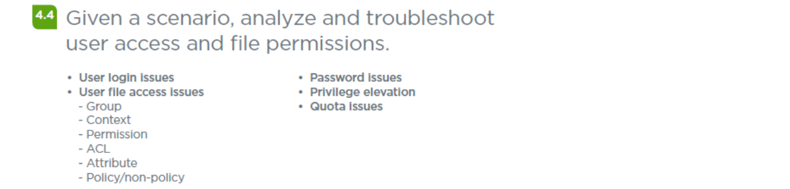
Domain 4.4 - Given a scenario, analyze and troubleshoot user access and file permissions.
<number>

Slide 29
Domain 4.4 - Given a scenario, analyze and troubleshoot user access and file permissions.
• User login issues – Check if account locked, password, shell, SSH settings, etc.
• User file access issues
- Group – make sure user in right group and group has correct permissions
- Context – Check SELinux or AppArmor settings
- Permission – does the user have correct permissions
- ACL – check permissions with getfacl and change with setfacl
- Attribute – use lsattr to check (-d option for directory attributes)
- Policy/non-policy – Related to SELinux, Fapolicyd on Redhat for example.
<number>

Slide 30
Domain 4.4 - Given a scenario, analyze and troubleshoot user access and file permissions.
• Password issues – check: /etc/password (shell), hosts.allow and hosts.deny, sshd_config, access.conf, PAM settings.
• Privilege elevation – make sure user is in sudoers file and is configured
• Quota issues – Sets amounts of disk space a user or group can use. Use repquota command to check.
<number>

Slide 31
Section break
Domain 4.5
<number>

Slide 32
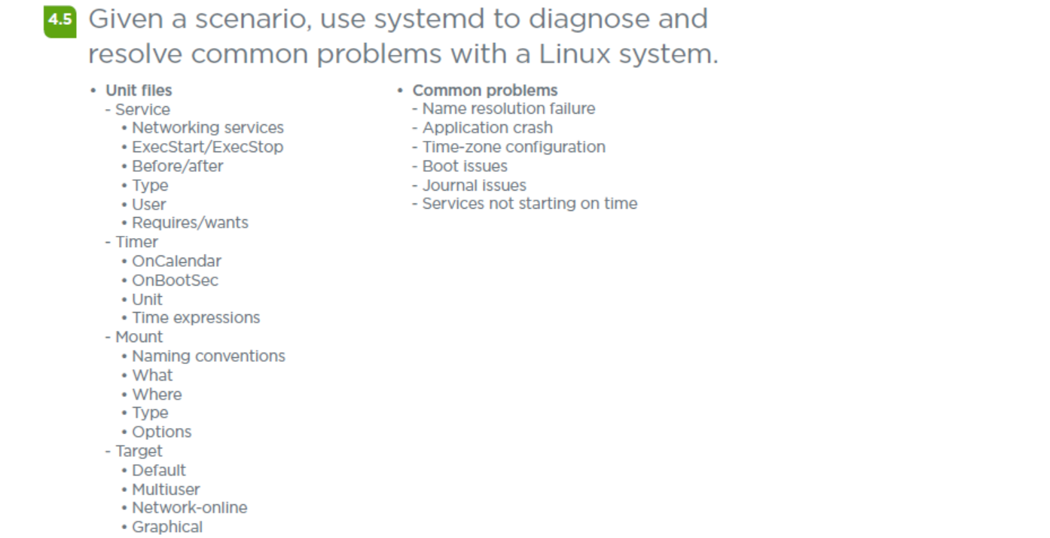
Domain 4.5 - Given a scenario, use systemd to diagnose and resolve common problems with a Linux system.
<number>

Slide 33
Domain 4.5 - Given a scenario, use systemd to diagnose and resolve common problems with a Linux system.
Unit files
- Service
• Networking services – usually created as service or socket units
• ExecStart/ExecStop – Path and arguments of command to start and stop unit.
• Before/after – Before units not started until current unit starts, After units are started before the current unit
• Type – simple, forking, oneshot, dbus, notify, & idle.
• User – User unit runs as, default root if not specified.
• Requires/wants – Requires lists any units upon which this unit essentially depends, Wants is similar but less strict.
<number>

Slide 34
Domain 4.5 - Given a scenario, use systemd to diagnose and resolve common problems with a Linux system.
Unit files (cont)
- Timer
• OnCalendar - activate the associated unit by specifying an absolute instead of relative to an event.
• OnBootSec - amount of time after the system is booted when the associated unit should be activated.
• Unit - specify the unit that should be activated when the timer elapses.
• Time expressions
https://manpages.ubuntu.com/manpages/bionic/man7/systemd.time.7.html
<number>

Slide 35
Domain 4.5 - Given a scenario, use systemd to diagnose and resolve common problems with a Linux system.
Unit files (cont)
- Mount
• Naming conventions - leading slash is removed, all other slashes are translated into dashes “-”, and all dashes and unprintable characters are replaced with C-style escape codes.
• What - absolute path to the resource that needs to be mounted.
• Where - absolute path of the mount point where the resource should be mounted.
• Type - filesystem type of the mount.
• Options - mount options that need to be applied.
<number>

Slide 36
Domain 4.5 - Given a scenario, use systemd to diagnose and resolve common problems with a Linux system.
Unit files (cont)
- Target - target unit is used to provide synchronization points for other units when booting up or changing states. They also can be used to bring the system to a new state. Other units specify their relation to targets to become tied to the target’s operations.
• Default
• Multiuser
• Network-online
• Graphical
<number>

Slide 37
Domain 4.5 - Given a scenario, use systemd to diagnose and resolve common problems with a Linux system.
• Where unit files live, in order of operation / preference:
- /etc/systemd/system
- /run/systemd/system
- /lib/systemd/system
- Default unit files live in the /lib folder, runtime versions in /run and you should put customized versions in /etc
- Can also use file snippets to override specific directives.
Most of above from:
https://www.digitalocean.com/community/tutorials/understanding-systemd-units-and-unit-files
<number>

Slide 38
Domain 4.5 - Given a scenario, use systemd to diagnose and resolve common problems with a Linux system.
• Common problems
- Name resolution failure – Standard DNS troubleshooting
- Application crash – Coredumps to troubleshoot, Restart=on-failure
- Time-zone configuration - systemd-timesyncd
- Boot issues – Debug logs, booting to different target or debug shell.
- Journal issues – Journals a mix of ASCII & binary data, journalctl
- Services not starting on time – services must be enabled, maybe a timing issues with another dependent service or unit.
<number>

Slide 39
Section break
Acronym List
<number>

Slide 40
Acronym List
ACL Access Control List
BIOS Basic Input/Output System
CI/CD Continuous Integration/Continuous Deployment
CIFS Common Internet File System
CPU Central Processing Unit
DNS Domain Name System
FHS Filesystem Hierarchy Standard
FUSE Filesystem in Userspace
GPT GUID (Globally Unique Identifier) Partition Table
GRUB Grand Unified Bootloader
GUID Globally Unique Identifier
I/O Input/Output
IOPS Input/Ouput Operations Per Second
IP Internet Protocol
ISO International Organization for Standardization
JSON JavaScript Object Notation
LDAP Lightweight Directory Access Protocol
LUKS Linux Unified Key Setup
LVM Logical Volume Manager
MFA Multifactor Authentication
MBR Master Boot Record
NAS Network-attached Storage
NAT Network Address Translation
NFS Network File System
NTP Network Time Protocol
<number>

Slide 41
Acronym List (cont)
NVMe Non-volatile Memory Express
OOM Out of Memory
PAM Pluggable Authentication Module
PKI Public Key Infrastructure
PXE Preboot Execution Environment
RAID Redundant Array of Independent (or Inexpensive) Disks
SAN Storage Area Network
SCP Secure Copy Protocol
SELinux Security Enhanced Linux
SFTP Secure File Transfer Protocol
SGID Set Group ID
SMB Server Message Block
SSD Solid-state Drive
SSH Secure Shell
SSL Secure Sockets Layer
SSO Single Sign-On
SSSD System Security Services Daemon
SUID Set User ID
TLS Transport Layer Security
UEFI Unified Extensible Firmware Interface
UFW Uncomplicated Firewall
USB Universal Serial Bus
YAML YAML Ain’t Markup Language
<number>

Slide 42

Chat Question
For fun, what is your favorite acronym that has different meanings on different exams?
Answer in the chat window and let’s share.
This photo is for placement only

Slide 43
For Next Class – What we’re out of classes?
That’s it! Thank you all so much for another amazing TTT!
Now...
Go pass your Exam and teach your students well!
<number>

Slide 44

Discussion time: Please type your questions in chat
Questions over content.
Share you experience.
What would you like to see
different moving forward?
Let’s keep the conversation going in the CompTIA Instructor Forum: https://cin.comptia.org
<number>

