Slide 1
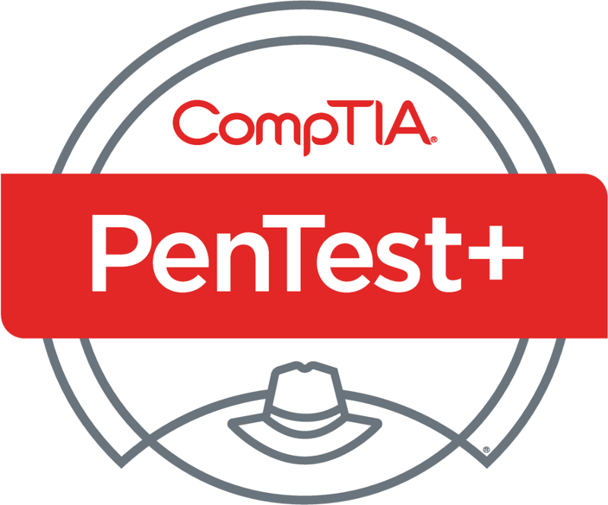
PenTest+ TTT Session 2: Planning and Scoping II
05/31/2018
@TeachCompTIA #PenTestPlusTTT

Slide 2
Housekeeping
Unmute your speakers.
Use Chrome if you have issues
Enable Flash: Chrome://settings/content flash settings enabled
Recording will be distributed within two hours. Slides and homework can be downloaded from the resource widget. You are able to do this via the recording as well.
Submit questions via the Q&A. The questions will be answered as submitted throughout the sessions.

Slide 3
Take Control of Your Console
Widgets are resizable and movable
Use the controls to minimize or maximize a widget
Drag the bottom right hand corner to resize it
Click the icon to download resources & bookmark helpful links
Chat with the audience and instructor by clicking the Group Chat icon and enter you questions or comments
Have a question? Click the Q&A icon and enter your questions
You can print your Certification of Attendance using the certification widget , after attending at least 110 minutes of the session
Do you have an idea or resource? We are trying the Idea widget out. Share resources you are using by typing in the Idea widget
The media player will show video, and when the instructor shares the screen, will show shared content.

Slide 4
Welcome to the Train-the-Trainer Series
Instructor:
T. Lee McWhorter, Jr.
IT Expert Generalist and Educator
lee@mcwhortertechnologies.com
Host:
Stephen Schneiter
Instructor Network Program Manager
CompTIA
sschneiter@comptia.org
Host:
Tazneen Kasem
Director. Product Management
Network+, CTT+, Project+ & CIN
CompTIA
tkasem@comptia.org
4

Slide 5
Agenda
Session Objectives
Review
Penetration testing engagement scoping
Compliance-based assessments

Slide 6
PenTest+ PT0-001 TTT Session Outline
Date | Topic
05/29/2018 | Introduction: CompTIA program information, Tech review (Labs, GNS3 Project, & VMs), and Planning and Scoping I.
05/31/2018 | Planning and Scoping II: Penetration testing engagement scoping and compliance-based assessments.
06/05/2018 | Information Gathering: Scanning, enumerating and the many other means of information gathering.
06/07/2018 | Vulnerability Identification: Vulnerability scanning and analysis to prepare for exploitation.
06/12/2018 | Attacks and Exploits I: Social engineering attack types and physical security.
06/14/2018 | Attacks and Exploits II: Network-based, wireless & RF-based, and application vulnerabilities.
✓
✓

Slide 7
PenTest+ PT0-001 TTT Session Outline
Date | Topic
06/26/2018 | Attacks and Exploits III: Local host vulnerabilities and post-exploitation techniques.
06/28/2018 | Penetration Tools I: Using and analyzing output from Nmap, Netcat and other penetration testing tools and utilities.
07/17/2018 | Penetration Tools II: Programming and scripting overview (BASH, PowerShell, Python & Ruby).
07/19/2018 | Reporting and Communications I: Report writing and handling best practices, and the importance of communications.
07/24/2018 | Reporting and Communications II: Recommending mitigation strategies and other post-report activities.
07/26/2018 | Wrap up: Final review, demos, and best practices as well as CompTIA wrap up information and survey.

Slide 8
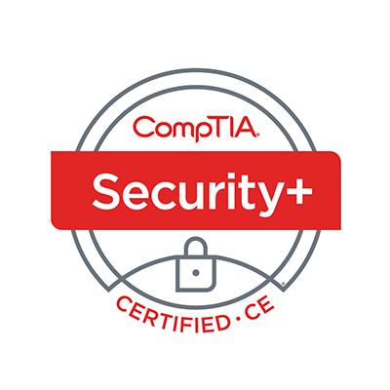
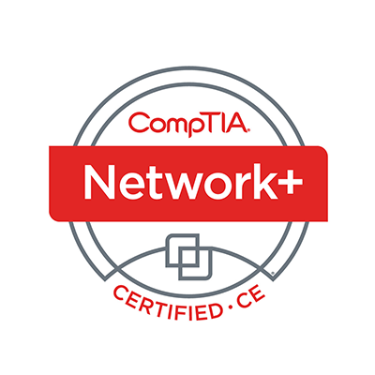
Welcome
Lee McWhorter
Instructor
Lead Author
Woz U Cyber Security Program
lee@mcwhortertechnologies.com

Slide 9
POLL
Where you able to get VirtualBox and GNS3 set up?
Yes, I’m rockin!
Yes, I think so…
No, something didn’t work
No, didn’t have time
What!? We had homework?

Slide 10
POLL
What does SOAP stand for?
Standard Object Authentication Protocol
Simple Object Access Protocol
Symmetric Object Access Protocol
Simple Object Authentication Protocol
Cleanliness

Slide 11
POLL – ANSWER SLIDE
What does SOAP stand for?
Standard Object Authentication Protocol
Simple Object Access Protocol
Symmetric Object Access Protocol
Simple Object Authentication Protocol
Cleanliness

Slide 12
POLL
Which of the following are critically important during planning and scoping?
Understanding the target audience
Obtaining proper signed authority
Budget
Both A and B
Both A and C
All of the above

Slide 13
POLL – ANSWER SLIDE
Which of the following are critically important during planning and scoping?
Understanding the target audience
Obtaining proper signed authority
Budget
Both A and B
Both A and C
All of the above

Slide 14
POLL
Which of the following is NOT an example of a support resource?
SOAP project file
Company Internal Employee Phone List
Network topology diagram
Web application parameters
3rd party software library documentation

Slide 15
POLL – ANSWER SLIDE
Which of the following is NOT an example of a support resource?
(Note: Only because not mentioned in Exam objectives…)
SOAP project file
Company Internal Employee Phone List
Network topology diagram
Web application parameters
3rd party software library documentation

Slide 16
Planning and Scoping I – Guidelines
Be sure that you understand the target audience.
Identify the resources and requirements that will govern and facilitate the pen test engagement.
Determine any budget restrictions that might affect the engagement.
Document any technical constraints that will affect the engagement.
Clearly define the rules of engagement.
Develop impact analysis and remediation timelines.
Identify any disclaimers that will affect the engagement.

Slide 17
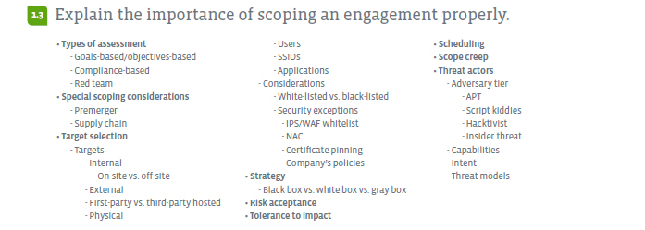
Planning and Scoping I – Domain 1.3

Slide 18
Planning and Scoping I – Domain 1.3
Types of assessment
Goals-based/objectives-based
In a Goals-based test, the goals are defined before the assessment begins and the tester works to achieve the goals. Once a goal is achieved, the penetration testers should determine how many unique ways the goal can be achieved.
Objective-based penetration testing approaches a pen test from all angles to ensure that information remains secure. This type of testing more accurately simulates the attacks launched by a hacker.
Compliance-based
A risk-based compliance monitoring program of testing / PCI DSS for example.
Red team

Slide 19
Planning and Scoping I – Domain 1.3
Special scoping considerations
Premerger
A merger is a statutory combination of two or more corporations by the transfer of their properties in to one surviving corporation. Often times before a merger is completed, pen testing can be part of the due diligence.
Supply chain
Supply chain cyber security refers to efforts to enhance cyber security within the supply chain. Typical supply chain cyber security activities for minimizing risks include buying only from trusted vendors, disconnecting critical machines from outside networks, and educating users on the threats and protective measures.

Slide 20
Planning and Scoping I – Domain 1.3
Target selection
Targets
Internal – Think inside the firewall targets
On-site vs. off-site
External – Publically facing targets
First-party vs. third-party hosted – Company hosted vs. others such as AWS, etc.
Physical – Will we test physical layer?
Users – Social Engineering?
SSIDs (service set identifier) - Wireless
Applications

Slide 21
Planning and Scoping I – Domain 1.3
Considerations
White-listed vs. black-listed
Security exceptions
IPS (Intrusion Prevention System)/WAF (Web application firewall) white-list
NAC (Network Access Control)
Certificate pinning
With certificate pinning, when you first visit a site, your browser takes note of a fingerprint of the site’s public key. From then on, before accepting a certificate for the site, your browser will check the fingerprint has not changed. This protects against misbehaving or compromised CA’s (Certificate Authority).
Company’s policies

Slide 22
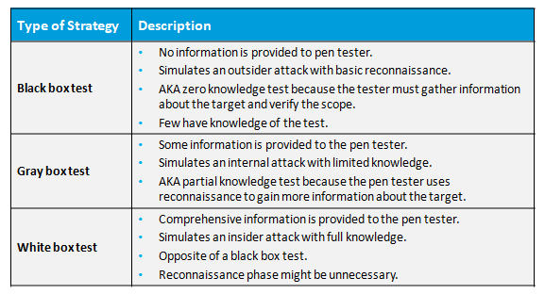
Planning and Scoping I – Domain 1.3

Slide 23
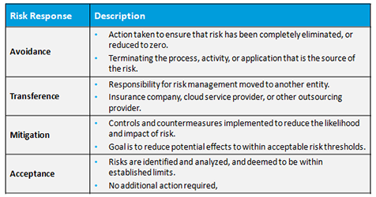
Planning and Scoping I – Domain 1.3
Risk acceptance – pen testing presents risks – how much will client bare?

Slide 24
Planning and Scoping I – Domain 1.3
Tolerance to impact – similar to above – how much impact will client bare?
Balance the need for testing with continuity of business operations.
In Scope
Out of Scope
Network storage
Intranet
Product databases
Employee email accounts
Time-tracking app
E-commerce servers
Customer-facing websites
Email servers
R&D network

Slide 25
Planning and Scoping I – Domain 1.3
Scheduling – Known vs. Unknown timing, peak vs. off-peak, etc.
List of events
Date and time restrictions
Client stakeholder notifications

Slide 26
Planning and Scoping I – Domain 1.3
Scope creep – The condition that occurs when a client requests additional services after a SOW has been signed and the project scope has been documented and agreed upon.
Additional of devices, time spent testing, # of people, follow-up, etc.
Takes resources and effort away from the items documented in the SOW.
Try to get another agreement to cover the additional work.

Slide 27
Planning and Scoping I – Domain 1.3
Threat actors
Adversary tier – during the pen test, who should we act like?
APT (Advanced persistent threat)
Script kiddies
Hacktivist
Insider threat
Capabilities
Lower tier adversaries less likely to have expensive or sophisticated capabilities.
Higher tier adversaries can use tools and methods of the tiers below them.

Slide 28
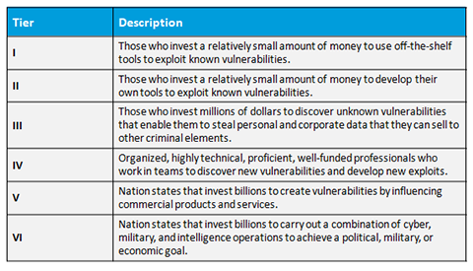
Planning and Scoping I – Domain 1.3

Slide 29
Planning and Scoping I – Domain 1.3
Intent and motivations can vary no matter what tier the adversaries occupy.
Greed/theft
Power/revenge and blackmail
Reputation and recognition/espionage and defamation of character
Association or affiliation with others/political and social change
Thrills and exploration/blackmail and defamation of character
Threat models
Models vary in scope.
Overall security of an organization.
Security of specific computers or other assets.

Slide 30
Planning and Scoping I – Domain 1.3
Threat actors

Slide 31
Planning and Scoping I – Domain 1.4

Slide 32
Planning and Scoping I – Domain 1.3
Compliance-based
What to look for: Clear objectives based on regulations.
How to look: Possible rules for completing the assessment.
Focus:
Password policies
Data isolation
Key management
Limitations:
Network access
Storage access

Slide 33
Planning and Scoping I – Domain 1.4

Slide 34
Chat Question
Beyond PCI DSS, what other types of compliance-based pen tests have your heard of or can think of?
Answer in the chat window and let’s share.
This photo is for placement only

Slide 35
Tech Time!
GNS3 comes with a number of standard appliances.
You can also add a large number more form the GNS3 Marketplace.
Note: Many major vendors such as Cisco do not provide any free appliances, you must have proper licenses, etc.
However, certain things were not available in the marketplace to meet my needs, so I built my own. ☺
Appliances can be built in a number of ways, I made mine as Docker images.
Many advantages of Docker – for one just look at file size:
10 node topology – portable project file roughly 675MB
1 Ubuntu Server VM (around 1GB) / 1 Ubuntu Desktop VM (over 3GB)
1 Windows 10 VM – 10 GB after fresh install, no updates…

Slide 36
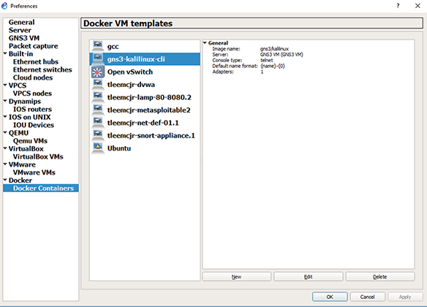
Tech Time!

Slide 37
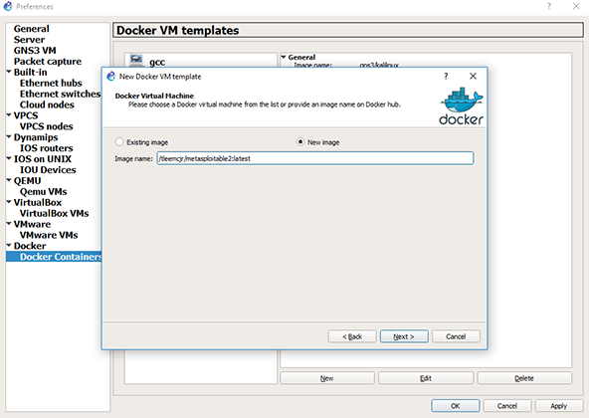
Tech Time!

Slide 38
Chat Question
What other appliances would you think might be useful for teaching security and pen test concepts?
Answer in the chat window and let’s share.
This photo is for placement only

Slide 39
Tech Time!
Adding standard appliances is fairly easy too, just start to drag one in from the Available Devices side-bar and a Wizard will help walk you through the install. Some standard one you will want to install are:
VyOS, Open VSwitch, Firefox and Kali Linux CLI (command line interface)
Note: Bug will Kali Linux CLI from marketplace, use gns3/kalilinux
My Docker images are all available from Docker Hub:
tleemcjr/Net-Def-01.1
tleemcjr/LAMP80-8080.2
tleemcjr/metasploitable2
tleemcjr/DVWA
tleemcjr/snort-appliance.1

Slide 40
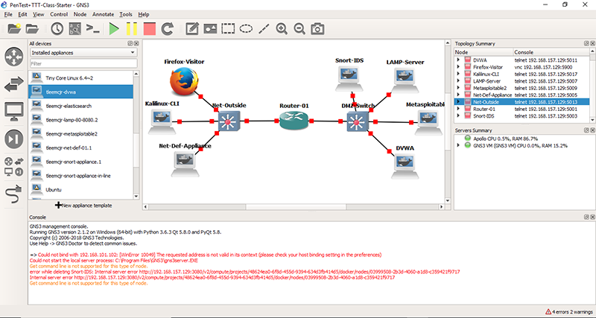

Slide 41
DEMO
GNS3 adding appliances and import project

Slide 42
POLL
Do you think this type of virtual network is useful for teaching security / pen test concepts?
Yes
No
Maybe
Don’t need no stinkin virtual network…

Slide 43
Homework for next class!
Set up / add standard and custom appliances used in the class topology to your GNS3 installation so they are usable from your Installed Devices side-bar.
Import the GNS3 portable project containing the class topology.
Take a look around the network, run some nmap scans, etc. Make yourself at home. ☺

Slide 44
Next Class!
Information Gathering and Vulnerability Identification Domains 2.1 & 2.2
We will go over the virtual machines and their host-only network.
These virtual machines will be provided the following week.

Slide 45
Discussion time: Please type your questions in chat
Questions over content.
Share you experience.
What would you like to see different moving forward?
Let’s keep the going on LinkedIn in the CompTIA Instructor Forum: http://bit.ly/2wMU4nL

