Slide 1
Security+ SY0-601 TTT Session 2
Domain 1 continued
February 16, 2021
@TeachCompTIA #SecurityPlusTTT

Slide 2
Agenda
Homework XXS level 6
Domain 1.0: Attacks, Threats & Vulnerabilities (Part two)
Domain 1.5: Explain different threat actors, vectors, and intelligence sources.
Domain 1.6: Explain the security concerns associated with various types of vulnerabilities.
Domain 1.7: Summarize the techniques used in security assessments.
Domain 1.8: Explain the techniques used in penetration testing.
Review

Slide 3
Security+ SY0-601 TTT Session Outline
Date | Topic
2/16/2020 | 1.0 Attacks, Threats and Vulnerabilities
2/18/2020 | 1.0 Attacks, Threats and Vulnerabilities (continued)
2/23/2020 | 2.0 Architecture and Design
2/25/2020 | 2.0 Architecture and Design (continued)
3/02/2020 | 3.0 Implementation
3/04/2021 | 3.0 Implementation (continued)
3/09/2021 | 4.0 Operations and Incident Response
3/11/2021 | 4.0 Operations and Incident Response (continued)
3/16/2021 | 5.0 Governance, Risk, and Compliance
3/18/2021 | 5.0 Governance, Risk, and Compliance (continued) Wrap-up
✓

Slide 4
Session resources
CompTIA Security+ SYO-601 objectives PDF

Slide 5
Homework Poll What level did you get to on the XSS google challenge?
Level One
Level Two
Level Three
Level Four
Level Five
Level Six
None of them

Slide 6
Domain 1.5
Explain different threat actors, vectors, and intelligence sources.

Slide 7
POLL
When was the first every hack attack recorded?
1903
1984
2002
1994
2019

Slide 8
History of hacking
1903-Morse code messages changed during demo
1957-Joe “Joybubbles” a blind 7-year-old started phone hacking “Phreaking”.
1984-Lex Luthor forms Legion of Doom aka LOD also Cult of the dead Cow form
1994-Russian hackers steal $10 million Citibank transferring money to bank accounts all over the world.
2004-North Korea claims to have trained 500 hackers to hack South Korea, Japan and allies' computers.

Slide 9
APT
APT1: China Cyber Espionage Units (PLA 61398)
APT28: Russia (Fancy Bear)
APT34: Iran (Helix Kitten)
APT38: North Korea (Lazarus Group)

Slide 10
POLL
Would you show or demonstrate the use of a TOR browser to access the Dark web?
Yes
No
maybe

Slide 11
Chat Question
With the knowledge of a pending APT attack on your business, what measures would you put in place to protect your network perimeter?
Answer in the chat window and let’s share.
This photo is for placement only

Slide 12
Demo OSINT tools
Live threat feed
Google dorks
haveibeenpwned

Slide 13
Domain 1.6
Explain the security concerns associated with various types of vulnerabilities.

Slide 14
POLL
How secure is cloud services?
Not secure
Secure for Data retention only
Mostly secure for most services
Highly secure

Slide 15
Chat Question
How can you defend against a zero-day attack?
Answer in the chat window and let’s share.
This photo is for placement only

Slide 16
Chat Question
If you had to identify ports of interest for secure internet access which ones would you suggest?
Answer in the chat window and let’s share.
This photo is for placement only

Slide 17
Demo nmap and zenmap
Virtual Win 10
Virtual Kali

Slide 18
Domain 1.7
Summarize the techniques used in security assessments.

Slide 19
POLL
Which vulnerability tools have you used in class or out?
OpenVas
Nessus
Burpsuite
GFI languard

Slide 20
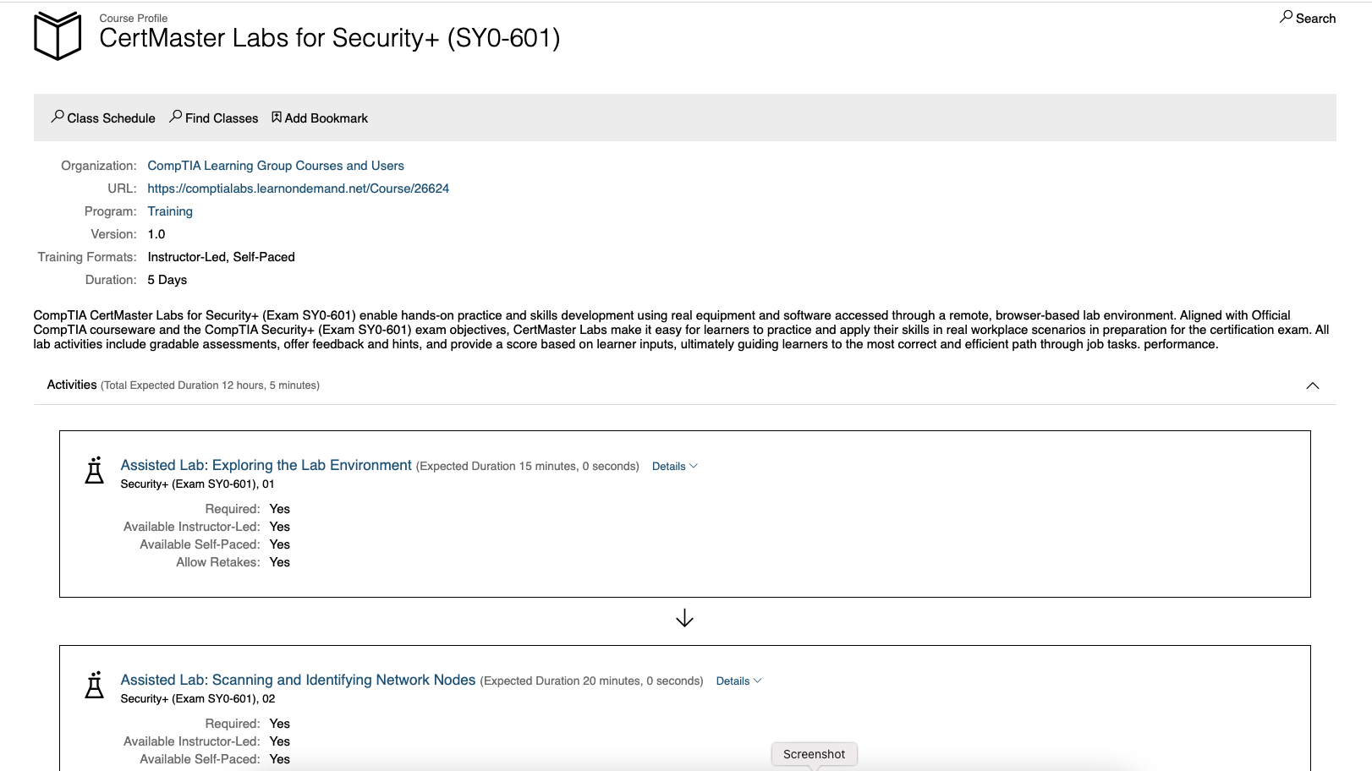
LearnOnDemand

Slide 21
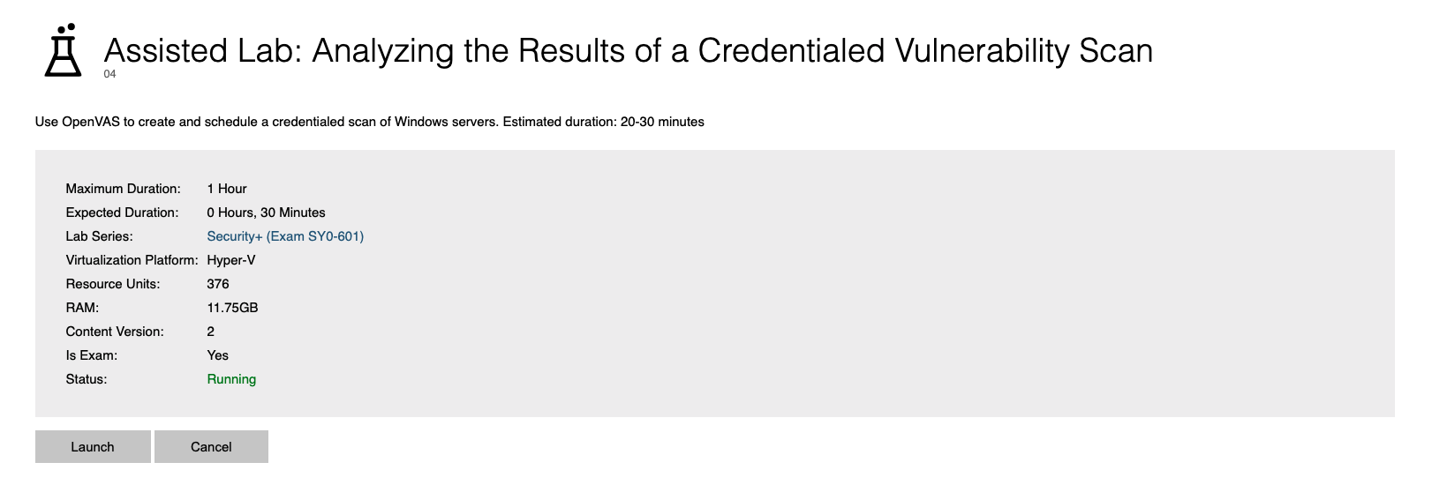
LearnOnDemand: using OpenVas

Slide 22
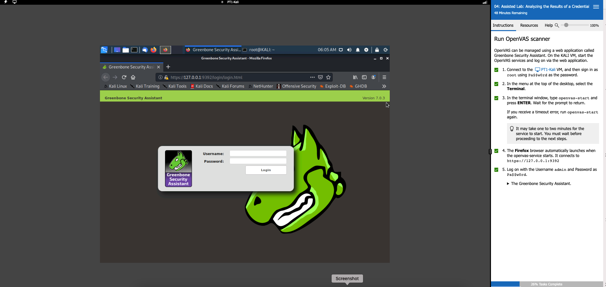
LearnOnDemand: using OpenVas

Slide 23
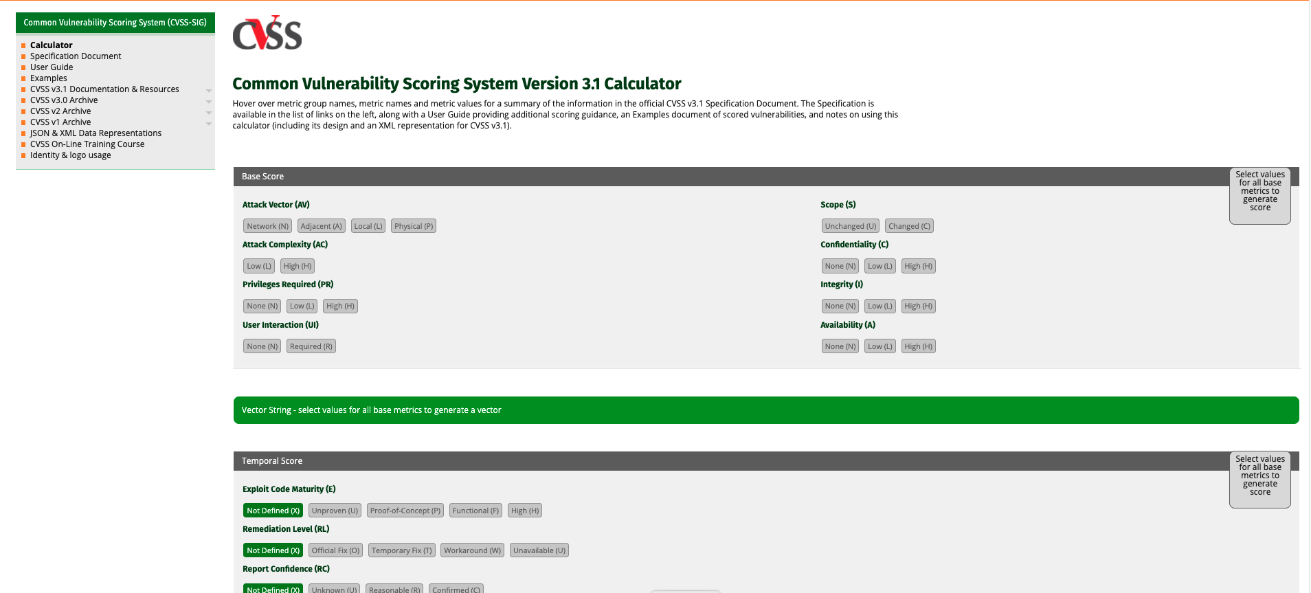
Demo CVSS exercise

Slide 24
Chat Question
What OSINT tools do you use?
Answer in the chat window and let’s share.
This photo is for placement only

Slide 25
Domain 1.8
Explain the techniques used in penetration testing.

Slide 26
POLL
What exercise team acts as referee of a penetration testing event?
Black
Blue
Purple
White

Slide 27
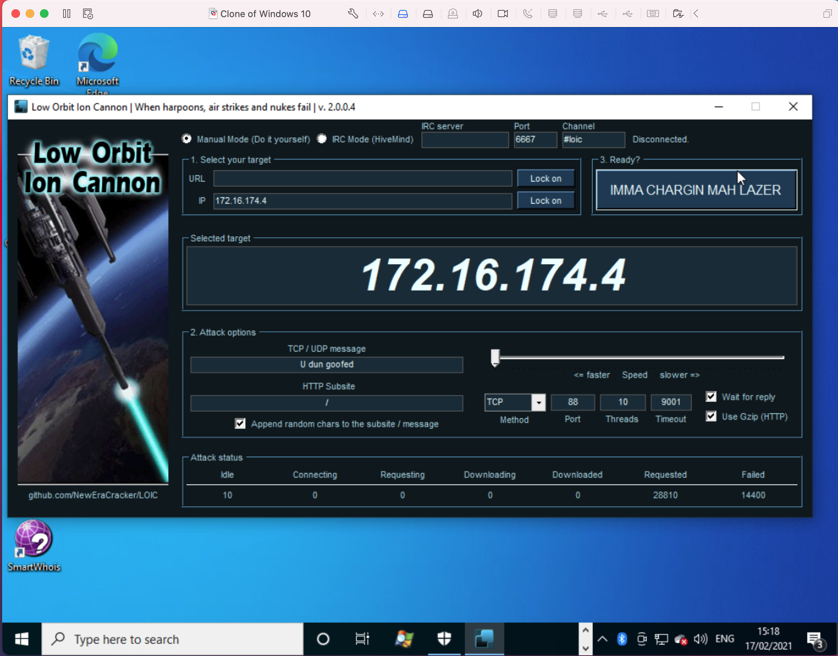
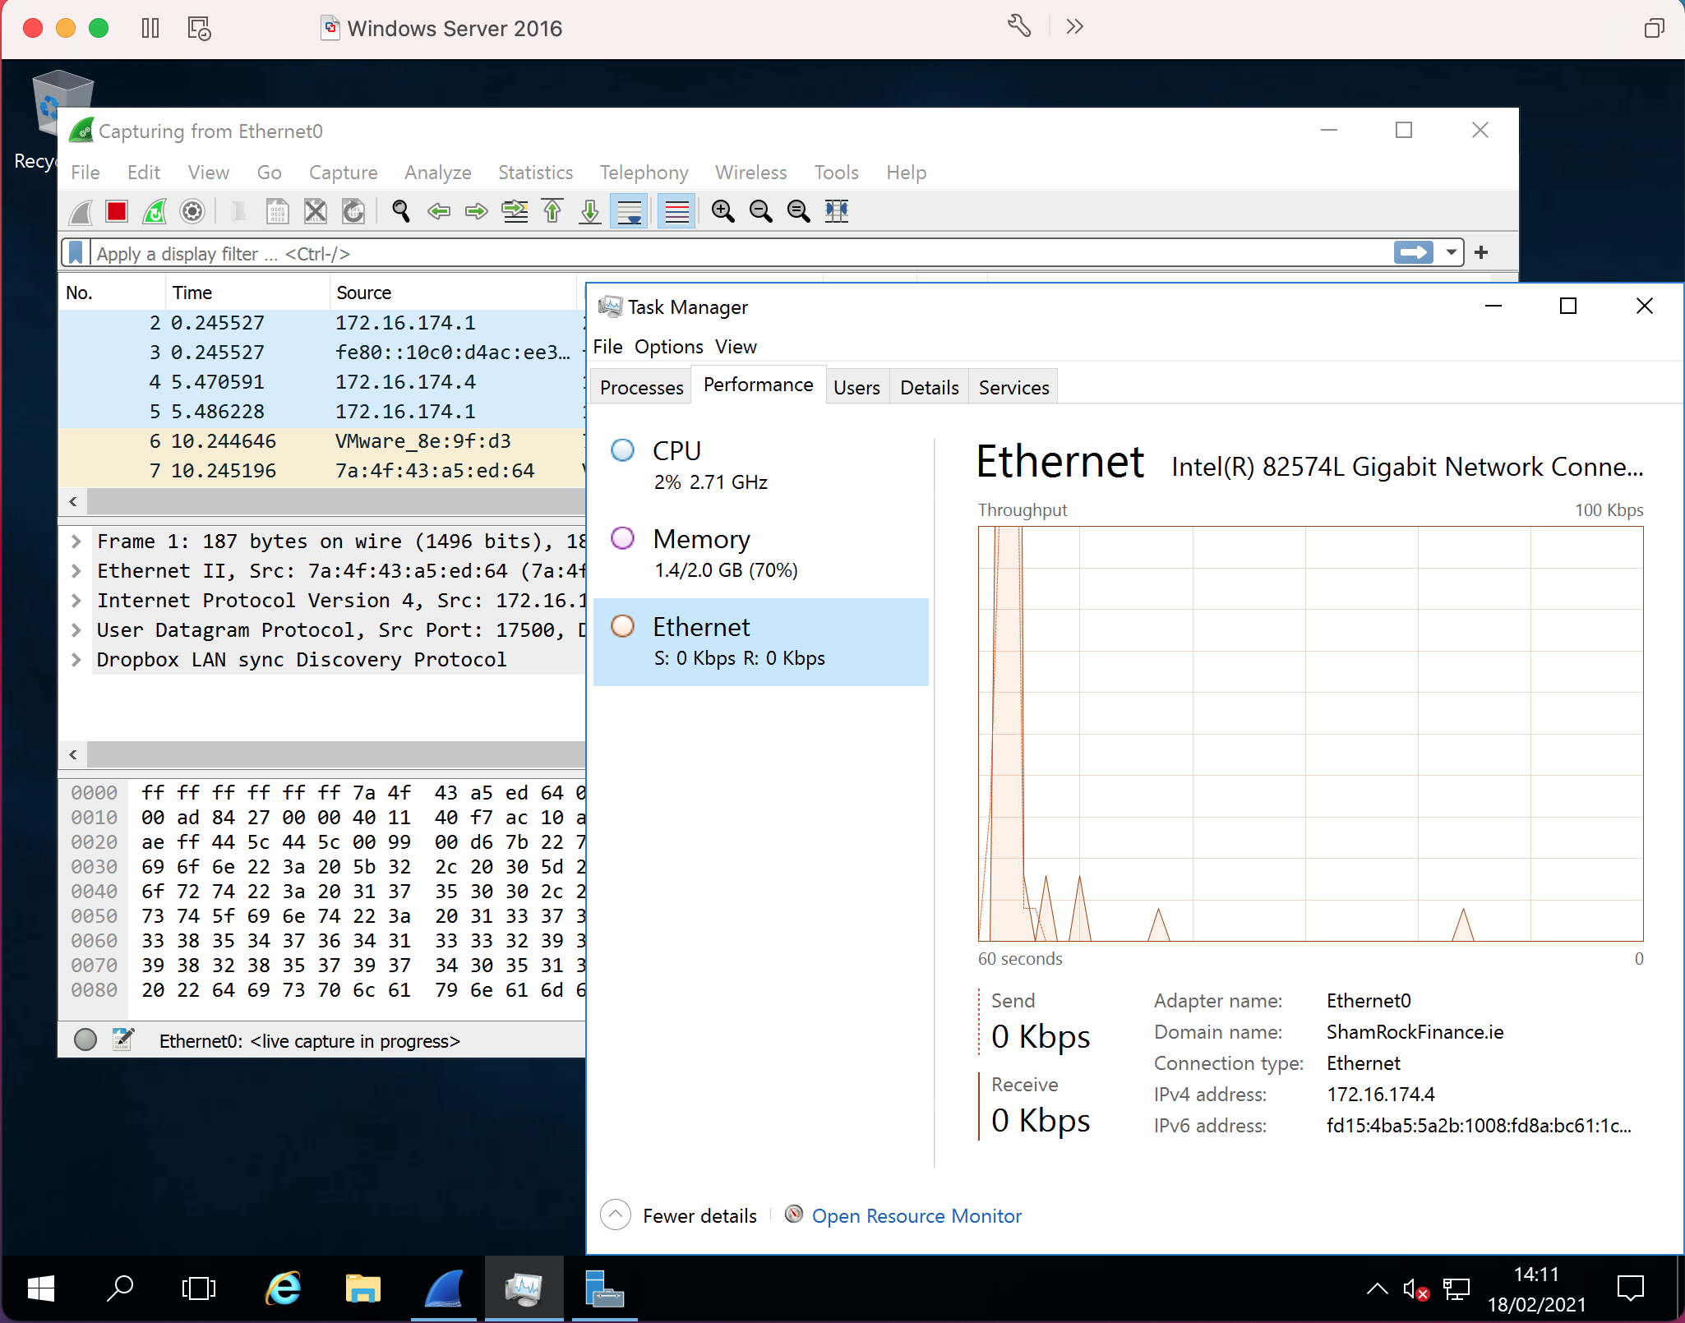
Demo attack a server

Slide 28
Chat Question
What would you expect to see in Rules of engagement (ROE) for a pen test?
Answer in the chat window and let’s share.
This photo is for placement only

Slide 29
Session resources
CompTIA Security+ SYO-601 objectives PDF

Slide 30
Security+ objectives
DOMAIN 1.0 Attacks, Threats and Vulnerabilities

