Slide 1
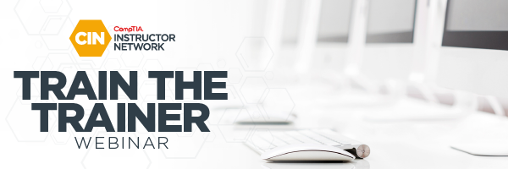
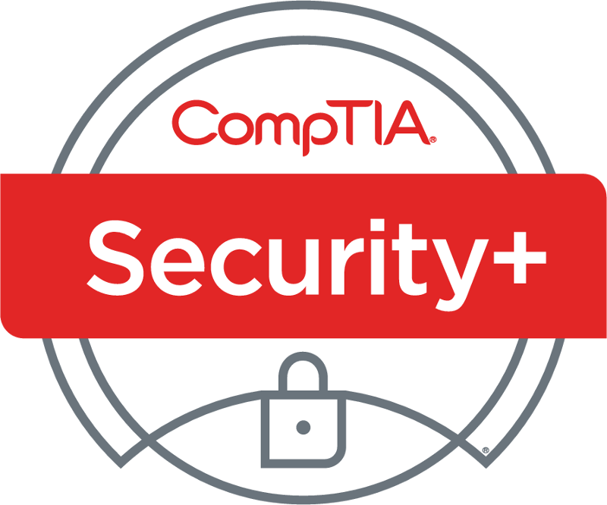
Security+ SY0-601 TTT Session 5
Domain 2 Architecture & Design (Part 2)
February 16, 2021
@TeachCompTIA #SecurityPlusTTT

Slide 2
Security+ SY0-601 TTT Session Outline
Date | Topic
2/16/2021 | 1.0 Attacks, Threats and Vulnerabilities
2/18/2021 | 1.0 Attacks, Threats and Vulnerabilities (continued)
2/23/2021 | 1.0 Attacks, Threats and Vulnerabilities (continued)
2/25/2021 | 2.0 Architecture and Design
3/02/2021 | 2.0 Architecture and Design (continued)
3/04/2021 | 3.0 Implementation
3/09/2021 | 3.0 Implementation (continued)
3/11/2021 | 4.0 Operations and Incident Response
3/16/2021 | 4.0 Operations and Incident Response (continued)
3/18/2021 | 5.0 Governance, Risk, and Compliance and Wrap-up
✓

Slide 3

Agenda
Domain 2.0: Architecture and design (Part two )
Domain 2.5: Given a scenario, implement cybersecurity resilience.
Domain 2.6: Explain the security implications of embedded and specialized systems.
Domain 2.7: Explain the importance of physical security controls.
Domain 2.8: Summarize the basics of cryptographic concepts.
Review

Slide 4
Security+
DOMAIN 2.0 Authentication and Design

Slide 5
Session resources
CompTIA Security+ SYO-601 objectives PDF

Slide 6
Domain 2.5
Given a scenario, implement cybersecurity resilience.

Slide 7
Poll
The CIA address Availability to keep systems up and available. The five nines approach allows for how much down time in any 12-month period?
5.39 minutes
32 seconds
32 minutes
5hr 39minutes

Slide 8

Chat Question
Which RAID solution requires a min 2 disks and gives zero fault tolerance?
Answer in the chat window and let’s share.
This photo is for placement only

Slide 9
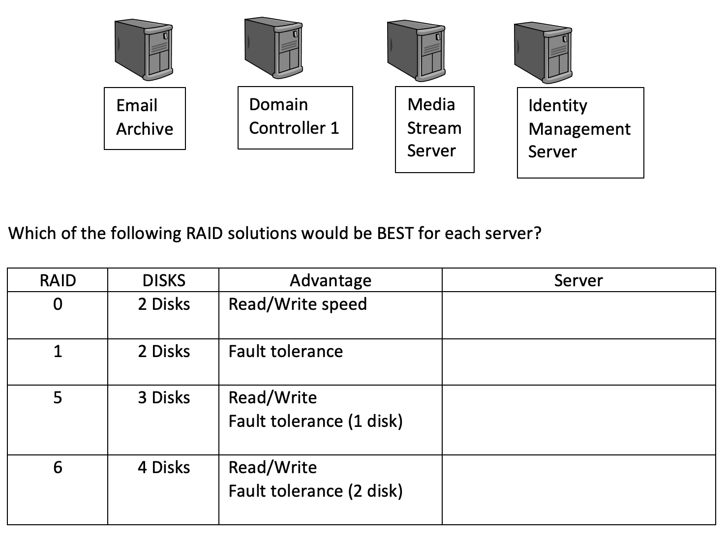
RAID exercise
RAID 0
RAID 1
RAID 5
RAID 6
RAID 10

Slide 10
Domain 2.6
Explain the security implications of embedded and specialized systems

Slide 11
POLL
Raspberry Pi was introduced as a cheap option for schools to teach coding, an alternative open-source hardware and software company also manufactures single-board microcontroller kits is known as?
Linux
BBC micro:bit
Microsoft
Arduino

Slide 12
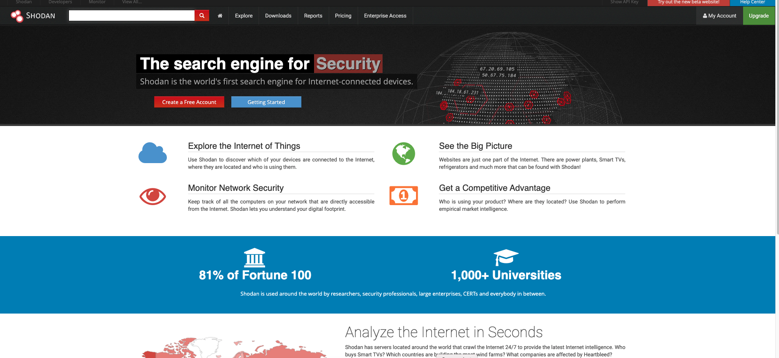
SHODAN

Slide 13
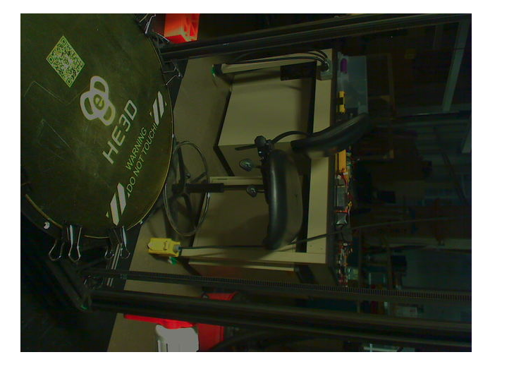
Webcam search

Slide 14
Chat Question
How can you use SHODAN for your own business?
Answer in the chat window and let’s share.
This photo is for placement only

Slide 15
Domain 2.7
Explain the importance of physical security controls.

Slide 16
POLL
Is a Faraday cage the same as a Tempest environment?
Yes
No
Not sure

Slide 17
POLL
You have been tasked to install a security camera for a client that wants to monitor visitors at the entrance to the drive leading up to the house. This is 3000 feet from the house. It is not posable to run a cable but use Wi-Fi. Which of the following IEEE standards would you MOST likely recommend?
802.11g
802.11n
802.11ac
802.11ah

Slide 18
Chat Question
What is the BEST method to destroy data on hard drive so it can not be recovered?.
This photo is for placement only

Slide 19
Domain 2.8
Summarize the basics of cryptographic concepts.

Slide 20
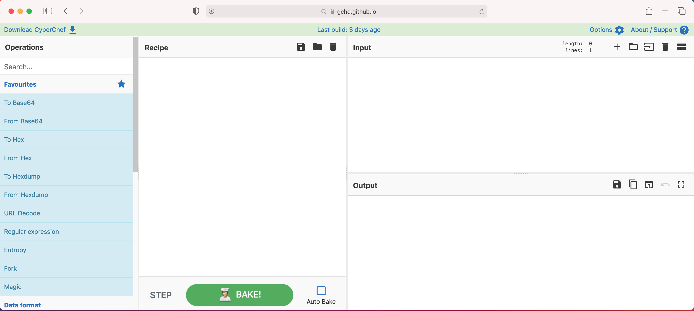
Cyberchef demo

Slide 21
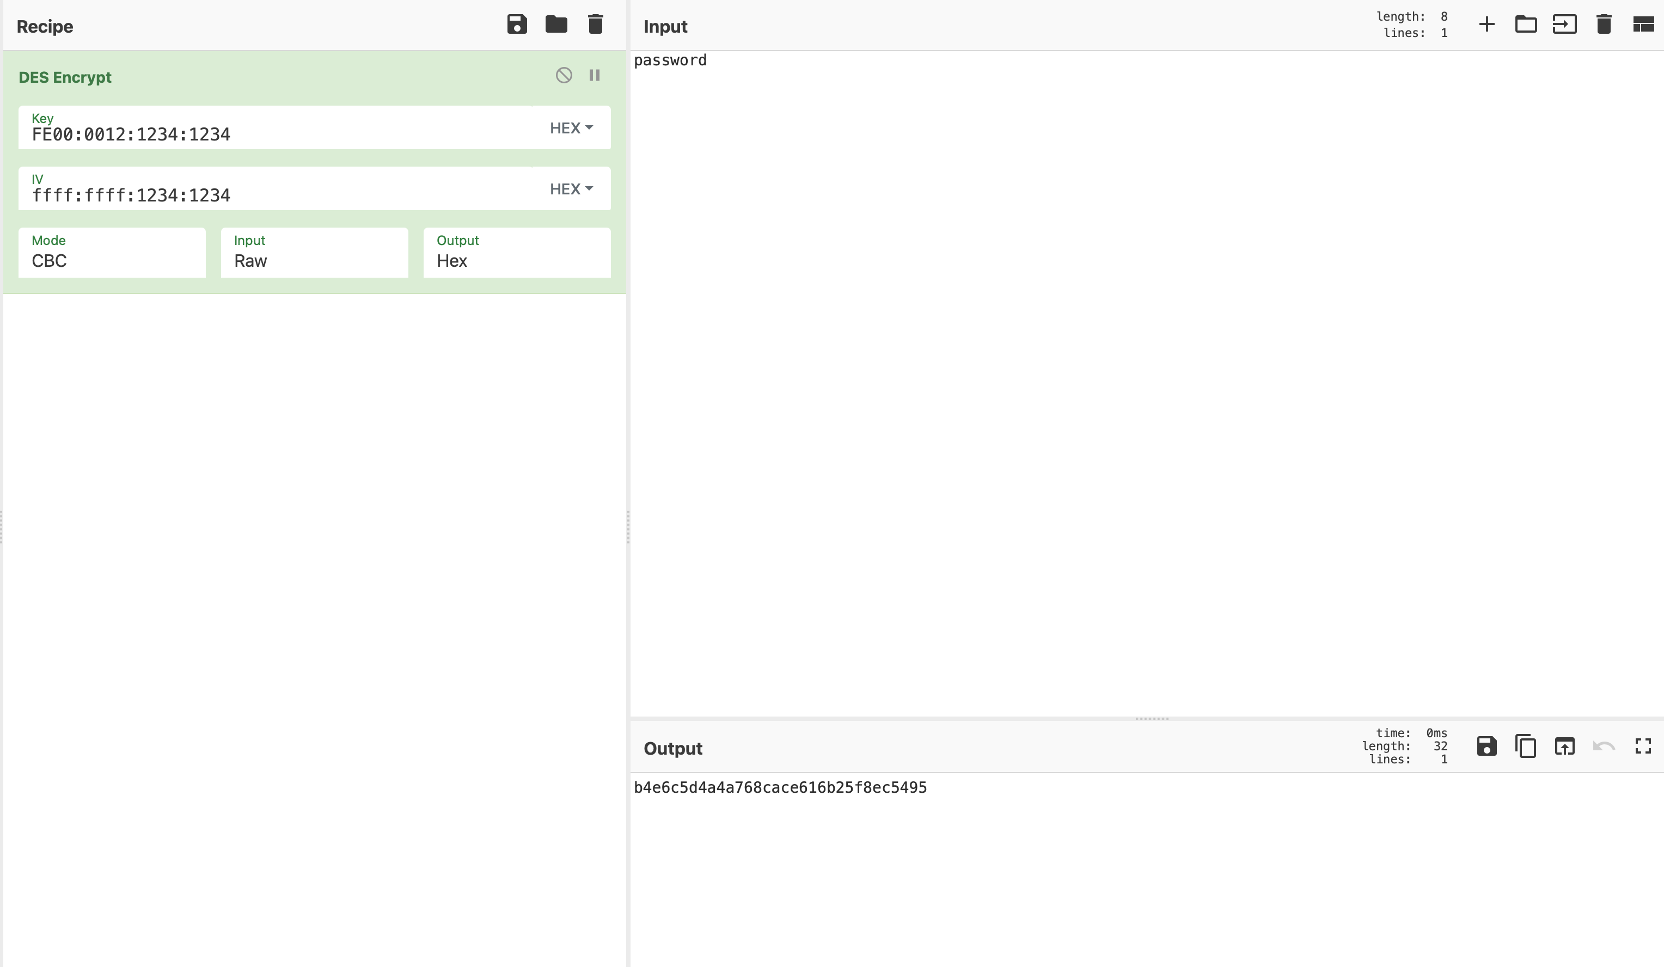
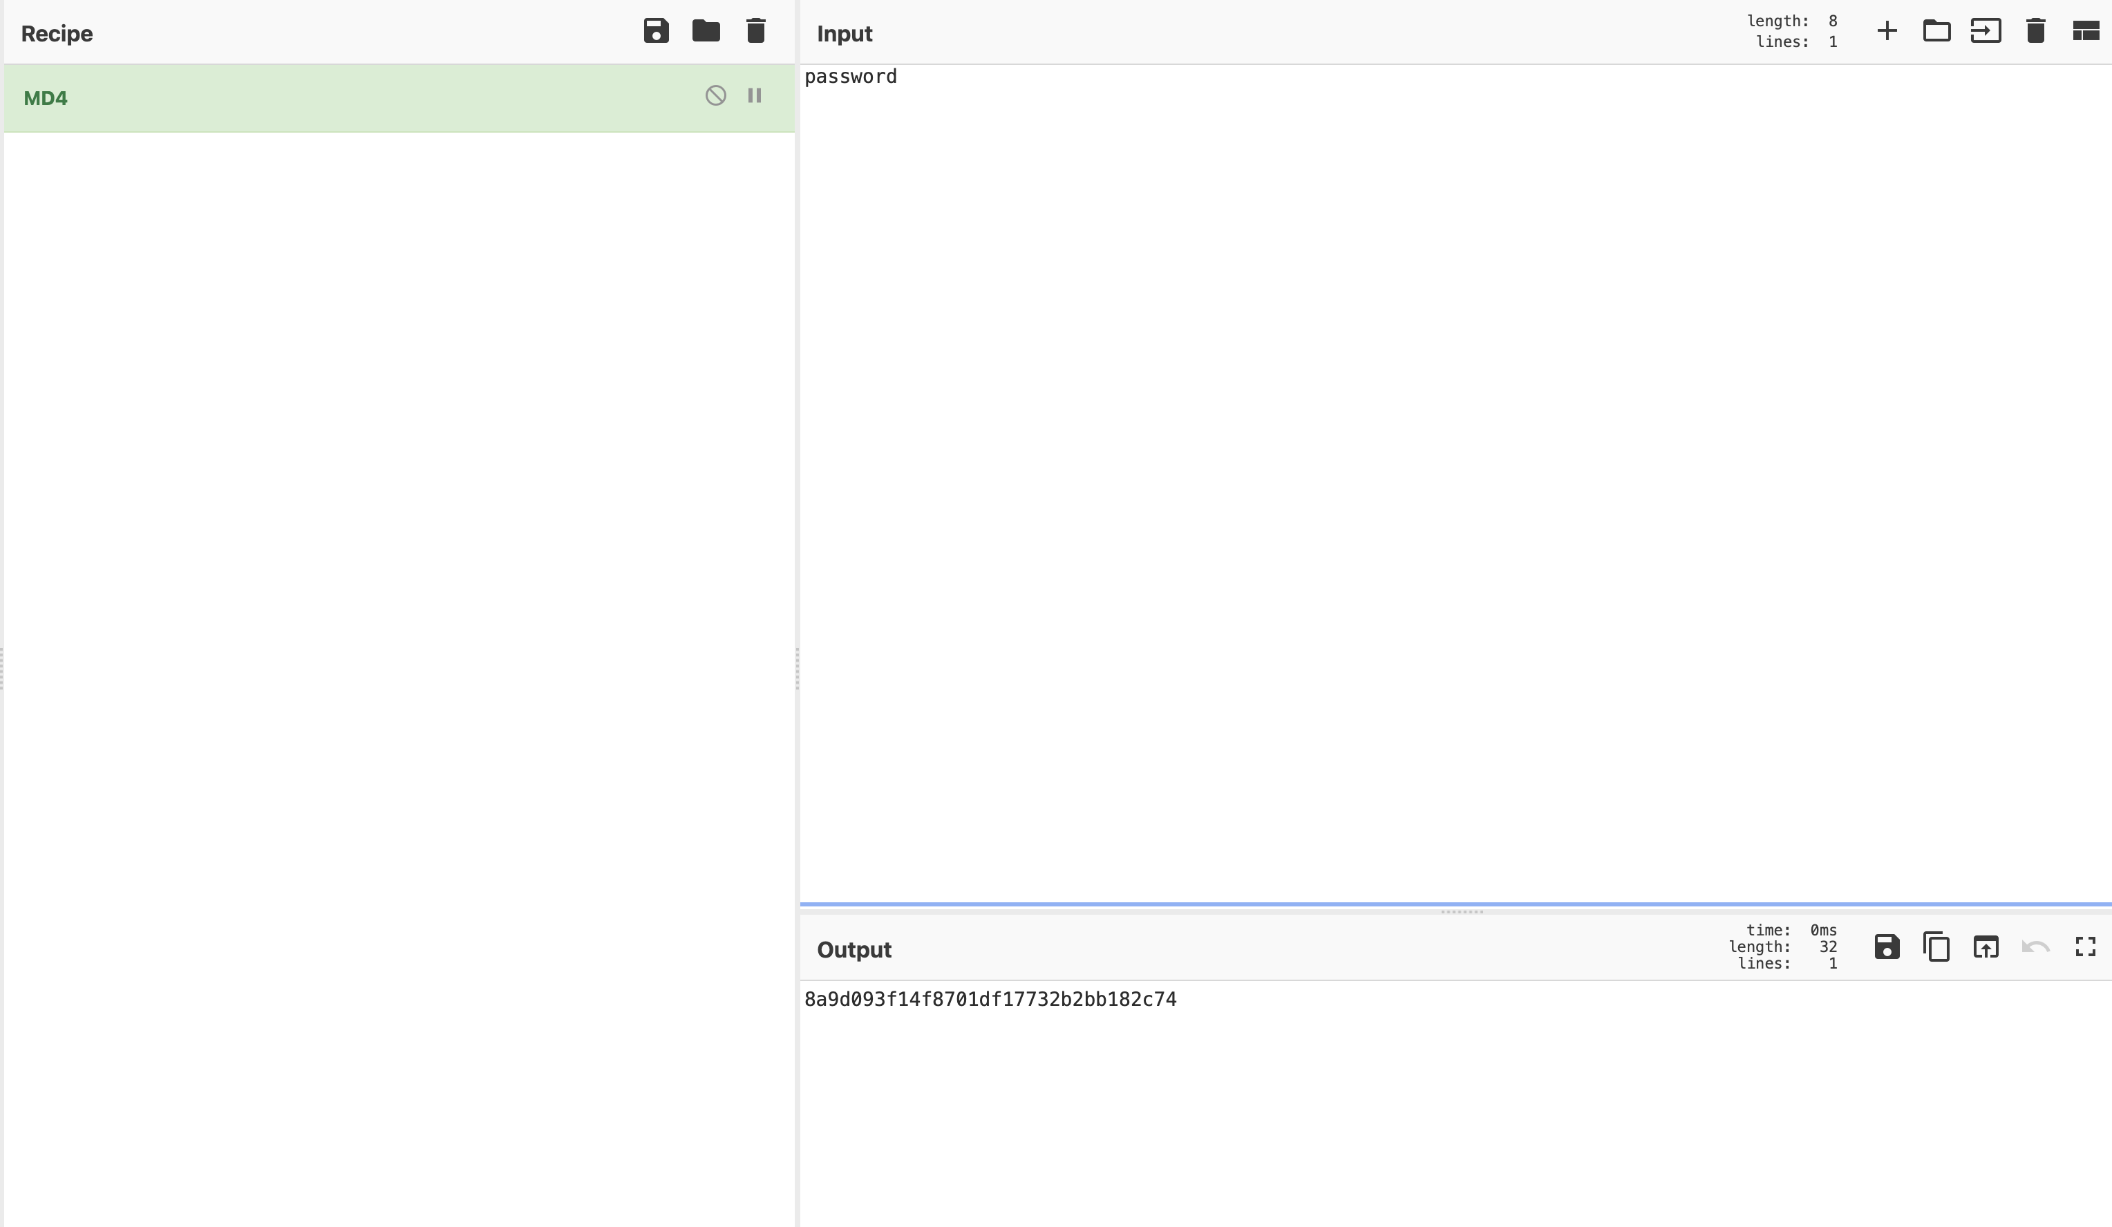
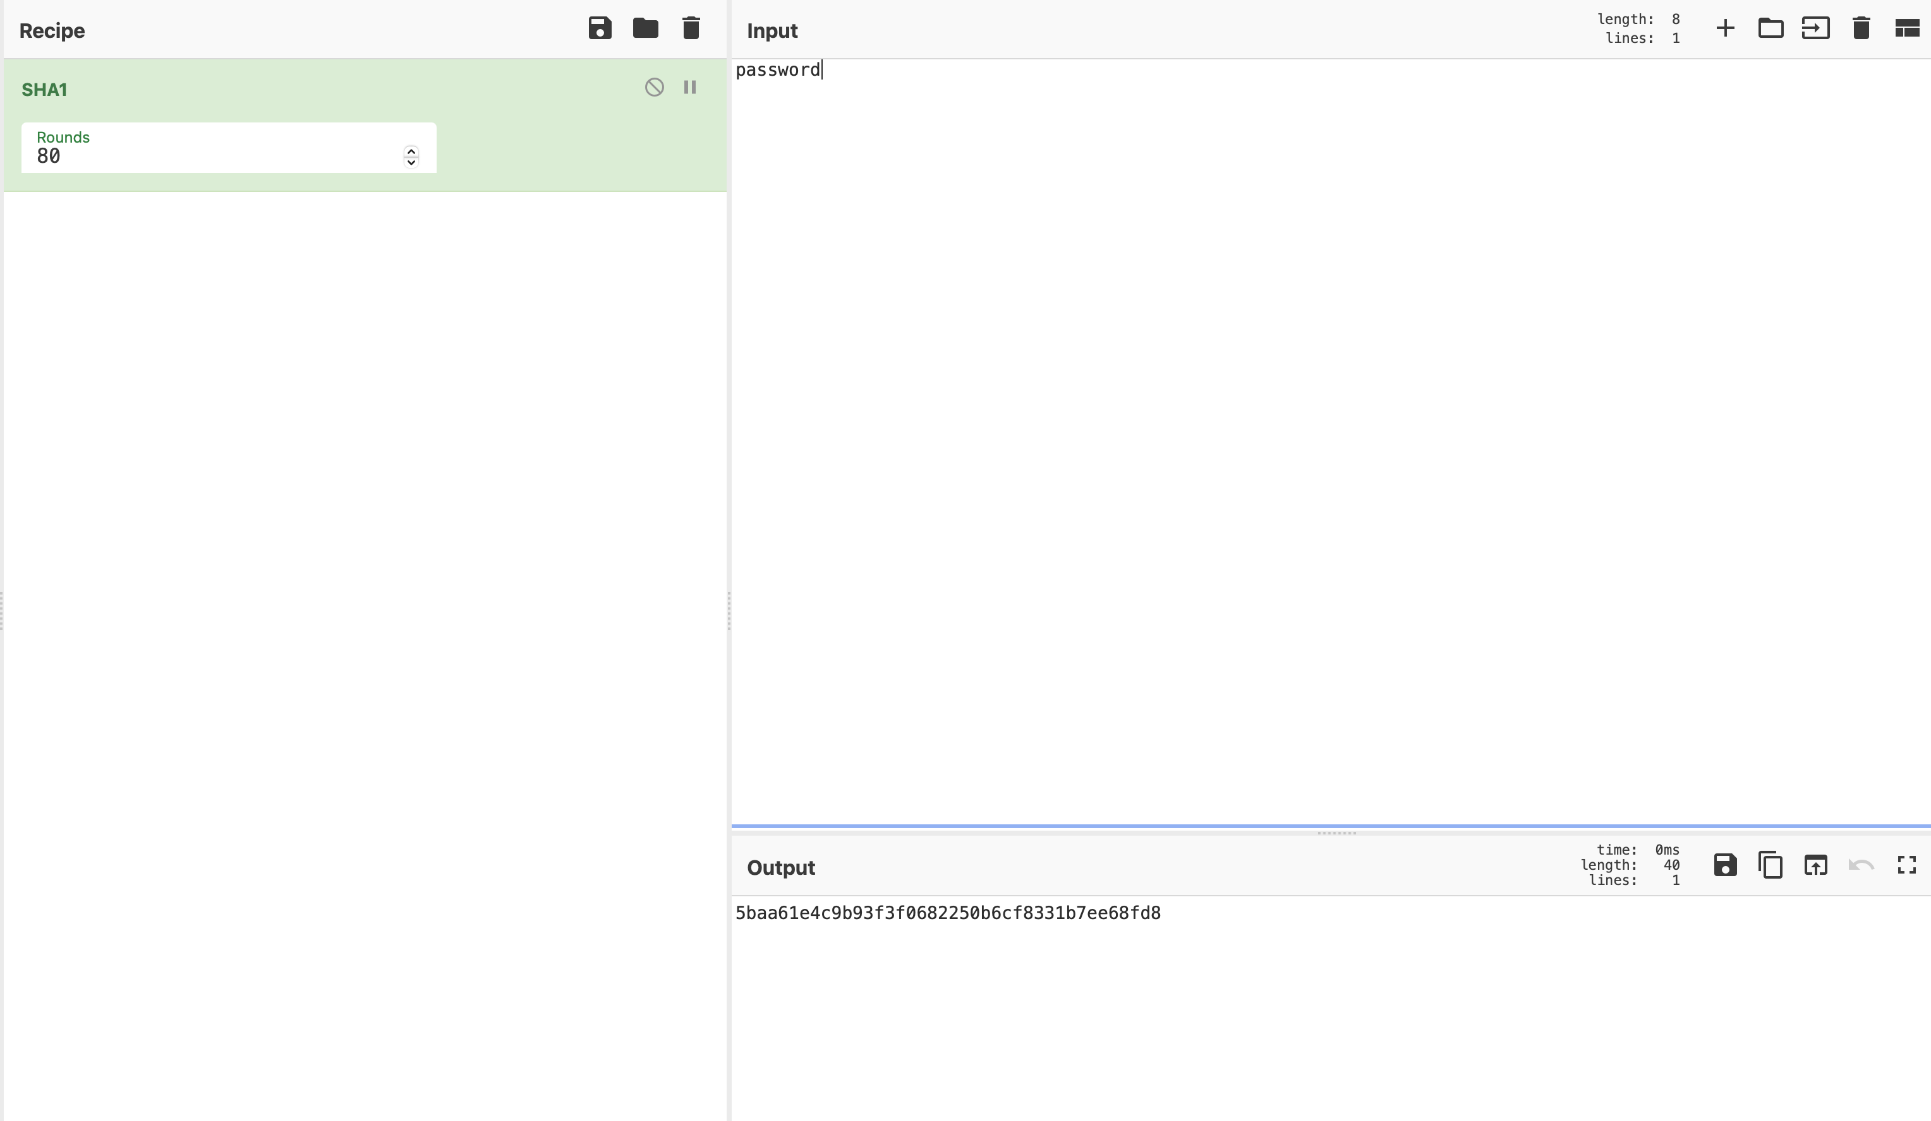
CyberChef examples

Slide 22
3DES Key
FF80:1234:1234:AA00:aaff:FFAA:FFAA:1234:1234:1234:FFFF:FFAA
3DES IV
FFFF:1234:1234:00AA

Slide 23
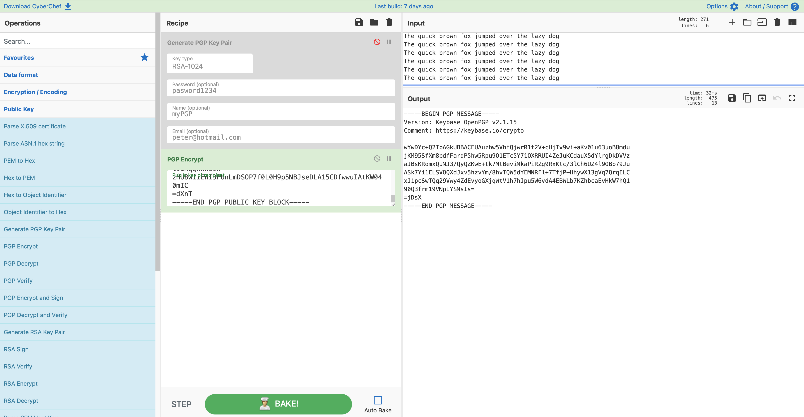
PGP on Cyberchef

Slide 24
Chat Question
What is a Digital signature used for?
Answer in the chat window and let’s share.
This photo is for placement only

Slide 25
Session resources
CompTIA Security+ SYO-601 objectives PDF

Slide 26
Security+
DOMAIN 2.0 Authentication and Design

